Slide 1
Chapter Five
Risk, Return, and the Historical Record

Slide 2
Chapter Overview
Interest rate determinants
Rates of return for different holding periods
Risk and risk premiums
Estimations of return and risk
Normal distribution
  Deviation from normality and risk estimation
Historical returns on risky portfolios

Slide 3
Interest Rate Determinants
Supply
  Households
Demand
  Businesses
Government’s net demand
  Federal Reserve actions

Slide 4
Real versus Nominal Interest Rates
Fisher Equation
(1 + r_{norm} ) = (1 + r_{real} )(1 + i ) (1)
where r_{norm} = nominal interest rate
r_{real} = real interest rate
i = inflation rate
Notes:
Nominal interest rate: Growth rate of your money
Real interest rate: Growth rate of your purchasing power

Slide 5
Approximation
From (1), (1 + r_{norm} ) = (1 + r_{real} )(1 + i )
= 1 + r_{real} + i + (r_{real} x i)
→ r_{norm} = r_{real} + i + (r_{real} x i)
Because (r_{real} x i) is a small number,
r_{norm} ≈ r_{real} + i or
r_{real} ≈ r_{norm} – i

Slide 6
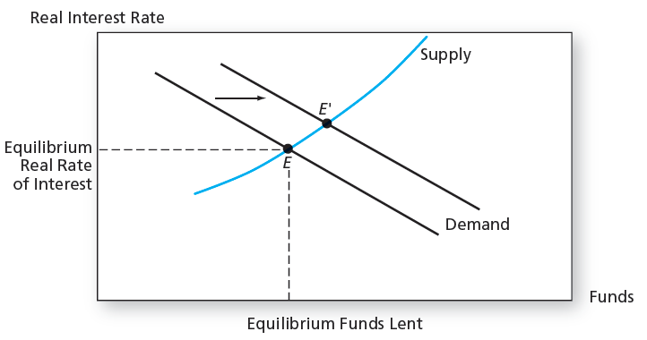
Figure 5.1 Determination of the Equilibrium Real Rate of Interest

Slide 7
Equilibrium Nominal Rate of Interest
As the inflation rate increases, investors will demand higher nominal rates of return
If E(i) denotes current expectations of inflation, then we get the Fisher Equation:

Slide 8
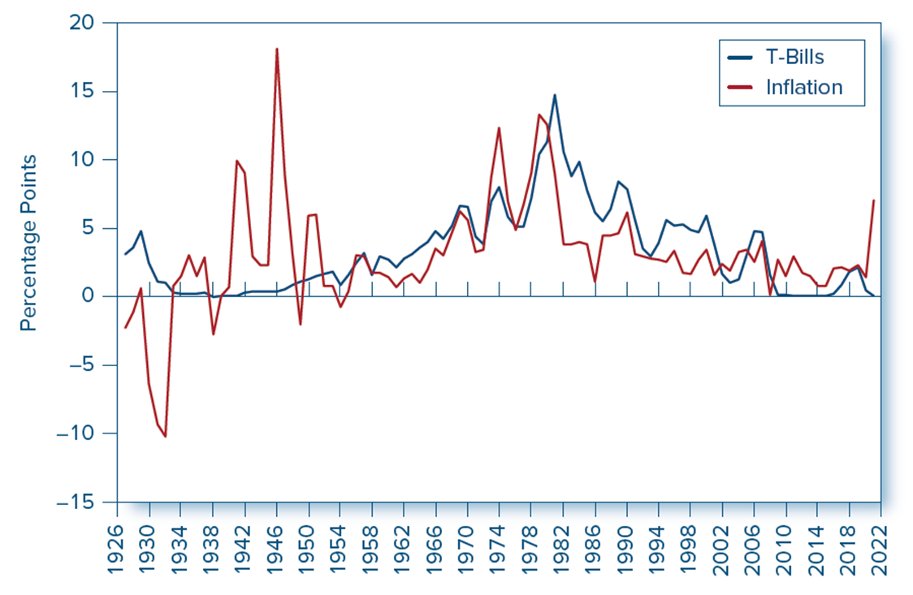
Figure 5.2 Interest Rates and Inflation, 19 27 to 20 21
Access the text alternative for slide images.

Slide 9
Rates of Return for Different
Holding Periods
Zero Coupon Bond:
  Par = $100
  Maturity = T
  Price = P
  Total risk free return

Slide 10
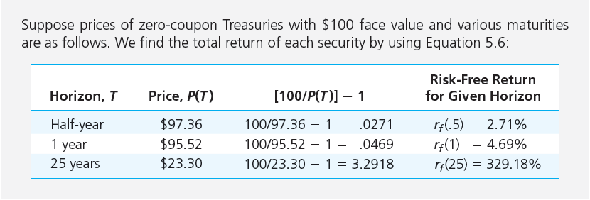
Rates of Return for Different
Maturities (Holding Periods)

Slide 11
Effective Annual Rate (EAR)
EAR: Percentage increase in funds invested over a 1-year horizon

Slide 12
EAR Illustration
Half Year: 1 + EAR = (1.0271)^{1/0.5} = 1.0549, thus EAR = 5.49%
One year: 1 + EAR = (1.0469)¹ = 1.0469, thus EAR = 4.69%
25 Years: 1 + EAR = (4.2918)^{1/25} = 1.06, thus EAR = 6%

Slide 13
Annual Percentage Rate (APR)
APR: Annualizing using simple interest
APR = r_{f}(T)/T
or alternatively
http://www.acsu.buffalo.edu/~keechung/Lecture%20Notes%20and%20Syllabus%20(MGF633)/Table%205.1%20%20EAR%20vs.%20APR%20.docx

Slide 14
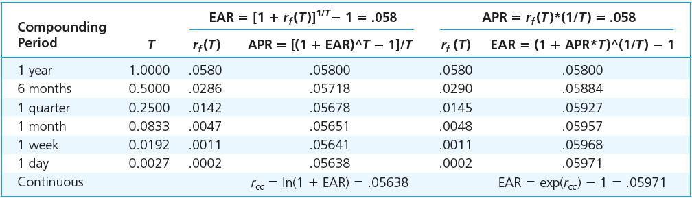
Table 5.1 APR vs. EAR

Slide 15
Table 5.3 T-Bills, Inflation, and Real Rates, 19 26 to 20 21
Average Annual Rates
Standard Deviation
 | T-Bills | Inflation | Real T-Bill | T-bills | Inflation | Real T-Bill
Full sample | 3.30 | 3.02 | 0.38 | 3.10 | 3.98 | 3.78
1927–1951 | 0.95 | 1.80 | −0.48 | 1.24 | 6.06 | 6.34
1952–2021 | 4.14 | 3.46 | 0.68 | 3.14 | 2.84 | 2.27
Source: Annual rates of return from rolling over 1-month T-bills: Kenneth French; annual inflation rates: Bureau of Labor Statistics.

Slide 16
Bills and Inflation, 1926-2021
Moderate i offsets most nominal gains on low-risk investments
Negative correlation between r_{real} and i → r_{nom} doesn’t fully compensate investors for increases in i. (i.e., as i goes up, r_{real} goes down)
r_{norm} ≈ r_{real} + i

Slide 17
Figure 5.2 Interest Rates and Inflation, 19 27 to 20 21
Access the text alternative for slide images.

Slide 18
Risk and Risk Premiums
Rates of return: Single period
  HPR = Holding period return
  P₀ = Beginning price
  P₁ = Ending price
  D₁ = Dividend during period one

Slide 19
Rates of Return: Single Period Example
Expected Ending Price = $110
Beginning Price = $100
Expected Dividend = $4
Holding Period Return
Capital Gains Yield
Dividend Yield

Slide 20
Expected Return and
Standard Deviation
Expected returns
  p(s) = Probability of a state
  r(s) = Return if a state occurs
  s = State

Slide 21
Scenario Returns: Example
State Prob. of State r in State
Excellent .25 0.3100
Good .45 0.1400
Poor .25 -0.0675
Crash .05 -0.5200
E(r) = (.25)(.31) + (.45)(.14) + (.25)(−.0675) + (0.05)(− 0.52)
E(r) = .0976 or 9.76%

Slide 22
Expected Return and
Standard Deviation
Variance (VAR):
Standard Deviation (STD):

Slide 23
Scenario VAR and STD: Example
Example VAR calculation:
  σ² = .25(.31 − 0.0976)² + .45(.14 − .0976)²
  + .25(− 0.0675 − 0.0976)² + .05(−.52 − .0976)²
  = .038
Example SD calculation:

Slide 24
Time Series Analysis of Past Rates of Return
True means and variances are unobservable
  Possible scenarios like the one in the examples are unknown
Means and variances must be estimated

Slide 25
Returns Using Arithmetic and Geometric Averaging
Arithmetic Average
Geometric (Time-Weighted) Average
  Terminal value of the investment:
  Geometric Average:

Slide 26
Geometric Average Return vs. Arithmetic Average Return
Example 1: Consider the following six-year sequence of investment returns: +30%, -20%, +30%, -20%, +30%, and -20%.
Arithmetic Mean Return = [0.30 + (-.20) + 0.30 + (-.20) + 0.30 + (-.20)]/ 6 = .05 or 5.00%
Geometric Mean Return = [ (1.3 x .80 x 1.3 x .80 x 1.3 x .80 )^{1/6} ] - 1 = .0198 or 1.98%

Slide 27
Geometric Average Return vs. Arithmetic Average Return
Example 2: S&P 500 returns from 2000 through 2015
Arithmetic Mean Return = [(-9.2) + (-11.9) + (-22.1) + 28.7 + 10.9 + 4.9 +15.8 + 5.5 + (-37.0) + 26.5 + 15.1 + 2.1 + 15.8 +32.4 +13.7 +1.40 / 16 = 5.78%
Geometric Mean Return = [ (.908 x .881 x .779 x 1.287 x 1.109 x 1.049 x 1.158 x 1.055 x .63 x 1.265 x 1.151 x 1.021 x 1.158 x 1.324 x 1.137 x 1.014)^{1/16})] – 1 = 4.05%
The average investor is led to believe he has made 5.78% average on his equity portfolio. In reality he has only made 4.05%.

Slide 28
Geometric Average Return vs. Arithmetic Average Return
For normally distributed returns,
Geometric Mean Return =
Arithmetic Mean Return – (1/2) SD²;
where SD = Standard Deviation of Returns

Slide 29
Standard Deviation
Unbiased estimate of standard deviation (SD)

Slide 30
The Reward-to-Volatility (Sharpe) Ratio
Excess Return
  The difference in any particular period between the actual rate of return on a risky asset and the actual risk-free rate
  The term "Excess Return” has also been used to denote the difference between the actual return and the required return.
  Risk Premium
  The difference between the expected HPR on a risky asset and the risk-free rate
Sharpe Ratio

Slide 31
Excess Return

Slide 32
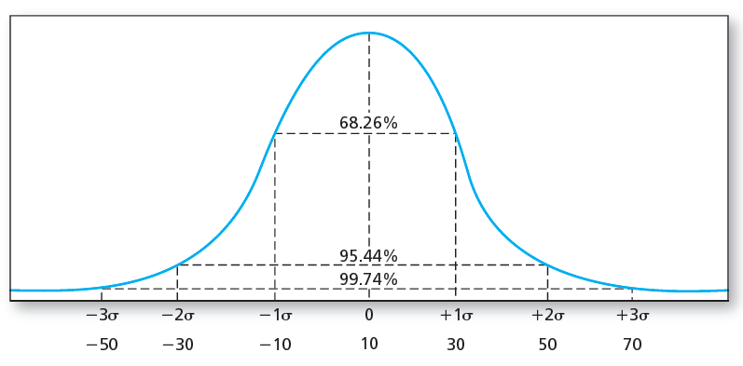
The Normal Distribution
Mean = 10%, SD = 20%

Slide 33
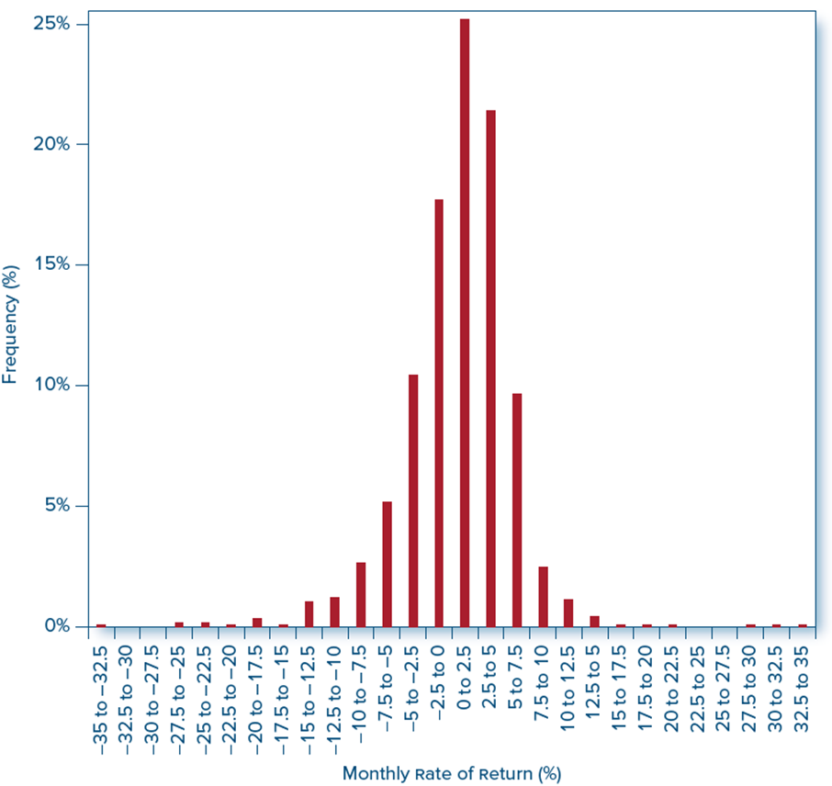
Figure 5.3 Frequency Distribution, Broad Market Index Monthly Return, 19 27 to 20 21
Access the text alternative for slide images.

Slide 34
The Normal Distribution
Central limit theorem suggests that stock returns approach the normal distribution as return measurement intervals become longer.
Investment management is easier with normal returns:
  Symmetric Returns → Standard deviation is a good measure of risk
  Symmetric Returns → Portfolio returns will be as well
  Only mean and standard deviation needed to estimate future scenarios
  Pairwise correlation coefficients summarize the dependence of returns across securities

Slide 35
Normality and Risk Measures
What if excess returns are not normally distributed?
  Standard deviation is no longer a complete measure of risk
  Sharpe ratio is not a complete measure of portfolio performance
  Need to consider skewness and kurtosis

Slide 36
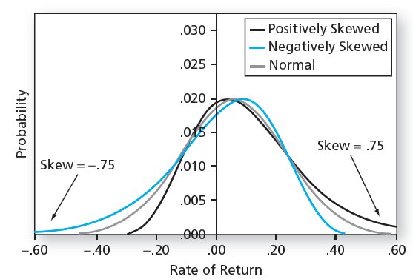
Normal and Skewed Distributions
Mean = 6%, SD = 17%

Slide 37
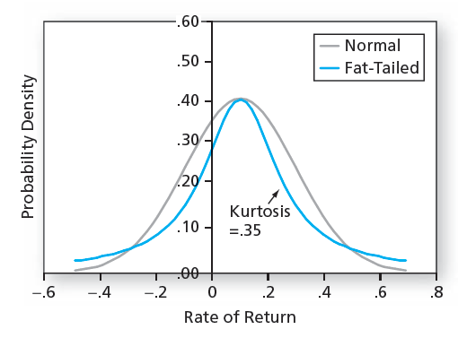
Normal and Fat-Tailed Distributions
Mean = .1, SD = .2

Slide 38
Table 5.4 Historic Returns on Risky Portfolios, 19 27 to 20 21
 | T–Bills | T–Bonds | Stocks
Average | 3.30% | 5.96% | 12.17%
Risk premium | N/A | 2.66 | 8.87
Standard deviation | 3.10 | 11.58 | 19.89
Max | 14.71 | 41.6803 | 57.35
Min | −0.02 | −25.96 | −44.04
Table 5.4
Risk and return of investments in major asset classes; estimates from annual data, 19 27 to 2021.

Slide 39
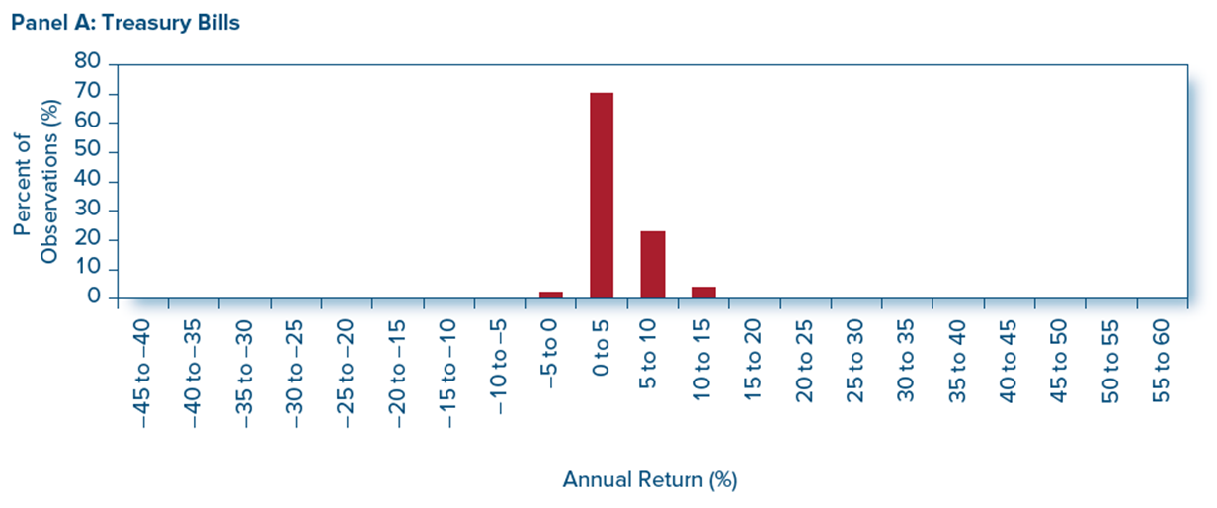
Figure 5.7 Frequency Distribution of Annual Returns: Treasury Bills

Slide 40
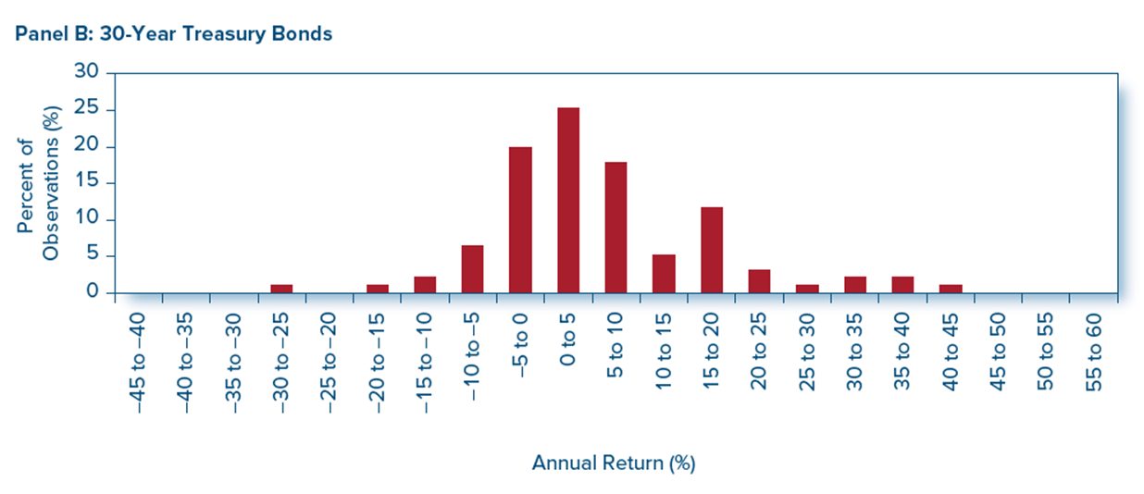
Figure 5.7 Frequency Distribution of Annual Returns: 30-Year Treasury Bonds
Access the text alternative for slide images.

Slide 41
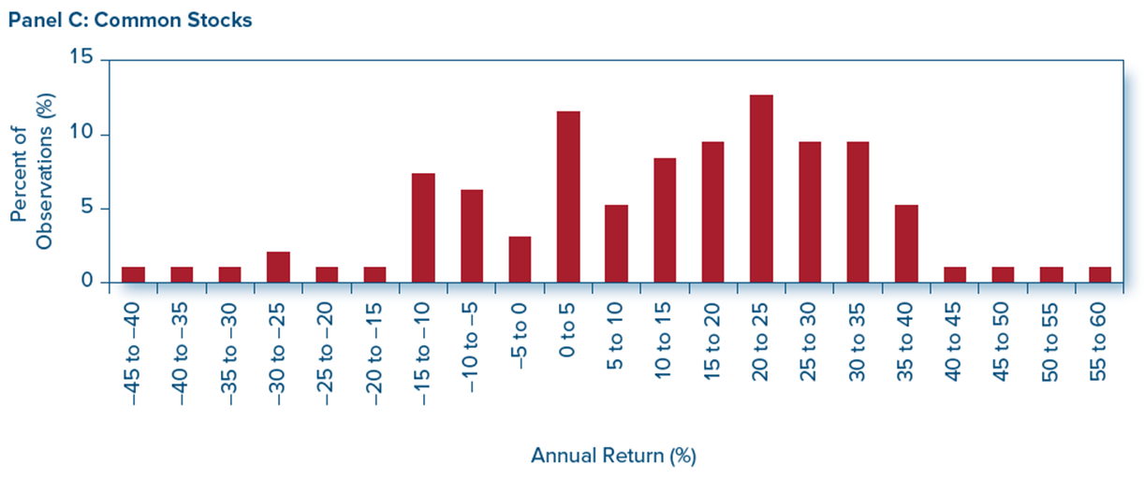
Figure 5.7 Frequency Distribution of Annual Returns: Common Stocks
Access the text alternative for slide images.

Slide 42
Historic Returns on Risky Portfolios: A Global View of the Historical Record
Century-plus-long history (1900–2020) of average excess returns in 20 stock markets.
Mean annual excess return across these countries was 5.3% versus the United States mean excess return of 7.7%.
Sharpe ratio across these countries was .29 versus U.S. Sharpe ratio of .40.
Tremendous variability in year-by-year returns.

Slide 43
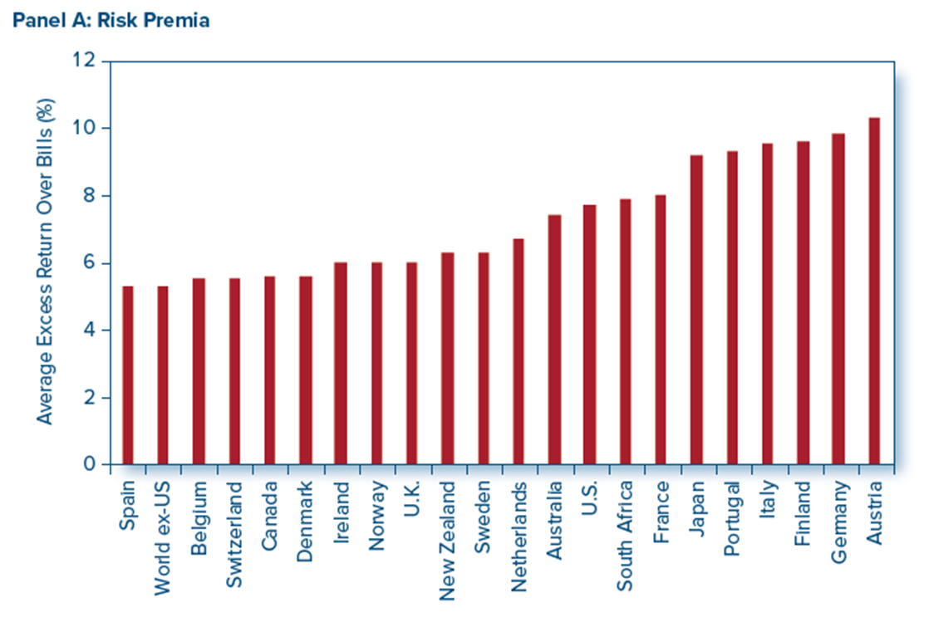
Figure 5.10 Average Excess Returns in 21 Countries, 1900 to 2020
Access the text alternative for slide images.

Slide 44
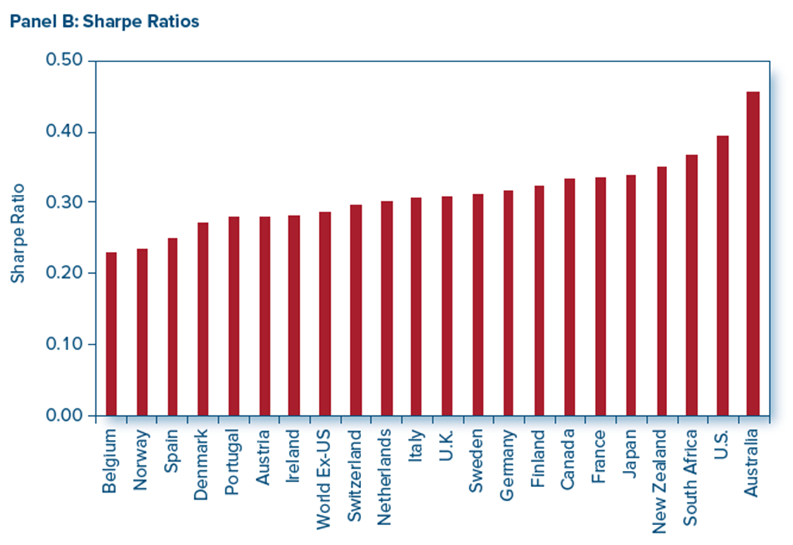
Figure 5.10 Sharpe Ratio in 21 Countries, 1900 to 2020
Access the text alternative for slide images.

