Slide 1
Chapter Three
How Securities Are Traded

Slide 2
Topics Covered
How securities are first marketed to the public by investment bankers
Underwriters, IPOs – Underpricing, SEOs
How and where already-issued securities are traded among investors.
Mechanics of trading – ECNs, specialist markets, dealer markets
Costs of trading – spreads, commissions
Buying on margin and short selling

Slide 3
How Firms Issue Securities
Primary Market
Market for newly-issued securities
Firms issue new securities through underwriter (investment banker) to public
Secondary Market
Investors trade previously issued securities among themselves

Slide 4
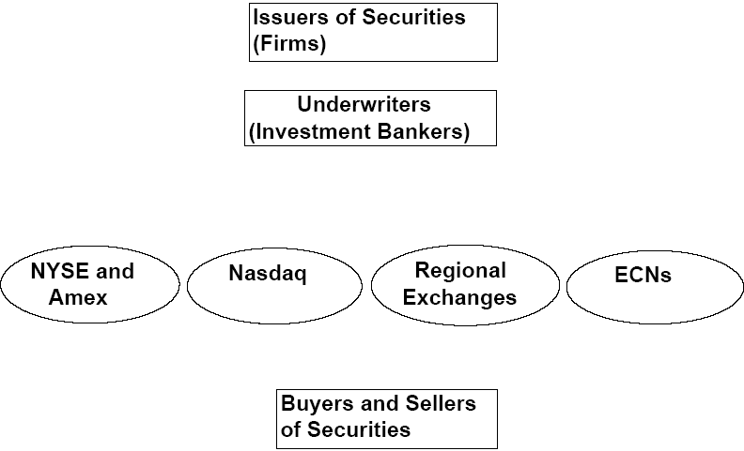

Slide 5
How Firms Issue Securities
Privately Held Firms
Up to 1,999 shareholders (from 2012)
Raise funds through private placement
Lower liquidity of shares
Have fewer obligations to release financial statements and other information

Slide 6
How Firms Issue Securities
Publicly Traded Companies
Raise capital from a wider range of investors through initial public offering (IPO)
Public offerings are marketed by investment bankers or underwriters
Registration must be filed with the SEC

Slide 7
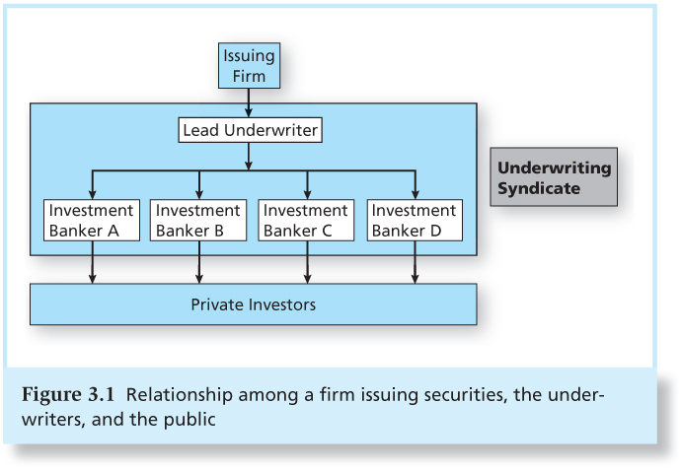
Figure 3.1 Relationship Among a Firm Issuing Securities, the Underwriters, and the Public

Slide 8
How Firms Issue Securities
Shelf Registration
SEC Rule 415: Allows firms to register securities and gradually sell them to the public for two years
Shares can be sold on short notice and in small amounts without incurring high floatation costs

Slide 9
How Firms Issue Securities
Initial Public Offerings
Road shows to publicize new offering
Bookbuilding to determine demand for the new issue
Degree of investor interest in the new offering provides valuable pricing information

Slide 10
How Firms Issue Securities
Initial Public Offerings
Underwriter bears price risk associated with placement of securities:
IPOs are commonly underpriced compared to the price they could be marketed
Some IPOs, however, are well overpriced (ex.: Facebook); others cannot even fully be sold

Slide 11
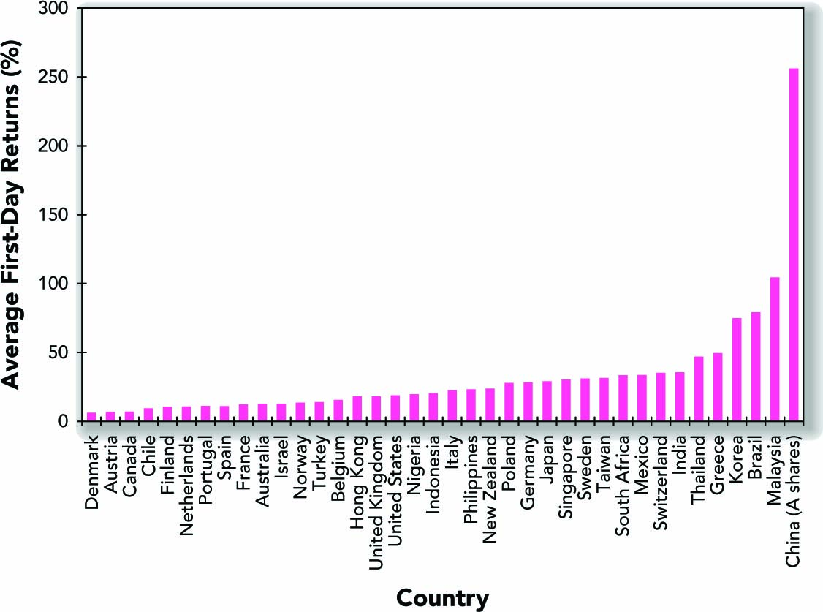
Average Initial Returns for IPOs in Various Countries

Slide 12
Notes:
12

Slide 13
Source: Prof. Jay Ritter, University of Florida
Notes:
13

Slide 14
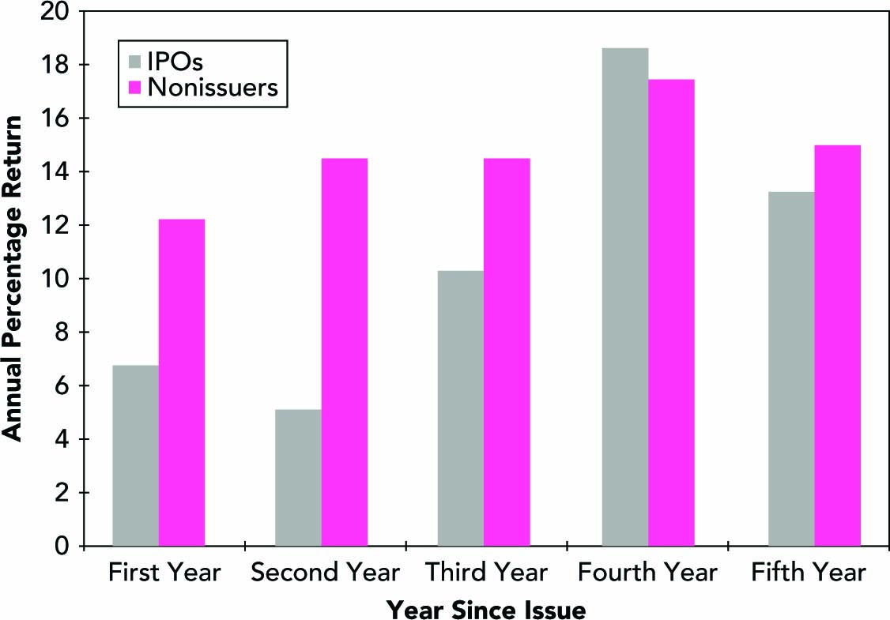
Long-term Relative Performance of Initial Public Offerings

Slide 15
Further evidence on IPO
http://www.acsu.buffalo.edu/~keechung/Lecture%20Notes%20and%20Syllabus%20(MGF633)/IPOs2016Statistics%20Jay%20Ritter.pdf
https://ublearns.buffalo.edu/d2l/le/content/356015/viewContent/5368813/View

Slide 16
How Securities are Traded
Types of Markets:
Direct search
Buyers and sellers seek each other
Brokered markets
Brokers search out buyers and sellers
Dealer markets
Dealers have inventories of assets from which they buy and sell
Auction markets
Traders converge at one place to trade

Slide 17
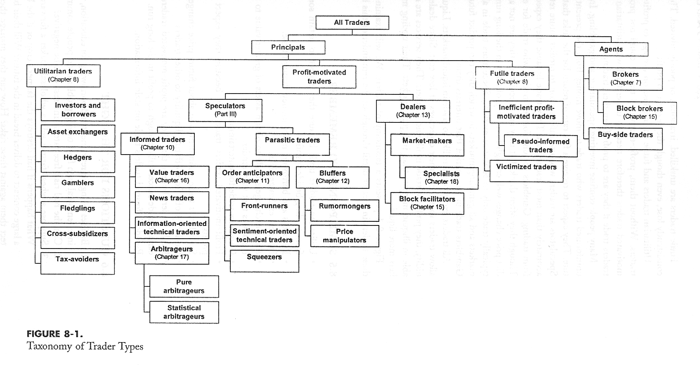

Slide 18
Costs of Trading
Commission: fee paid to broker for making the transaction (zero for retail trading from 2019)
Spread: cost of trading with dealer
Bid: price dealer will buy from you
Ask: price dealer will sell to you
Spread: ask - bid
Combination: on some trades both are paid

Slide 19
Orders and Order Properties

Slide 20
Orders
Orders are instructions to trade that traders give to brokers and exchanges that arrange their trades.
Orders always specify
The security to be traded
The quantity to be traded
The side of the order (buy or sell)

Slide 21
Orders may specify
Price specifications
How long the order is valid
When the order can be executed
Whether they can be partially filled or not

Slide 22
Some important terms 1
Bid: buy order specifying a price (price is called the bid).
Offer: sell order specifying a price (price is called offer or ask).
Best Bid: standing buy order that bids the highest price bid.
Best offer: standing sell order that has the lowest price offer.

Slide 23
Some important terms 2
Dealers have an obligation to continuously quote bids and offers, and the associated sizes (number of shares), when they are registered market markers for the stock.
Their quotes also have to be firm during regular market hours.

Slide 24
Some important terms 3
Public orders with a price limit can also become the market bid or offer if they are at a better price than those currently quoted by a registered market maker.
The market’s best bid and offer constitute the inside market, the best bid/ask, or the BBO. The best bid and offer across all markets trading an instrument is called the NBBO.

Slide 25
Some important terms 4
The difference between the best offer and the best bid is the bid/ask spread, or the inside spread (touch).
Orders supply liquidity if they give other traders the opportunity to trade.
Orders demand liquidity (immediacy) if they take advantage of the liquidity supplied by other traders’ orders.

Slide 26
What are agency/proprietary orders?
Orders submitted by traders for their own account are proprietary orders.
Broker-dealers and dealers.
Since most traders are unable to directly access the markets, most order are instead agency orders.
Presented by a broker to the market.

Slide 27
Market orders
Instruction to trade at the best price currently available in the market.
Immediacy
Buy at ask/sell at bid => pay the bid/ask spread
Price uncertainty
Fills quickly but sometimes at inferior prices.

Slide 28
Used by impatient traders and traders who want to be sure that they will trade. It is usually thought that insiders use that type of order.
When submitting a market order execution is nearly certain but the execution price is uncertain.
Takes liquidity from the market in terms of immediacy. They then pay a price for immediacy which is the bid-ask spread.

Slide 29
Market order: Example 1
Suppose that the quote is 20 bid, 24 offered. Suppose that the best estimate of the true value of the security is 22.
A market buy order would be executed at 24 for a security worth 22.
The price paid would be 24 and therefore the price of immediacy would then be 2.

Slide 30
Market order: Example 2
A market sell order would be executed at 20 for a security worth 22.
The price received would be 20 and therefore the price of immediacy would then be 2.
The price of immediacy is the bid-ask spread.

Slide 31
Market impact
Large market orders tend to move prices.
Liquidity might not be sufficient at the inside quotes for large orders to fill at the best price.
Prices might move further following the trade.
Information and liquidity reasons.

Slide 32
Market impact: Example
For example, suppose that a 2,000 share market buy order arrives and the best offer (ask) is $10 for 1,000 shares.
Half the order will fill at $10, but the next 1,000 will have to fill at the next price in the book, say at $11 (where we assume that there is also 1,000 offered).
The volume-weighted average price for the order will be $10.5, which is larger than $10.

Slide 33
Limit orders
A limit order is an instruction to trade at the best price available, but only if it is no worse than the limit price specified by the trader.
For a limit buy order, the limit price specifies a maximum price.
For a limit sell order, the limit price specifies a minimum price.

Slide 34
Limit orders: Examples
If you submit a limit buy order for 100 shares (round lot) of Dell with limit price of $20. This means that you do not want to buy those 100 shares of Dell at a price above $20.
If you submit a limit sell order for 100 shares (round lot) of Dell with limit price of $24. This means that you do not want to sell those 100 shares of Dell at a price below $24.

Slide 35
If the limit order is executable (marketable), than the broker (or an exchange) will fill the order right away.
If the order is not executable, the order will be a standing offer to trade.
Waiting for incoming order to obtain a fill.
Cancel the order.
Standing orders are placed in a file called a limit order book.

Slide 36
Limit price placement: (from very aggressive to least aggressive)
Marketable limit order: order that can immediately execute upon submission (limit price of a buy order is at or above the best offer),
At the market limit order: limit buy order with limit price equal to the best bid and limit sell order with limit price equal to the best offer,
Behind the market limit order: limit buy order with limit price below the best bid and limit sell order with limit price above the best offer.

Slide 37
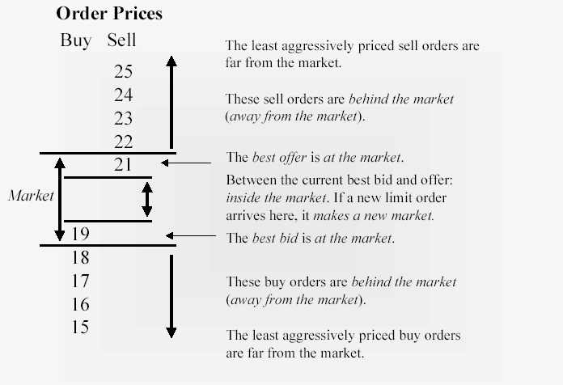

Slide 38
A standing limit order is a trading option that offers liquidity
A limit sell order is a call option and a limit buy order is a put option. Their strike prices are the limit prices.
A limit order is not an option contract (not sold).
The option is good until cancelled or until the order expires.
The value of the implicit limit order option increases with maturity.

Slide 39
Why would anyone use limit orders?
The compensation that limit order traders hope to receive for giving away free trading options is to trade at a better price.
However, options might not fill (execution uncertainty).
Chasing the price.

Slide 40
Limit order traders might also regret having had their order filled (adverse selection)…
What could cause a limit order to regret obtaining a fill?
How would this fact affect strategies involving limit orders?

Slide 41
Stop orders
Activates when the price of the stock reaches or passes through a predetermined limit (stop price). When the trade takes place the order becomes a market order (conditional market order).
Buy only after price rises to the stop price.
Sell only after price falls to the stop price.

Slide 42
Stop orders are typically used to close down losing positions (stop loss orders).
Mainly used on market orders and few on limit orders.

Slide 43
Example: Suppose that the market for Dell is currently 20 bid, 24 offered.
Suppose that you place a stop loss order for 1,000 shares of Dell at a stop price of 15.
Suppose that after having placed that order, the market falls to: 13 bid, 15 offered. The bid price passed your stop price.
Your order is then executed at 13 provided there is enough quantity at that price.
The stop price may not be the price at which you are executed, as above.

Slide 44
Difference between stop orders and limit orders
The difference lies in their relation with respect to the order flow.
A stop loss order transacts when the market is falling and it is a sell order. Therefore such an order takes liquidity away from the market (it must be accommodated so it provides impetus to any downward movement).

Slide 45
A limit order trades on the opposite side of the market movement. If the market is rising, the upward movement triggers limit sell orders.
Outstanding limit orders provide liquidity to the market.

Slide 46
Trading Mechanisms
Dealer markets
Electronic communication networks (ECNs)
Trading systems that automatically execute orders
Specialists markets
Maintain a “fair and orderly market”
Have been largely replaced by ECNs

Slide 47
The Rise of Electronic Trading
In the US, the share of electronic trading rose from 16% to 80% in 2000s and was triggered by an interaction of new technologies and new regulations
1975: Elimination of fixed commissions on the NYSE
1997: Limit order display rule on NASDAQ, leading to narrower bid-ask spreads

Slide 48
The Rise of Electronic Trading
1997 and 2001: Reduction of minimum tick size from one-eighth to one-sixteenth, and 1 cent, respectively
2000: Emergence of NASDAQ Stock Market
2006: NYSE is renamed to NYSE Arca after acquiring the electronic Archipelago Exchange
2007: Creation of National Market System (NMS) to link exchanges electronically

Slide 49
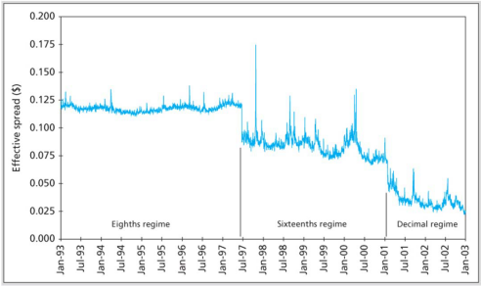
Figure 3.5 The Effective Spread Fell Dramatically as the Minimum Tick Size Fell
(Value-weighted average of NYSE-listed shares)

Slide 50
U.S. Markets
NASDAQ
Lists about 3,000 firms
Originally, NASDAQ was primarily a dealer market with a price quotation system
Dealer collusion
Today, NASDAQ’s Market Center offers a sophisticated electronic trading platform with automatic trade execution
Large orders may still be negotiated through brokers and dealers

Slide 51
U.S. Markets
The New York Stock Exchange
The largest U.S. stock exchange as measured by the value of the stocks listed on the exchange
Automatic electronic trading runs side-by-side with traditional broker/specialist system
SuperDot : Electronic order-routing system
DirectPlus: Fully automated execution for small orders
Specialists: Handle large orders and maintain orderly trading

Slide 52
U.S. Markets
ECNs (Electronic Communication Networks)
ECNs are electronic trading venues that automatically match buy and sell orders using a limit order book, without a traditional human market maker stepping in.
Collects limit orders (bids and offers), ranks them by price–time priority, automatically matches compatible orders, and publishes quotes to the broader market (often contributing to the NBBO)
Compete in terms of the speed they can offer
Latency: The time it takes to accept, process, and deliver a trading order
Major ECNs include Direct Edge, BATS, and NYSE Arca

Slide 53
New Trading Strategies
Algorithmic Trading
The use of computer programs to make trading decisions
Algorithmic trading (a.k.a. algo trading) is when computers automatically place, modify, and cancel trades based on pre-specified rules—speed, price, volume, timing, or signals from data. Humans design the rules; machines execute them fast and consistently.
High-Frequency Trading
Special class of algorithmic with very short order execution time
https://papers.ssrn.com/sol3/papers.cfm?abstract_id=2697604
Dark Pools
Trading venues that preserve anonymity, mainly relevant in block trading

Slide 54
New Trading Strategies
Bond Trading
Most bond trading takes place in the OTC market among bond dealers
NYSE Bonds is the largest centralized bond market of any U.S. exchange
Market for many bond issues is “thin” and is subject to liquidity risk

Slide 55
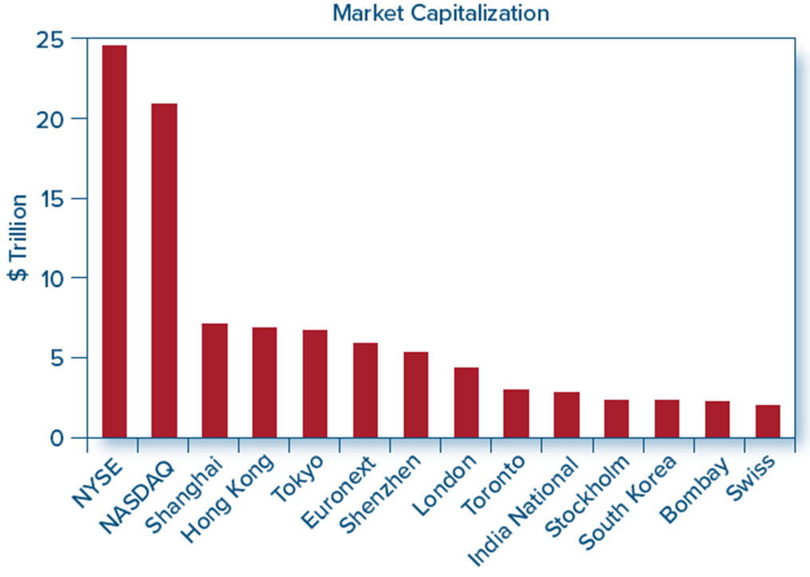
Figure 3.7 Biggest Stock Markets in the World
Access the text alternative for these images
Source: https://www.stockmarketclock.com/exchanges, December 2018.

Slide 56
Short sale: sale of a security that you do not own
To sell it, you must borrow it from someone who owns it. You get some cash from the sale of the security but you remain indebted to the lender for the security.

Slide 57
The trader engaging in such a strategy expects the security to decline in value.
As, if it is the case, he will be able to buy back the security at the a price lower than the price at which he sold.
The profit margin comes from that difference in prices.

Slide 58
Short sale - Initial conditions
Z Corp 100 Shares
50% Initial Margin
30% Maintenance Margin
$100 Initial Price
Sale Proceeds $10,000
Margin & Equity $5,000
Stock Owed $10,000

Slide 59
Short sale - Maintenance margin
Stock Price Rises to $110
Sale Proceeds $10,000
Initial Margin $5,000
Stock Owed $11,000
Net Equity $4,000
Margin % (4000/11000) 36%

Slide 60
Short sale - Margin call
How much can the stock price rise before a margin call?
($15,000* - 100P) / (100P) = 30%
P = $115.38
* Initial margin plus sale proceeds

Slide 61
Margin trading
Using only a portion of the proceeds for an investment.
Borrow remaining component.
Margin arrangements differ for stocks and futures.

Slide 62
Stock margin trading
Maximum margin
Currently 50%
Set by the Fed
Maintenance margin
Minimum level the equity margin can be
Margin call
Call for more equity funds

Slide 63
Margin trading - Initial conditions
X Corp $70
50% Initial Margin
40% Maintenance Margin
1000 Shares Purchased
Initial Position
Stock $70,000 Borrowed $35,000
Equity $35,000

Slide 64
Margin trading-Maintenance margin
Stock price falls to $60 per share
New Position
Stock $60,000 Borrowed $35,000
Equity $25,000
Margin% = $25,000/$60,000 = 41.67%

Slide 65
Margin trading - Margin call
How far can the stock price fall before a margin call?
(1000P - $35,000)* / 1000P = 40%
P = $58.33
* 1000P - Amount Borrowed = Equity

Slide 66
Insider Trading
Officers, directors, major stockholders must report all transactions in firm’s stock
Insiders do exploit their knowledge
Jaffe study:
Inside buyers > Inside sellers = Stock does well
Inside sellers > Inside buyers = Stock does poorly

