Slide 1
Correspondence, Construction, and Realism The Case of Searle and Foucault
C. G. Prado

Slide 2
Correspondence or constructive?
What is truth?
1) Correspondence theory: truth is a replication of objective reality in our beliefs and statements
2) Constructivist theory: what we believe and say determines truth
The correspondence theory dominates analytical philosophy
But not exclusively as we will see
The constructivist theory is especially strong in French Continental “post structuralism” and “postmodernism”

Slide 3
Two opposing thinkers
Paradigmatic exponents of this divide
John Searle: beliefs and statements are true by virtue of accurately representing the objective world
Michel Foucault: “the world” is what we believe and say it is, and truth is an historical construct
Deeper difference
Searle: beliefs and statements are shown to be true by being compared to an immediately accessible world
Foucault: extralinguistic reality plays no such role, and neither dictates nor serves as a standard for what is said or believed

Slide 4
Agreement between Foucault and Donaldson
The fundamental difference between them:
has to do with realism
and their understanding of justification
I.e., what justifies “truth” for Searle is the real world
But this is not the case for Foucault
And in this respect Foucault agrees with Donald Davidson,
the icon of analytic philosophy

Slide 5
What makes a statement true?
For Searle the justification of a belief or sentence as corresponding to mind-independent reality
=> the faithful portrayal of that reality
i.e., Reality, the world, is what makes a sentence true
And we establish a belief or sentence as true (justify our belief) by checking the world
For Foucault justification is a truth-determining discursive maneuver
Reality has nothing to do with this. The world neither determines the truth nor is a test of truth
Justification does not and cannot reach beyond language to the things themselves

Slide 6
How relevant is the world to truth?
Both Searle and Foucault are realists
“realism” = Both believe there is a world outside of our mind and language
Foucault’s constructivism does not make him a linguistic idealist as is commonly claimed
What divides them concerns the relevance of the world to truth
The question as to whether the world has an epistemic role to play in the determination and demonstration of truth

Slide 7
Foucault is not a solipsist
Foucault is often criticized by analytic philosophers as holding a hopeless irrealism
as denying that there is a world outside of our minds
as a solipsist
On truth, justification, and realism, he shares much with Davidson and Rorty in the analytic tradition
who disagree with Searle

Slide 8
Searle’s correspondism
Searle: “[o]ur statements are typically true or false depending on whether they correspond to how things are, that is, to the facts in the world.” (Mind, Language, and Society, 1998)
“Statements are assessed as true when … the way they represent things as being is the way that things really are”
“Statements are made true by how things are in the world that is independent of the statement[s].”
It is “intuitive” that true sentences are “made true by how things are in the real world.”

Slide 9
Hard times for the correspondence theory
In analytic philosophy “correspondism” “has come upon hard times.”
Searle “seems to be resuscitating the old correspondence theory of truth” (Nick Fotion, Searle, 2000)
See “Rorty v. Searle, at Last: A Debate” Logos, 2, no. 3 (1999)
Rorty rejects the correspondence theory because we do not understand the alleged relation of correspondence
What do sentences correspond to?
A complex object (since sentences are complex)?
A linguistic entity (if language corresponds to something else it must be linguistic too)

Slide 10
Things are what they are
Searle replies that facts are conditions in the world that satisfy the truth conditions expressed by statements
To say a sentence corresponds to the facts is “shorthand for the variety of ways in which statements can accurately represent how things are.”
But what is at issue is not the idea that things are as they are
Epistemology with its doubts about whether there is an “external” reality is a long-lived mistake (Prado)

Slide 11
What makes a sentence true?
Searle’s correspondism
entails a relation between sentences and states-of-affairs or facts
And so he rejects Wilfred Sellar’s claim that “[s]emantical statements” or attributions of truth “do not assert relations between linguistic and extra-linguistic items”
And he rejects Davidson’s claim that “[n]othing, no thing, makes sentences and theories true; not experience … not the world, can make a sentence true.”
And Peter Strawson: the trouble with the correspondence theory is its “misrepresentation of correspondence between statement and fact as a relation.”

Slide 12
[How can ideas represent material reality?]
The problem recalls the criticism that Berkeley gives of Locke’s theory that ideas can represent reality
Ideas are ideal entities, but reality is supposedly non-ideal, or material.
How can something non-material, an idea, be said to represent something completely unlike it, i.e., a material fact or reality?
Berkeley concludes that all we need are ideas, with no need for something non-ideal or material for them to represent: Idealism
Similarly, if “ideas” are linguistic entities, how can they be said to represent, or correspond to, alleged non-linguistic “facts”?
To deny this correspondence implies “linguistic idealism”

Slide 13
What does “fact” mean?
Searle responds to these criticisms:
The “puzzle about facts” – the worry about what is at the other end of the supposed relation between sentences and reality –
“is strictly an artifact of a certain philosophical confusion. We have a noun, ‘fact,’ and so we think it must name a type of object.
Whereas in fact, what the word ‘fact’ evolved to do
was to provide us with, so to speak, the non-linguistic counterpart of true statements stated in a language….
[T]hat is, the word ‘fact’ evolved so that you would have a word for the non-linguistic counterpart of the statement in virtue of which the statement is true.”

Slide 14
Facts are non-linguistic
The aim here is to avoid reifying facts
(i.e., treating a fact as a thing)
But if “fact” denotes the “non-linguistic counterpart” of a statement, it still denotes something—i.e., some kind of thing
And what would this be beyond what has been stated in the sentence?
But Searle insists that facts are not linguistic
“it is a use-mention fallacy to suppose that the linguistic … identification of a fact requires that the fact identified be itself linguistic in nature.”
Since facts are what makes sentences true they cannot be “identical with their linguistic descriptions.” They cannot be “only what true sentences state.” (as Strawson puts it)

Slide 15
[Use-mention fallacy]
‘The use–mention distinction is a foundational concept of analytic philosophy, according to which it is necessary to make a distinction between using a word (or phrase) and mentioning it, and many philosophical works have been "vitiated by a failure to distinguish use and mention". The distinction is disputed by non-analytic philosophers.

Slide 16
[Say “cheese”]
‘The distinction between use and mention can be illustrated for the word cheese:^{[2][3]}
Use: Cheese is derived from milk.
Mention: 'Cheese' is derived from the Old English word ċēse.
The first sentence is a statement about the substance called "cheese"; it uses the word 'cheese' to refer to that substance. The second is a statement about the word 'cheese' as a signifier; it mentions the word without using it to refer to anything other than itself.’
https://en.wikipedia.org/wiki/Use%E2%80%93mention_distinction

Slide 17
Disquotation
Disquotation of true sentences articulates how sentences are true:
“For any sentence s used to make a statement p, s is true if and only if p.” (Searle)
‘The cat is on the mat’ is true if and only if the cat is on the mat.
Note the logical formulation (“if and only if”) > continuance of logical positivism
The single quote marks on the left, the embedded sentence, is “disquoted” on the right of the main predicate
It states what must be true for the sentence in quotes to be true.

Slide 18
Left-hand, right-hand
Disquotation, usually used to obviate the need for a relation of correspondence, actually coincides with the theory of correspondence if the theory is stated as:
“A statement p is true if and only if the statement p corresponds to a fact”
“if the sentence quoted on the left-hand side … is true, then it is true because it corresponds to the fact stated on the right-hand side.”
“For any s, s is true if s corresponds to the fact that p”

Slide 19
‘It is true that p’ and ‘p’
Disquotation is generally accepted as an analysis of what it means that a sentence is true
not as a theory of correspondence
But Searle does not embrace the implications of disquotation
rejecting the redundancy account of truth (i.e., we are just saying the same thing twice)
or the view that “instances of ‘It is true that p’ and ‘p’ have exactly the same meaning.” (Robert Audi, Cambridge Dictionary of Philosophy)

Slide 20
Metalinguistic predicates
Searle: disquotation “makes it look as if ‘is true’ is redundant, but it is not”
“We need a metalinguistic predicate for assessing success in achieving the word-to-word direction of fit, and that term is ‘true.’”
If being true is corresponding to facts
saying that a sentence corresponds to facts is not a reiteration of the sentence
Attributing truth to a sentence is the assertion that a relation obtains between the sentence and a fact
And this is not merely repeating the sentence.

Slide 21
Truth through power
Foucault’s theory of truth is much more complex than Searle’s
See Prado’s, Starting with Foucault (2000)
Foucault has been dismissed by analytic philosophers (Robert Nola, 1994) as having “nothing to say” about central “philosophical theories of truth and knowledge.”
Or worse: his internalization of truth to discourse is rejected as “linguistic idealism,” irrealism—and so also not worth serious consideration
His pivotal concept: we are constantly “subjected to the production of truth through power.”
Truth is produced “by virtue of multiple forms of constraint”
by power or power relations

Slide 22
What is power?
Power is not a constraint of individuals but of actions
Power is not force or capacity or domination or authority
It is not attributable to anyone nor does it bear on anyone in particular
Foucault insists on the relational character of power
We must be “nominalistic” about power because “power is not an institution and not a structure; neither is it a certain strength.”
“it is a set of actions upon other actions,”
“a way in which certain actions modify others,”
“a mode of action which does not act directly and immediately on others. Instead it acts upon their actions.”

Slide 23
It’s an environment
Power is “a total structure of actions brought to bear upon possible actions”
enabling and enhancing some actions
and precluding others
Power is best thought of as an environment in which agents act
conditioning what those agents do and do not do

Slide 24
Truth is the currency of propositions
Power produces truth by determining
what may be said
what must be said
and what may not be said
Truth is the currency of propositions in a discourse or a regime of truth
not a portrayal or accurate representation of anything
[Currency: truth is like money
It has value if people value it
But it has no intrinsic value of its own
And then it gets you what you want]

Slide 25
Power acts blindly
This is often interpreted as meaning that truth is controlled by a dominant group
But this supposes an independent truth
that is distorted by those in power through the imposition of an ideology
But Foucault insists that power relations produce truth blindly and randomly
not through conscious manipulations and distortions

Slide 26
What what they do does
The agents of power are usually unknowing with respect to the consequences of their actions on others’ actions
“people know what they do;
they frequently know why they do what they do;
but what they don’t know is what what they do does.”
Power is thus the sum total of interactions that constrain individuals’ actions
It is people acting in ways that blindly and impersonally condition the options and actions of others

Slide 27
Ideology and truth
It is wrongly thought that Foucault is concerned with
historical or ideological distortions of truth
not truth itself
He is not interested in what ideology makes pass for truth
because the concept of ideology “always stands in … opposition to something else which is supposed to count as truth”
I.e., there is ideology, and there is the truth of the matter.
But he rejects any such notion of ahistoric truth as Searle holds

Slide 28
Pluralism of truth
The main reason for misunderstanding
He says different things about truth:
E.g., “there are different truths.”
When he says that there are many truths it is thought that he is not talking about truth itself
But he is opposed to the traditional philosophical understanding of truth as unitary
Truth is intrinsically pluralistic

Slide 29
The regime of truth
1) His criterial use of truth: what counts as truth in a given discourse
Each society “has its regime of truth”
Each society “has mechanisms … which enable one to distinguish true and false statements” and “means by which each is sanctioned”
Each society has “procedures accorded value in the acquisition of truth” and “those who are charged with saying what counts as true.”
This view by itself would be consistent with saying that his view is
about what passes for truth, or ideological distortion
but not about truth itself

Slide 30
Moves in chess: what makes them true?
2) His constructivist view of truth as power-produced
making clear that there is no truth other than what is produced by power
Power establishes “correctness” in the way a proper move in chess accords with the rules of chess
The criterial conception has to do with the mechanisms by which truth is established within the construction
while the constructivist use of truth is the original establishment of the rules
The historicity of truth: the sum total of actions that shape the discourses’ content

Slide 31
Radically different perspectives
3) The Nietzschean perspectival use of truth
There are only interpretations
There is no descriptive completeness
There can be no holistic description within which all diverse perspectives are reconciled [contrary to Hegel’s theory of truth]
This is not conceptual-scheme relativism [i.e., Kant]
i.e., varying organizations of a noumenal reality
Nietzsche [referring to Kant]:“the antithesis ‘thing-in-itself’ and ‘appearance’ is untenable.”

Slide 32
Against Kant and Hegel, but for Nietzsche
Foucault is clear about this:
dismissing the idea of “a subject which is either transcendental in relation to the field of events”
[i.e., Kant]
“or runs in its empty sameness throughout the course of history.”
[meaning, Hegel’s idea of Spirit in history]
[Foucault argues for the history of philosophy as
Kant → Hegel → Nietzsche]

Slide 33
Blind man and the elephant
Searle would hold that we can rationalize diverse perspectives
by referring to an objective and knowable world
But for Foucault there is no transdiscursive truth in virtue of which the different truths are commensurable
I.e., he rejects the idea that the different truths are different perspectives on this objective world (like the blind men and the elephant)

Slide 34
Epistemological crises
1) Criterial use of truth: what counts as true within a discourse
2) Constructivist use: the production of truth in discourse
3) Perspectivist use: The incommensurability of truths
4) What Prado calls the Experiential use of truth

Slide 35
Experiential truth
4) The Experiential use of truth:
Truth through inquiry: what an individual comes to believe through investigation, test or trial
what an individual comes to believe through the experience of “epistemological crises” and reflection on previous criteria used to resolve doubt, potentially forging new criteria
i.e., cognitive change breaking with past rationality
[Establishing what is “true for me,” “existential” truth]

Slide 36
Going against the regime
Experiential truth is opposed to the first three,
which involve the production of truth by power
It is based on cognitive and emotional disruption of the ruling power discourses
truth determined not by the actions of others
but by individuals in their particular situations and histories
But for Foucault, this kind of truth is “repugnant to both science and philosophy”

Slide 37
What about the world out there?
Up to this point Foucault would fit Searle’s picture of a linguistic idealist
5) But there is also the tacit-realist use of truth
When he speaks of truth as produced by power, Foucault says, he does not mean “the ensemble of truths which are to be discovered and accepted” or “those true things that are waiting to be discovered.”
I.e., he distinguishes his conception of truth as produced by power from the traditional conception of objective or ahistorical truth
Such tacit-realist remarks seem to suggest that
He is either inconsistent
Or his theory is about ideological distortion of “real truth” by power relations

Slide 38
It’s irrelevant
Prado: Foucault should not have said “truths” in the above remarks
He does distinguish between discourse-relative truth and what is the case
But not to assert the existence of some “real” truth outside of what is established by power relations
What he means to say is
that what is the case, or “the ensemble of truths to be discovered”
is irrelevant to the production of discourse-related truth

Slide 39
Brute reality
In speaking of an “ensemble of truths,”
he is conflating linguistic truth and extra-linguistic states of affairs
in the same way that Searle tries to make facts nonlinguistic
His tacit-realist use of “truth” is a reference to a brute reality
He is not setting aside truths about the world, but the world itself
[Setting aside: “bracketing” the world]
He is not interested in the world
because he is interested in what governs objectification and description of the world

Slide 40
Bracketing the world?
Prado: “In an unprecedented way, he is leaving the world aside while saying something complicated about truth.”
Unthinkable as this is to Searle, Foucault is talking about truth without talking about how things are
[But is this really “unprecedented”?
Prado goes on to trace this approach to “knowledge” back to Kant
But we have already seen it in Husserl, who “brackets” the world in order to investigate the structures of consciousness]

Slide 41
Five ways of speaking of truth
Hence Foucault uses “truth” and “true” in five distinctive ways
1) The criterial use involving the mechanisms of attributing “truth” as determined by concrete systems in play
2) The constructivist use regarding how these truths are produced in the first place
3) The perspectivist use involving the incommensurable plurality of truths
4) The experiential use involving how change of beliefs are brought about through crises in individuals’ experience
5) The tacit-realist use which refers to extra-linguistic states of affairs, but only to dismiss this as irrelevant to the production of truth

Slide 42
Father Kant
Contemporary relativistic conceptions of truth as found in Foucault
as well as in William James, John Dewey, Nelson Goodman, and Richard Rorty
derive from Kant
who argued that “we cannot step entirely outside our … conceptions and theories so as to compare them with the world that is not conceptualized at all, a bare ‘whatever there is.’” (Bernard Williams’ description of Kant’s theory of knowledge)

Slide 43
The implications of conceptualization
Searle sees this as untenable epistemological skepticism
And doesn’t see the confirmation of descriptions of facts to be a problem
But for others, once the implications of conceptualization are grasped
it becomes clear that reality is knowable only from some conceptual perspective
Realism then morphs from naïve “direct” realism to sophisticated indirect forms
Confirmation or justification of truth-claims become uncertain
And truth as correspondence appears untenable or even incoherent

Slide 44
Confronting words and things
Hence, different forms of relativism are enabled
from Progagoras’ “man is the measure of all things”
to Derrida’s “axial proposition” that “[t]here is nothing outside of the text.”
Davidson: a comparative “confrontation” between what we say or believe with an extralinguistic reality is absurd
We cannot climb out of our conceptualizations of the world
to gain a neutral position from which to compare our beliefs to reality
in order to establish that their truth conditions are satisfied

Slide 45
Going outside of our beliefs
Davidson’s own coherence theory of truth and knowledge:
“nothing can count as a reason for holding a belief except another belief.”
Davidson agrees with Rorty on this issue, who says
“nothing counts as justification unless by reference to what we already accept,
and there is no way to get outside our beliefs and our language … to find some test.”
But this could also apply to Foucault

Slide 46
Invading the general culture
Thomas Nagel recognizes that the truth issue
is not only a philosophical one,
but “runs through practically every area of inquiry
and … has even invaded the general culture.”
[“America’s First Postmodern President”
“Trump's ascendance is no accident. He's the culmination of our epoch of unreality.”
Jeet Heer, New Republic, July 8, 2017
https://newrepublic.com/article/143730/americas-first-postmodern-president

Slide 47
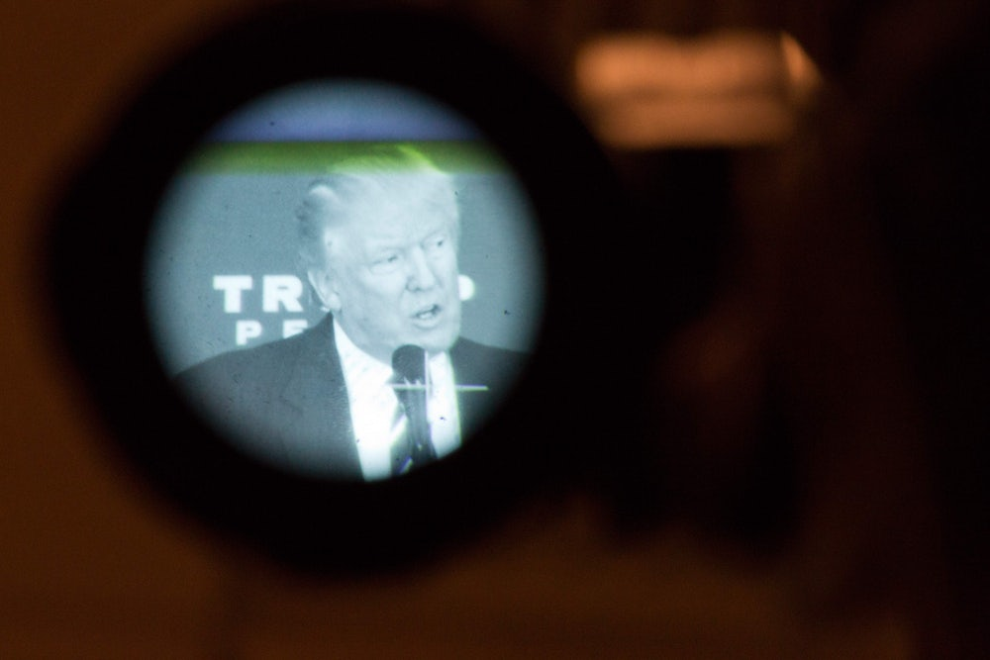

Slide 48
[The perfect crime]
‘For [Jean] Baudrillard, “the perfect crime” was the murder of reality, which has been covered up with decoys (“virtual reality” and “reality shows”) that are mistaken for what has been destroyed.
“Our culture of meaning is collapsing beneath our excess of meaning,
the culture of reality collapsing beneath the excess of reality,
the information culture collapsing beneath the excess of information—
the sign and reality sharing a single shroud,”
Baudrillard wrote in The Perfect Crime (1995).’

Slide 49
(Bill) Clinton and Moral Relativism
Nagel writes that sophisticated versions of relativism have invaded every sphere
Social sciences
Politics and law
Media
Arguments about abortion, capital punishment,
or a president’s morality
(our text was published in 2003 after the Clinton sex scandal of 1998)

Slide 50
Our point of view … and reality
Nagel (The Last Word, 1997) articulates the basic issue:
Whether understanding and justification
“come to an end with objective principles whose validity is independent of our point of view”
Or whether they “come to an end within our point of view.”
In our time the predominant view is that
“ultimately, even the most apparently objective and universal principles derive their validity or authority from the perspective and practice of those who follow them.”
The issue, “in a nutshell
is whether the first person, singular or plural, is hiding at the bottom of everything we say or think.”

Slide 51
At the bottom of everything?
Searle is the model objectivist
Justification of the truth of one’s beliefs or sentences consists in
demonstrating their correspondence with the facts
At bottom of what we think and say
what we appeal to in justifying our claims
are things and events
forever untouched by what we say or think about them
The first person is not at the bottom of everything

Slide 52
Justification is an imposition
Foucault is the model relativist or “subjectivist”:
We [not I, not experiential truth] are at the bottom of everything we say or think
Justification never comes to an end in an objective reality
It is a continuous process in ordinary life and in academic disciplines
Establishing that a belief or sentence is true
is judging it or rendering it acceptable in a regime of truth
according to the rules and practices of that regime
There is never any confrontation with an extralinguistic reality
Justification is one sort of truth-making
It is closure imposed on debate about the propriety or acceptability of a move in discourse

Slide 53
There is a real world out there
Searle’s realism: He thinks that
“the universe exists quite independently of our minds
and that, within the limits set by our evolutionary endowments, we can come to comprehend its nature.”
= “Default positions” that he thinks most people hold true
“There is a real world that exists independently of us, independently of our experiences, our thoughts, our language.”
“There is a way that things are that is logically independent of all human representations.”

Slide 54
A condition of intelligibility
Such “external realism” is not a debatable philosophical theory
but a “condition of intelligibility”
Acceptance of the mind-independent reality of the world
is presupposed in what we think, say, and do
“For a large classes of utterances, each individual utterance requires for its intelligibility a publicly accessible reality.”

Slide 55
Access to external reality
Nevertheless, Searle recognizes that
“There is nothing inevitable about the concepts we have for describing reality”
And thought and perception are inescapably aspectual (perspectival)
Seeming to agree in this with Davidson, Rorty, and Foucault
that our access to things in themselves is mediated by conceptualization
But he adds that it does not follow from this
“that external realism is false because we have no access to external reality except through our concepts.”

Slide 56
Different conceptual schemes
There are different ways of counting the things in a room
In one “conceptual scheme” it’s a number of individual pieces
In another its counted as one set
“The appearance of a problem derives entirely
from the apparent inconsistency in saying there is only one object
and yet there are several objects.”
But “once you understand the nature of the claims, there is no inconsistency whatever. They are both consistent, and indeed, both are true.”
“I weigh 160 in pounds and 72 in kilograms. So what do I weigh really? The answer is, both 160 and 72 are true depending on which system of measurement we are using.”

Slide 57
Is heat a fluid or kinetic energy?
But this is not conceptual relativism. He is simply applying different inclusion criteria and different measurement systems
I jog a mile at 7 am, when it is 60 Degrees Fahrenheit
I run 1.6 kilometers at 0700 hours when it is 15 degrees Celsius
But there is conceptual relativity
when one physicist conceives of cooling as a loss of caloric fluid
and another as a reduction of mean kinetic energy
Or when a theist sees death as a transition and an atheist as an annihilation
[Or when William James distinguishes the productive function of mind/body phenomena from a transmissive function.

Slide 58
Different ways of describing a country
Fotion defends Searle by noting that one historian describes a people as mainly industrious, another as mainly selfish, and a third as mainly religious
But these are not mutually exclusive or incommensurable descriptions
It is a difference in what the historians regard as “mainly”
In pointing to differences in ideology as underlying the different theories, this does suggest incommensurability

Slide 59
All true beliefs must be commensurable
But Searle’s realism precludes conceptual relativism and incommensurability
since he holds that “the facts” are the final arbiters of truth
All true beliefs must be commensurable
no matter how incomplete or selective
because they portray how things are

Slide 60
Descartes’ doubts
Searle is impatient with epistemology, with how-do-we-know questions
He dismisses this as Descartes’ unproductive legacy
The world is manifest
and all justification requires is that we observe it
to see if what we say and believe about it is true

Slide 61
[Does the sun rise in the morning?
Recall the context of Descartes’ doubt
In 1600 everyone believed that the sun went around the world. This was manifest and all one had to do was look at the sky to justify the belief
But the new astronomy demonstrates that reality is the opposite of this false appearance
→ look at the appearances in the light of the concept of heliocentrism
Kant describes his philosophy as involving a “Copernican” revolution in philosophy
Going from one model of knowing: object → subject
To a different one: subject → object

Slide 62
[Copernican revolution in philosophy]
“Hitherto it has been assumed that all our knowledge must conform to objects. But all attempts to extend our knowledge of objects by establishing something in regard to them a priori, by means of concepts, have, on this assumption, ended in failure. We must therefore make trial whether we may not have more success in the tasks of metaphysics, if we suppose that objects must conform to our knowledge.”
Kant, Critique of Pure Reason, B xvi

Slide 63
Everything does not come out of somebody’s head
Foucault: we have to talk about truth without talking about how things are
Truth has to do with us and our practices not with the world
[Recall: Husserl investigates consciousness while bracketing the world]
We must put the world aside
And outline how truth is produced and functions in discourse
This does not mean that he is a linguistic idealist or irrealist
holding that there is no world outside of our constructs
Truth’s internality to discourse “does not mean that there is nothing there and that everything comes out of somebody’s head.” (Foucault)
But he doesn’t say much about this issue
because he is not interested in it [or because he is a Kantian]

Slide 64
The world is …
Rorty does however discuss it in detail
He is also read as a linguistic idealist because he rejects the correspondence theory
He holds that attributions of truth are only “a compliment paid to sentences that seem to be paying their way.”
Rorty like Foucault puts the world aside
As the “vacuous notion of the ineffable cause of sense”
Or simply everything that “inquiry at the moment is leaving alone.”
Brute reality has no “epistemic role to play with respect to truth-claims”
There is “no way of transferring … nonlinguistic brutality to facts, to the truth of sentences.”

Slide 65
A mind-independent reality is not the standard of truth
Like Davidson, Rorty denies that any thing makes sentences true
And agrees with Sellars that attributions of truth do not affirm that certain relations hold between sentences and the world
This is not to deny mind-independent reality and events
But only that we can compare our beliefs and sentences to them as the ultimate standard

Slide 66
But is this a useful thing to say?
But Rorty’s acknowledgement of brute reality is vulnerable
Rorty’s pragmatism implies that “our symbol sequences are meaningful only insofar as they help bring about habits of action that turn out to be useful.” (Frank Farrell, “Rorty and Antirealism”)
In rejecting the correspondence theory,
Rorty detaches language from the world
“and gives up reference and representation”
And so his acknowledgement of brute reality turns out to be
just a statement that may or may not be useful
[I.e., he cannot claim that there really is a brute reality—that his statement about brute reality refers to this brute reality]

Slide 67
Giving up reference
If Farrell is right this applies to Foucault as well
His internalization of truth to discourse gives up the idea of reference—that the truth is a truth about something
And so Foucault’s insistence that truth’s internality to discourse
would either itself be part of a discourse of power
or completely empty of any meaning
[Or, Foucault says that truth is wholly internal to the discourse of power
But this assertion is supposed to be an objective truth that is independent of any discourse of power
And so he affirms that some true discourse—his own—is independent of power ]

Slide 68
Begging the question
Prado: But Farrell begs the question against Rorty
He supposes that representation is the only way to acknowledge brute reality
And representation means “hooking up” with what it represents
But Rorty is an anti-representationalist: a true statement is a useful one, not one that represents something
The argument of the analytic Farrell shows that analytic philosophy is still verificationist
i.e., he supposes that if Rorty’s acknowledgement of brute reality is meaningful it must be verified by being shown to correspond to how things are
But this is precisely what Rorty rejects

Slide 69
What there is does not determine truth
Rorty’s pragmatism means that acknowledging brute reality can only be either useful or not
This is not a failure on the part of Rorty
Rorty’s acknowledgement of brute reality is not an exception to his pragmatism but part of it
Like Rorty and Davidson, Foucault denies
that what there is imposes itself on discourse and determines truth

Slide 70
Affirming brute reality is a move in discourse
But this does not mean that reality is just what we think and say
but rather that discursive practices objectify what count as things and events
and determine what may be said about them
Such remarks regarding “brute reality, etc.” are moves in discourse
to counter irrealist moves like Derrida’s assertion that “[t]here is nothing outside of the text.”

Slide 71
A daunting idea clarified
This is perhaps a daunting idea (Prado)
that truth is not determined by how things are in the world
It can be clarified by a parallel to how truth is established in a court of law
A jury issues a verdict
And a judge accepts it as the judgment of the court
Prior to this point the defendant’s actions may be described
as criminally negligent by the prosecution
or innocently injurious by the defense

Slide 72
The jury decides what is true
In law the actions are indeterminate as to classification and culpability prior to the verdict
It is only then true that the action was established as criminally negligent
We like to think that the accused either did or did not act in a criminally negligent way
And the jury members discern what really happened by considering and weighing the evidence
comparing their beliefs to an objective reality
But this is not what the truth of guilt or innocence means in law:
Prior to the verdict the actions are not yet criminally negligent or innocently injurious from the legal perspective
This is what the jury decides is true

Slide 73
[The Copenhagen interpretation of quantum mechanics]
“A commonly held interpretation of quantum mechanics is the Copenhagen interpretation. In the Copenhagen interpretation, a system stops being a superposition of states and becomes either one or the other when an observation takes place. This thought experiment makes apparent the fact that the nature of measurement, or observation, is not well-defined in this interpretation. The experiment can be interpreted to mean that while the box is closed, the system simultaneously exists in a superposition of the states "decayed nucleus/dead cat" and "undecayed nucleus/living cat", and that only when the box is opened and an observation performed does the wave function collapse into one of the two states.”
https://en.wikipedia.org/wiki/Schr%C3%B6dinger%27s_cat

Slide 74
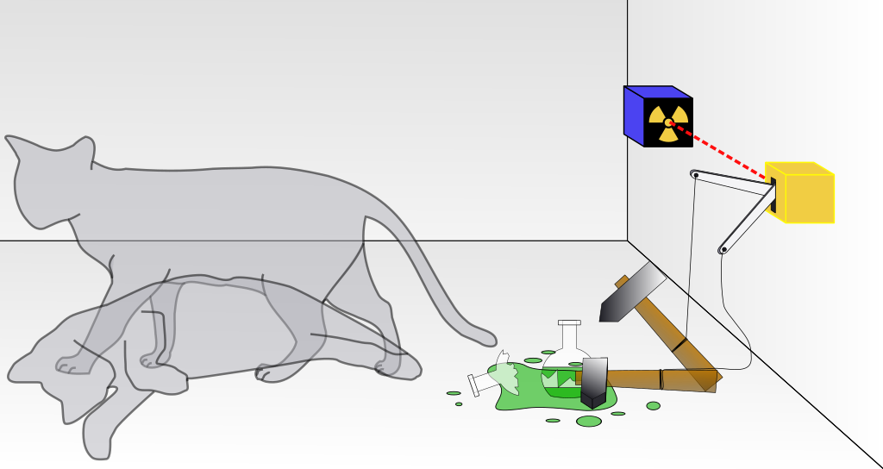
[Schrödinger's cat]

Slide 75
[Einstein: a risky game with truth]
“You are the only contemporary physicist, besides Laue, who sees that one cannot get around the assumption of reality, if only one is honest. Most of them simply do not see what sort of risky game they are playing with reality—reality as something independent of what is experimentally established. Their interpretation is, however, refuted most elegantly by your system of radioactive atom + amplifier + charge of gun powder + cat in a box, in which the psi-function of the system contains both the cat alive and blown to bits. Nobody really doubts that the presence or absence of the cat is something independent of the act of observation.”
Einstein to Schrodinger

Slide 76
Truth is a status symbol
Prado: “it is admittedly difficult to understand that the production of truth is independent of extralinguistic reality.”
Foucault: there is no truth independent of societal and disciplinary truth-establishing practices
What is true is so because of what we say and do
Prado: like verdicts in a court of law

Slide 77
Rorty and Foucault
Rorty: sentences are bits of brute reality themselves
Their truth is not their relation to other bits of brute reality
[Is this objectively true, or is it a move in pragmatism that is useful or not?]
Foucault: Truth is a status given to beliefs and sentences in discursive practices
not a property of beliefs or sentences
[Is this objectively true, or is it a move within a power construct?]

Slide 78
Science is not inevitable
Given his external realism and correspondism
Searle is an inevitabilist re empirical inquiry
Science is “bound to be as it is … because of the inherent structure of the universe.”
But for Foucault and Rorty science is
“a goal oriented … artifact reflecting specific ends as well as determinate social and historical conditions.”

Slide 79
6.022×10²³ is an inevitable achievement of science because reality just is this way
For Searle, humans would inevitably discover
Boyle’s law
For a fixed amount of an ideal gas kept at a fixed temperature, pressure and volume are inversely proportional.
or Avagadro’s Number
1 gram of hydrogen element (H), having the atomic (mass) number 1, has 6.022×10²³ hydrogen atoms. Similarly, 12 grams of ¹²C, with the mass number 12 (atomic number 6), has the same number of carbon atoms, 6.022×10²³.
History, philosophy, and the social sciences are molded by the facts
and must “bottom out” in what is “not itself an institutional construction.”

Slide 80
There is only one world, not seventeen
Searle: Disputes in inquiry are all finally resolvable
because the world is the final arbiter
Our conceptual frameworks organize a single, accessible reality
“We live in exactly one world, not two or three or seventeen.”
Davidson points out that conceptual relativism is about the structuring or organizing of experience
not the world itself
And so conceptual frameworks may be incommensurable
“[r]eality itself is relative to a scheme: what counts as real in one system may not in another.”

Slide 81
The Kantian noumenal realm
For Searle the world, reality is manifest
And directly accessible
It is not a Kantian noumenal realm
beyond phenomenal structures
Conceptual diversity is not a matter of what counts as real
But a matter of focus, interest, completeness of description, and application of diverse measurement-systems

Slide 82
The moons of Jupiter
Rorty: Searle’s reference to “hard facts” is a philosopher’s ploy
against the arguments of pragmatists and relativists regarding truth
Searle “changes the subject from truth to factuality”
“When Galileo saw the moons of Jupiter through his telescope, it might be said, the impact on his retina was ‘hard’ in the relevant sense.”
Regardless of how the experience was conceptualized,
objectively real moons had a causal impact on Galileo’s eyes as well as on the eyes of the Paduan astronomers.

Slide 83
Shattering the crystalline spheres
Rorty: “[t]he astronomers of Padua took it as merely one more anomaly … whereas Galileo’s admirers took it as shattering the crystalline spheres once and for all”
But for Searle, this changes nothing: “the datum itself is utterly real quite apart from the interpretation it receives.”
But however real the datum and its cause
to the Paduan astronomers it was an anomaly
to Galileo it was a discovery with vast implications

Slide 84
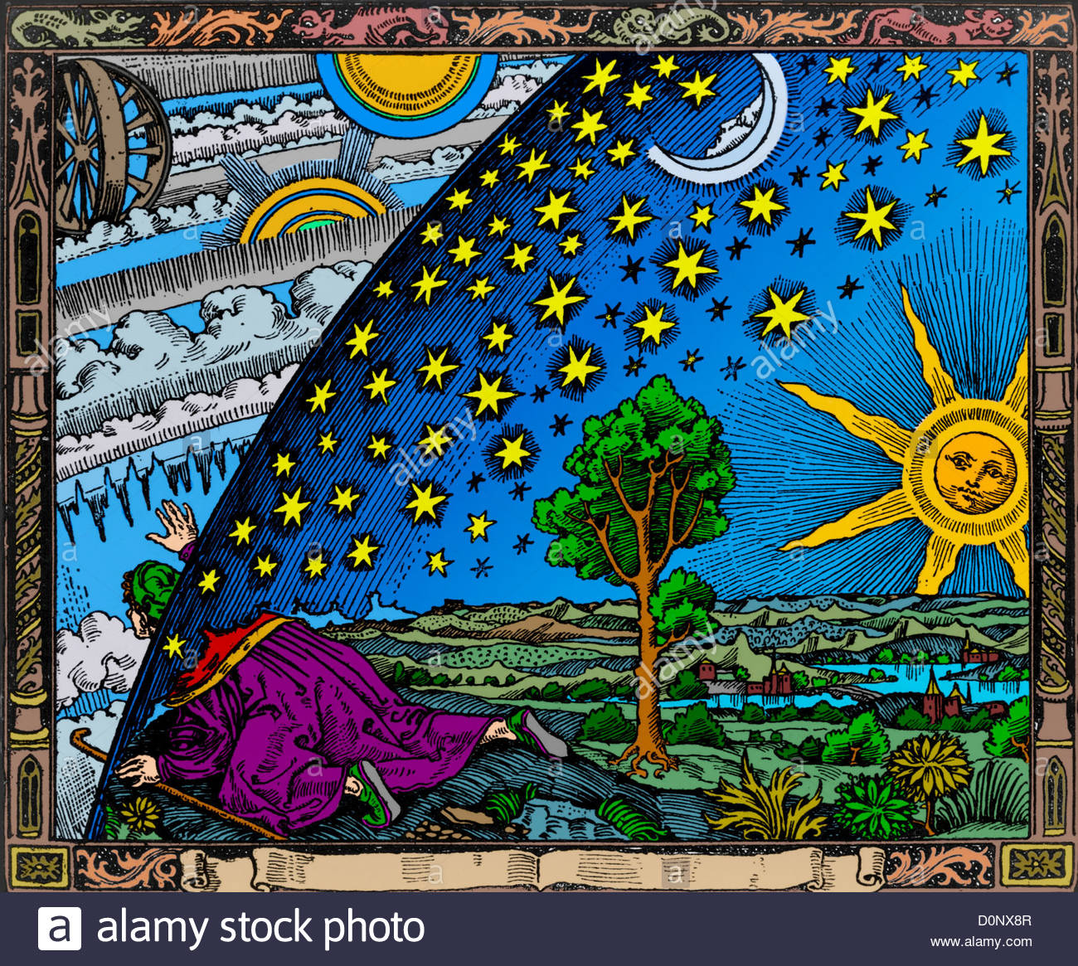
Reality and Appearance: before Copernicus

Slide 85
Truth (and Power): Before Copernicus
When the Almighty made the universe
He made the earth and then he made the sun.
Then round the earth he bade the sun to turn—
That’s in the Bible, Genesis, Chapter One.
And from that time all beings here below
Were in obedient circles meant to go:
Around the popes the cardinals
Around the cardinals the bishops
Around the bishops the secretaries
Around the secretaries the aldermen
Around the aldermen the craftsmen
Around the craftsmen the servants
Around the servants the dogs, the chickens and the beggars. . . .
--Galileo, by Berthold Brecht

Slide 86
What can be said about the universe
Foucault would add that in the dispute
Galileo challenged established truth in what could and could not be said about Jupiter and its moons
And attempted to establish new things that could or could not be said
But Jupiter and its moons themselves would not figure in this account
because we cannot transfer their nonlinguistic reality to our beliefs and sentences
If we could there would have been no dispute

Slide 87
[The closed space of the Middle Ages]
“One could say, by way of retracing this history of space very roughly, that in the Middle Ages there was a hierarchic ensemble of places: sacred places and profane places: protected places and open, exposed places: urban places and rural places (all these concern the real life of men). In cosmological theory, there were the supercelestial places as opposed to the celestial, and the celestial place was in its turn opposed to the terrestrial place. There were places where things had been put because they had been violently displaced, and then on the contrary places where things found their natural ground and stability. It was this complete hierarchy, this opposition, this intersection of places that constituted what could very roughly be called medieval space: the space of emplacement.

Slide 88
[The open space of the modern age]
“This space of emplacement was opened up by Galileo. For the real scandal of Galileo’s work lay not so much in his discovery, or rediscovery, that the earth revolved around the sun, but in his constitution of an infinite, and infinitely open space. In such a space the place of the Middle Ages turned out to be dissolved, as it were; a thing’s place was no longer anything but a point in its movement, just as the stability of a thing was only its movement indefinitely slowed down. In other words, starting with Galileo and the seventeenth century, extension was substituted for localization.”
--Michel Foucault web.mit.edu/allanmc/www/foucault1.pdf

Slide 89
Going beyond a facile division
No serious thinkers deny the reality of the world
As Searle claims they do
Not even Derrida believes that “everything comes out of somebody’s head.”
There may be the odd solipsist
or believers in a flat world
or who say that NASA’s films of the moon landing are fake
The fact that Foucault is not a linguistic idealist
belies the facile opposition of Searle and Foucault as divided by their conceptions of truth and its existential implications

Slide 90
A more complicated picture
Once this easy division becomes suspect
so does the more complex one in which Searle and Foucault philosophize in incompatible ways
as determined by their respective historical intellectual antecedents and contexts
The picture of Searle as model analytical philosopher and Foucault as model Continental
is more complicated than their different accounts of truth

Slide 91
Where justification comes to an end
These accounts are connected to how each thinks language and belief relate to the world
the mind-independent reality that both accept
This issue is captured in Nagel’s question of “where … justification comes to an end.”
Searle takes it as coming to an end in comparisons of beliefs and sentences to “the facts”
and so he cannot take conceptual relativism seriously
trivializing it as using different measurement systems and/or differently focused descriptions

Slide 92
Can we just look and see?
For Searle, the mind-independent world is immediately evident
All that is required is that we just look and see
whether what we think and say corresponds to how things are
If the correspondence theory is the condition of intelligibility
what other conception of truth could there be?
For Foucault, how can we just look and see what is there
independently of our histories, our practices, the whole conceptual structure that defines who we are at any given moment
and how the world is disposed for us as the subjects we are?

Slide 93
Bestowing status on a proposition
For Searle justification ends in successful comparison
But it is unclear what is compared
what are the “facts” against which beliefs and sentences are checked
[E.g., you look through the telescope and see that moons circling Jupiter—verifying Galileo’s Copernican astronomy
For Foucault, justification ends—but only for a time—in acceptance of a discursive move
in bestowing a certain status on a proposition
in the incorporation of that proposition in a regime of truth
[The defenders of the old pre-Copernican regime see the same movement but regard it as just another anomaly within the geocentric theory]

Slide 94
What is the main focus: truth, or coherence?
This difference captures something basic to the difference between analytic and Continental thought
For Searle et al truth is the main focus
conceived as accurate representation
with justification as likening representations to their originals
For Foucault et al there can be no such likening
So assimilation and coherence are the focal points
and justification is a matter of discursive practices and historical subjectivity

Slide 95
Language as omnipresent
For Continental philosophers the point is not to compare representations to anything
But to “look at the world critically with the intention of identifying some sort of transformation, whether personal or collective.” (Critchley)
For Searle, the point is
“getting it right”
But Foucault and Rorty see language as omnipresent
structuring every aspect of our individual and collective awareness
and inescapable
For Foucault what matters is
grasping where language has brought us and where it might take us

Slide 96
The crux
The crux of the issue: not truth per se, but how truth works
And that is determined by what is thought to be a sufficient reason to hold a belief or to make or accept an assertion
E.g., I see the sun come up in the morning. Is that a sufficient reason to believe that the sun really does come up, circle around the earth, etc.?
And that is determined by how we conceive of our access or relation to the world
E.g., do I directly relate to the way things are in sensation,
or do I do this indirectly, through the mediation of concepts?

Slide 97
Searle is right in a general way
Searle is right in a general way that realism is a condition of intelligibility:
that we take something to be the case independently of us
if we are to play the reason game at all

Slide 98
But then we must shift the focus
But when we shift the focus from truth itself
to our reasons for holding something true
the key point has to do with our relation to the world
And this is most succinctly expressed by Davidson
who said that nothing can count as a reason for holding a belief except another belief
And rejects “as unintelligible the request for a ground or source of justification of another ilk”

Slide 99
Mind penetrates “reality”
This is because of the ubiquity of language and perspective,
as expressed by another icon of analytic philosophy, Putnam, who says that
“elements of what we call ‘language’ or ‘mind’ penetrate so deeply into what we call ‘reality’ that the very project of representing ourselves as being ‘mappers’ of something ‘language-independent’ is fatally compromised from the start. Like Relativism, but in a different way, Realism is an impossible attempt to view the world from Nowhere.”

Slide 100
Giving up easy labels
The fundamental grounds of the analytic/Continental distinction evaporate
if Searlean representationalism is abandoned
if we stop thinking of what we say and believe as propositional facsimiles of things and events
if realism is understood following Putnam rather than Searle
as an impossible attempt to view the world from Nowhere
if truth stops being accurate portrayal
And it becomes necessary to give up easy labels
and to identify philosophers by their specific positions on particular issues

Slide 101
Some (rhetorical) questions
Should we abandon representationalism?
Should we acknowledge that beliefs and sentences are not little pictures of reality?
Should we give up external realists, like Searle, and become internal realists, like Putnam?
i.e., what we consider to be reality is within mind or language, not outside of it
Should we understand truth as wholly linguistic,
And not as bridging a gap between mind and language on one side
and brute reality on the other?

Slide 102
Searle’s “alternative” seems hollow, quaint
These questions now have a hollow sound
They seem purely rhetorical
Foucault’s view, made inevitable by Kant, has displaced Searle’s
Foucault’s view does not seem to be an alternative to Searle’s
How could anybody really think that we only have to just look and see that a belief is true?
Searle’s grudging admission of the aspectual nature of awareness now just seems quaint

Slide 103
Our intellectual age
The analytic/Continental distinction is contingent
on a conception of philosophical problems as perennial, as ahistoric
as Rorty argues in Chapter 1 of this book (Prado)
And this conception is itself contingent
on denying Putnam’s point that mind/language has deeply penetrated “what we call ‘reality’”
What characterizes our intellectual age
is that this denial is impossible

Slide 104
[Background history of philosophy]
Prado concludes by arguing that the Kantian position
that what we call reality is pervaded by our subjective concepts of reality
has displaced the alternative position
that our concepts are representations of objective reality
classically presented by John Locke
The problems with Locke’s theory were exposed by Hume’s empiricism
Hence: Locke → Hume → Kant

Slide 105
[Hume’s empiricism]
Recall Hume’s distinction between analytical and synthetic truths
Analytical truths are a priori truths about language:
e.g., “All bachelors are unmarried.” The predicate is already contained a priori in the subject.
Hume: all statements that are universal and necessary, including math and logic, are ultimately tautological
The truths of science are synthetic: the subject and predicate are only combined a posteriori, in experience. “All fire is hot.”
“Adam, though his rational faculties be supposed, at the very first, entirely perfect, could not have inferred from the fluidity and transparency of water that it would suffocate him, or from the light and warmth of fire that it would consume him.”
Hume, Enquiry Concerning Human Understanding, Section IV, Part I.

Slide 106
A Priori A Posteriori
Analytic 3+2=5
a²+b²=c²
A = A
Bachelors are unmarried
Synthetic (Some) fire burns
1st “Law” of Newton,
“law” of gravity
X
X

Slide 107
[Is fire necessarily hot?]
Recall Kant:
“But all attempts to extend our knowledge of objects by establishing something in regard to them a priori, by means of concepts, have, on this assumption, ended in failure.”
I.e., to say that “fire is necessarily hot”—is to suppose that the concept is derived from the object (object → subject)
But Hume shows that the objects of experience are individual experiences,
which we generalize on the basis of limited experience
And no universally valid knowledge, as in scientific laws, can be derived from such a basis

Slide 108
[Kant replies to Hume]
Kant replied that some truths are “a priori synthetic”
E.g., objects exist in time and space, and are governed by causal laws
Such categories are presupposed to our empirical sciences, not derived from experience
And since they condition science a priori it is impossible to say that reality in itself consists
in individual things
separated in space
moving in time,
and governed by causal laws
Our science is phenomenal, about appearances-for-us,
and we can never know things as they are in themselves

Slide 109
[Universal and necessary knowledge that is not just analytic or tautological: science]
Kant concludes: we can attain universal and necessary knowledge
if we suppose that the objects of experience are determined by our concepts
Subject → object
But then we have to give up the notion that science represents reality as it is in itself
All we know consists in appearances for us, shaped by our ways of knowing
We cannot know things as they are in themselves.

Slide 110
A Priori A Posteriori
Analytic Bachelors are unmarried A = A (Logical principles)
Synthetic 3+2=5 This stove is hot
a²+b²=c²
1st Law of Newton
Law of gravity
Fire necessarily burns
X

Slide 111
[Hegel replies to Kant]
Hegel asked : how does Kant even know what the a priori categories themselves are?
If all knowledge is governed by a priori categories in such a way that we can never know the nature of the objects we are thinking about
then this should apply to our knowledge of the categories themselves
If we know categories themselves only through categories, then we cannot know categories as they are in themselves
But Kant supposes that we can know these categories, by reflecting on how our mind works
Kant thus slides back to Hume, and supposes that we have direct, empirical knowledge of the categories themselves,
but then we can never say they are universal and necessary

Slide 112
[Revisiting Foucault’s Kantian supposition
So if for Foucault we only know “reality” within “regimes of truth”
How do we get any objective picture of these regimes themselves?
Foucault examines the shift between the medieval worldview and the one opened up by Galileo
The shift from closed to open space
without supposing anything about objective reality in itself
And yet he supposes that he can know this succession of perspectives as they are in themselves

Slide 113
[The correspondence theory returns in Foucault]
Foucault implies that we have the ability to know objectively certain kinds of objects,
i.e., the regimes of truth that dominate an era
Such knowledge about the regimes of truth is not itself determined by regimes of truth
It is either true or false depending on whether Foucault’s account corresponds to the reality itself existing outside our thoughts about it
He thus both denies and affirms the correspondence theory of truth
It is false as a depiction of “brute reality”
It is true regarding “regimes of truth”

Slide 114
[Hegel’s Phenomenology]
Hegel’s reply to this dilemma
We should examine the phenomenal experience of objects, starting with the simplest
We can at least know what seems to be true from different perspectives or concepts
and follow out the movement in which one concept or approach to an object is transformed into another one
In this process, one perspective does not simply displace the other,
but also incorporates it in a complex way, building on it all the while negating it
→ Hegel’s historical phenomenology

Slide 115
[Historical and perspectival nature of philosophy]
Philosophy is thus intrinsically historical and perspectival
But we can decipher a logic of development
E.g., from simple to complex
This is not about an abstract Spirit “runs in its empty sameness throughout the course of history.”
But an increasingly complex Spirit of History that develops over time
E.g., the shift from the medieval perspective to the modern one in science
1) the sun obviously goes around the earth: Medieval perspective
2) the earth really goes around the sun, and the first view is an illusory appearance: “the Copernican revolution” in science
Are these incommensurable perspectives?

Slide 116
[Incommensurable perspectives?]
There are two radically different perspectives:
one of how things appear when we take the world as it immediately appears as if we can directly contemplate it
Object → subject
and one of how things appear when we include our own moving perspective in the picture
Subject → object

Slide 117
[Reconciling the differences]
The two perspectives then can be combined:
We see the sun coming up in the morning: Object → subject
Because our perspective is in motion in relation to the world: Subject → object
This leads to a more complex picture:
Object → Subject → Object²

Slide 118
[Historically Progressive Knowledge]
All our experience of the world is mediated by our theories of it
But this does not mean that different theories are incommensurable
Or are the result of different systems of measurement (Searle)
They build on one another in a progressive, more comprehensive way
as our theoretical knowledge of the world expands and deepens
A limited “paradigm” being replaced by a more comprehensive one

Slide 119
[What seems to be self-evident today rests on the history of theory]
Today it seems that the heliocentric view of the universe is directly evident
as it is from outer space
But travel to outer space rests on a complex theoretical basis
We underestimate the extent to which theory penetrates our experience of the world
because we take the previous developments of knowledge for granted
Historically oriented philosophy reminds us that the seeming evidences of direct experience
are appearances of a prior history
which we must understand if we are to understand ourselves and our world

