Slide 1
2 The Matrix
What is Reality (2)

Slide 2
Summary
Problems of The Simpsons: experience of duty; how to know what is duty
Problems of The Matrix:
  duty to know the truth (who am I?),
  illusion and reality,
  the highest duty
Illusion and reality: escaping from the scientific prison of the mind: determinism

Slide 3
What is truth?
What is the Answer to the Ultimate Question of Life, the Universe and Everything?
  Hitchhiker’s Guide to the Galaxy by Douglas Adams
This Answer was first calculated by the supercomputer Deep Thought
  after seven and a half million years of calculation
The answer is on the next slide:

Slide 4
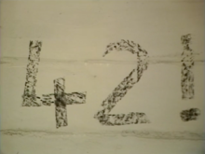

Slide 5
Copernican revolution in science
Scientific revolution at the time of Descartes
Old geocentric view of world
  Aristotle > Ptolemy
=World is the way it appears
Copernican revolution: appearance is an illusion
Reality is radically different
Hence: Descartes’, doubt, his sense of living in a dream from which he tries to wake up
  Not an artificial philosophical puzzle
  But a burning experience, a waking up from a grand illusion

Slide 6
Scientific background: the Copernican Revolution
What do we see?
  Sky as a “vault” over a circular horizon.
  The sun passes around this vault of the sky.
What is the reality?
  The earth is moving around the sun
  What we see is an appearance.
  We do not see the reality.

Slide 7
Egocentric nature of perception
What do we actually see?
Is this the reality in itself?
=egocentric nature of perception
Child’s view of the world
Adult’s geocentric view of pre-modern times.
Moral parallel: egotism

Slide 8
We are the source of the illusion
Kant:
  1) our perceptual world is produced by our subjective forms of perceiving
  2) our practical world is produced by our choice to be separate egos
Two outcomes
  1) We implicitly create our own reality
  2) We normally believe that our reality is determined by forces that are independent of us

Slide 9
What is real?
Morpheus: What is real? How do you define real? If you're talking about what you can feel, what you can smell, what you can taste and see, then real is simply electrical signals interpreted by your brain.

Slide 10
What is perception?
Scientific theory
1) Real (external) world
2) Signals go to brain
3) Perception of external world occurs

Slide 11
Problems and possibilities
But 3 is not the same as 1, since it is my perception: “electrical signals interpreted”
  Where does 3 take place?
We start from 3 (appearance), not 1 (reality)
How go from 3 to 1?
It is possible to eliminate 1 and substitute 2 (= a manipulated Virtual Reality)

Slide 12
Perception and reality
1) Do I perceive the person outside of me?
Or do I perceive an image of that person “in my head”?
And project it outside?
2) What is the nature of “an image” (e.g., consciousness of something that is red)?
  Material?
  Nonmaterial?

Slide 13

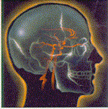
Perception: What do I see?
Common sense realism (Aristotle)
A

Slide 14
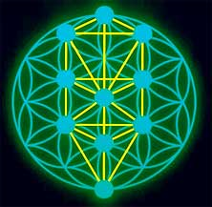
The real thing in itself (Kant)
B

Slide 15

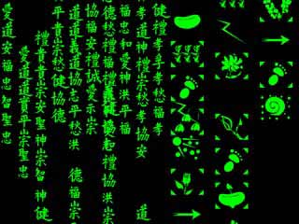
The Matrix
C

Slide 16
What is real?
Materialism: “The red surface of an apple does not look like a matrix of molecules reflecting photons at certain critical wavelengths, but that is what it is.” (Churchland)
Dualism: “there is no conceivable connection between any sort of body and any perception of a colour or smell which we find in our minds.” (Locke)

Slide 17
Where is the mental image?
If the “image” is not a material thing, it cannot be “in my head”: Locke says “in our minds”
And so there is no need to project it outside of my head (as the materialist Hobbes says we do)
My consciousness of the person next to me is just what it seems to be—an irreducible non-material consciousness somehow connected to a material process (Descartes, Locke)

Slide 18
Why red and not green?
Physical phenomenon: “a matrix of molecules reflecting photons at certain critical wavelengths”
Conscious experience: red (not molecules)
Why not green instead?
How do I know you do not perceive green, but call it red?
  You would still stop at the “red” traffic light

Slide 19
The Divine Programmer (Locke)
What is the connection between
  1) the consciousness of something red (immaterial image) and
  2) the matrix of molecules reflecting a pattern of photons to the brain (material process)
2 cannot cause 1 because matter only produces more matter
Therefore this is a correlation “produced by the appointment of an infinitely Wise Agent, which perfectly surpass our comprehensions.”

Slide 20
Two projects of humanity
1) each group, and eventually each person, sees itself as separate from the others
  results in conflict, suffering, misery
    Hobbes: war of all against all
    World of 1999
2) motivates the search for another way (like a splinter in the mind)

Slide 21
What is reality?
Implicitly people create their own world
> world seemingly governed by external laws
But choice is at the basis of this appearance
We semi-consciously produce our own existence as governed by these laws
Reality: collective humanity chains, enslaves itself
Some individuals benefit from this slavery and manipulate it

