Slide 1
4 From Renaissance to Enlightenment

Slide 2
Larger historical context
“Renaissance” = “rebirth”
Return to Greek and Roman philosophy and culture
after the “Middle Ages” or “medieval” period
in which religion and the authority of the Catholic Church dominated thought
and feudal lords who received their power from birth ruled an agriculturally based world
New cities emerged engaged in international trade
starting with the merchant republics of Italy

Slide 3
Money and Art
From feudal aristocracy to greater equality of merchant republics
“During the Renaissance, money and art went hand in hand. Artists depended entirely on patrons while the patrons needed money to foster artistic talent. Wealth was brought to Italy in the 14th, 15th, and 16th centuries by expanding trade into Asia and Europe.” Wikipedia: Renaissance

Slide 4
Contrast with Greece and Rome
Recall Plato: excluding the merchants from the Republic
“Must not they be truly unfortunate whose souls are compelled to pass through life always hungering?”
Social order of Greece and Rome
1) Legal order of individual citizens
2) Loss of republics with rise of empire, kingdoms
Renaissance: return of independent republics
But different: founded by merchants
→ Plato’s “always hungering” individuals become the center of social and intellectual life

Slide 5
Humanism and the Rise of Modern Science

Slide 6
Periods of early modern philosophy
This first period of European philosophy
400 years from 1400 to 1800
Especially 1600 to 1800: the period of the great philosophers starting with Descartes, “the father of modern philosophy”
Renaissance philosophy: 1400 to 1600: opposing trends
Humanism
Emphasizing the uniqueness of the individual, and the subjective side of experience, relativity and moral responsibility
Rise of science
The universe as a mechanism
Following the right methods one could arrive at a complete and objective account of the world

Slide 7
Two sets of issues: epistemic and metaphysical
Two large issues emerge by 1600s
1) Epistemic situation:
(1) what can we know with certainty?
(2) How can we live with uncertainty?
2) Metaphysical status of human beings
(1) Are human beings made in “the image of God”?
(2) or a speck of dust in a mechanistic universe?

Slide 8
Two large tendencies
By 1750: Two large tendencies emerged
1) “Age of Reason”: Enlightenment philosophes for whom
human beings are elements in an ordered universe
that is transparent to educated understanding
which generates rational and universal principles of moral behavior
2) Romantics reject these claims
continuing the humanist trend

Slide 9
Intellectual and Imaginative Enjoyment
Renaissance humanism
Love of things of the intellect and imagination for their own sake
inspiring the search for intellectual and imaginative enjoyment
New sources for doing so are discovered
From classical antiquity: Plato, Lucretius (materialism), Sextus Empiricus (scepticism)
versus medieval emphasis on Aristotle

Slide 10
What is humanism?
Stages of “humanism”
1) = Pursuit of the “humanities”:
poetics, rhetoric, and history
versus medieval emphasis on geometry, logic, and theology
2) a broad concern with the human situation and intellectual and imaginative enjoyment
versus the “futile curiosity” of scientific and philosophic enquiry

Slide 11
Practical pursuits
Philosophy is displaced by emphasis on literature and the arts
and practical pursuits of education, politics, and rhetoric
=Humanist pursuits outside the universities
Medieval philosophy of Aristotle is rejected by the humanists
The universities continue to be dominated by scholastic Aristotelianism

Slide 12
Shift to practical philosophies
Greatest northern humanist: Erasmus (1466-1536), whose goals are
reforming education
and simplifying Christian teachings
Reborn interest in the practical philosophies of Stoicism and Epicureanism
shifting emphasis from logic and metaphysics
to ethics and political theory

Slide 13
Against Aristotle
Against the Aristotelianism that had dominated medieval philosophy
Grown men discussing whether God could have incarnated in a vegetable rather than in Jesus
Petrarch called Aristotelianism the product of a “rabid dog”
Martin Luther said Aristotle was a “buffoon”
Erasmus:
“you could extricate yourself faster from a labyrinth than from the tortuous obscurities” of the medieval schools
They absurdly try to prove that it is worse to tell a lie than to let the whole world perish

Slide 14
Three themes that stand out
The rediscovered texts of Plato, Epicurus and the Stoics
turn to the emphasis on what makes the good life
to ethical and political reflection
Three themes stand out in the profusion of intellectual movements
1) individualism and “the dignity of man”
2) human independence from the divine
3) human frailty

Slide 15
Human dignity
1) individualism and “the dignity of man”
Pico della Mirandola: man is “a great miracle and a being worth of all admiration”
Individual responsibility for one’s own life
versus doctrines of predestination and grace of Lutherans and Calvinists
Individuals are unique and interesting, with their different feelings, tastes, and aspirations
→Interest in letters, confessions, memoirs, biographies
Historical context:
Citizen state of Athens → Italian city states
Intensified individualism of the merchant (always hungering)

Slide 16
The man of virtu
E.g., Vasari’s Lives of artists: Michaelangelo as the man of virtu:
not Christian virtue,
but glory and renown through creative endeavor
Also depictions of virtu:
Michangelo’s sculpture of Lorenzo de Medici
Titian’s portrait of Andrea Gritti
Faces that show independence and pride
absent from medieval icons

Slide 17
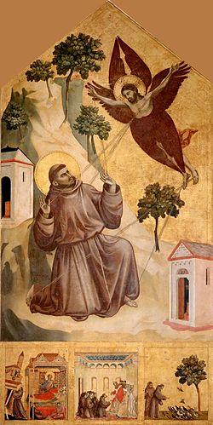
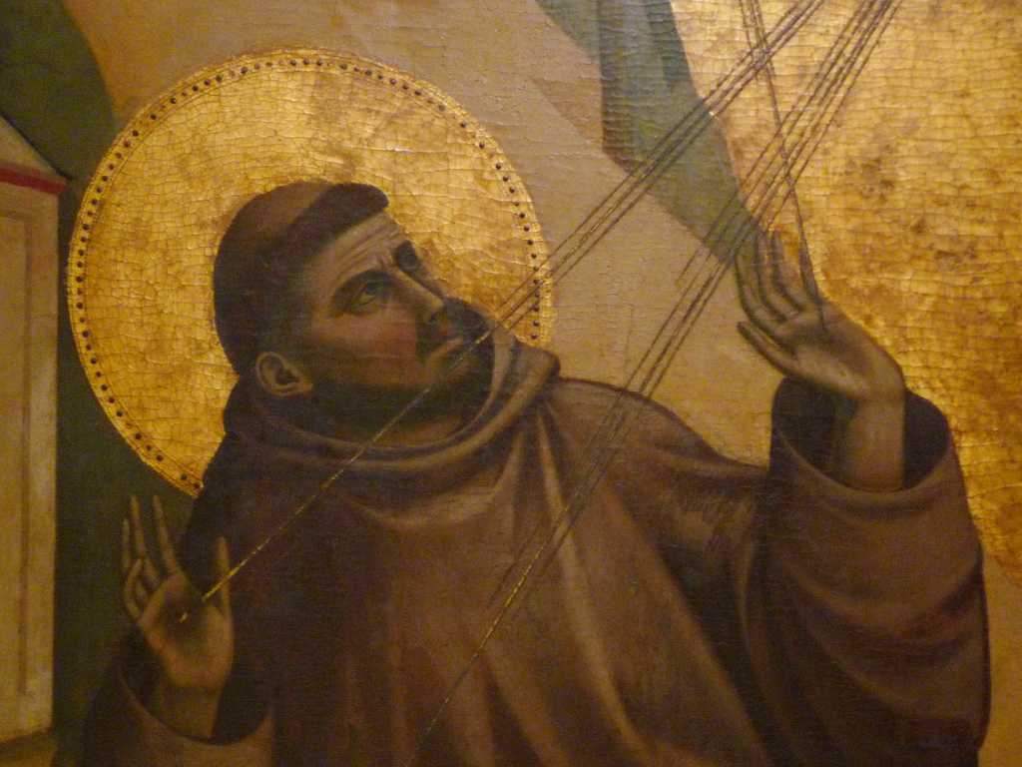
Saint Francis Receiving the Stigmata (Giotto, 1300)

Slide 18
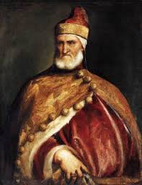
Titian’s portrait of Doge Andrea Gritti (1545)

Slide 19
Recall China
Recall the picture of the individual human being in Daoism.
The individual, the sage, is almost swallowed up in the cosmic whole

Slide 20
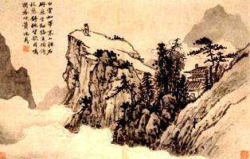
Wild Man of the Mountain

Slide 21
Independence from God
2) Independence from the divine
Medievals saw human importance in relation to God
Aquinas: happiness as acquaintance with God (which is what Aristotle said)
But Christian thinkers such as Erasmus saw happiness as “being willing to be what you are”
Renaissance atheists (Machiavelli and Pomponazzi) saw the rise of religions as natural historical phenomena

Slide 22
“The whole man”
Humanist ideal of the “whole man”: unity of spirit, character and body
versus emphasis on the highest part: the “active intellect” of Aristotle as the human essence
→Leonardo da Vinci’s studies of human anatomy
Famous Vitruvian Man
Note: geometrical perfection of the human body

Slide 23
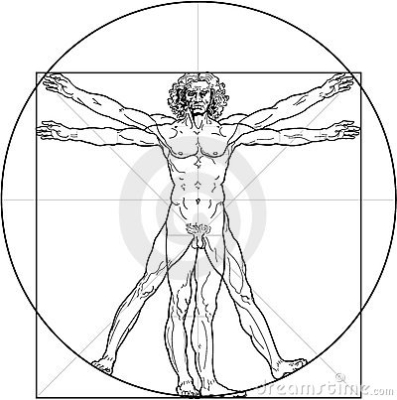
Vitruvian Man by Leonardo da Vinci (1490)

Slide 24
Human folly
3) Human being warts and all
Desiderius Erasmus’ The Praise of Folly (1511)
Especially focusing on inability to know God
→Scepticism, reinforced by rediscovery of the Greek sceptics
And by traveller’s tales of foreign customs and exotic beliefs
The virtuous individual must recognize
the limitations of life in the real world
and human frailty
→ Da Vinci’s Mona Lisa (1503): what is she smiling about?

Slide 25
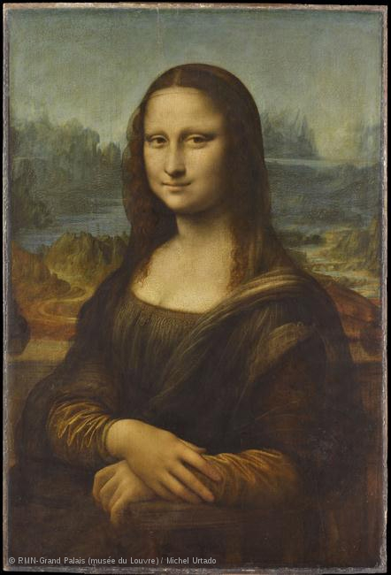

Slide 26
Pico’s 900 theses
Two variants of the Renaissance man
Giovanni Pico Della Mirandola (Pico, 1463-94)
Niccolo Machiavelli (1469-1527)
In 1486, at the age of 23, Pico arrived in Rome announcing 900 theses (Luther—1517) had 95)
“to resolve any question proposed … in natural philosophy or theology”
At first, 13 were condemned by the Pope
When Pico publicly defended these, the other 887 were also condemned

Slide 27
Human dignity
Pico draws on Orphic mysteries, hermetic, Kabbalistic, and magical sources
Oration on the Dignity of Man
God says to Adam: “The nature of other creatures is defined and restricted …; you, by contrast, … may, by your own free will, … trace for yourself the lineaments of your own nature …
“We have made you a creature neither of heaven nor of earth … in order that you may as the free and proud shaper of your own being, fashion yourself in the form you may prefer.”

Slide 28
We make ourselves
Human dignity is due
not to the nature of the human being (“essentialism”)
but to freedom of the individual to make his/her own nature (“existentialism”)
“whether to the lower, brutish forms of life”
or to rise to “the superior orders”
This promethean ideal
→ enthusiasm for magic, alchemy
“good magic” [by which] a person makes himself “lord and master over the powers that threaten his autonomy”
but hostility to astrology
the belief that our lives are governed by the stars

Slide 29
Not divine
Dignity does not come from sharing the nature of God
Human beings are a distinctive kind
not like animals, not like angels, not like God
Through contemplation we can make ourselves like God (as Plato and Aristotle argue)
but then we cease to be human, but instead become “some higher divinity, clothed with human flesh”
To be human is to make a compromise:
“an inviolable compact of peace between the flesh and the spirit”

Slide 30
Human frailty
Human frailty impedes our capacity to make the best of ourselves
“It is not granted to us” “flesh as we are” to attain knowledge of the highest things “by our own efforts”
And so we should look at all the sources of wisdom available to us, learning from them all
Pythagoras, Hermes, the Bible, Plato and Aristotle …
“The confrontation of many schools … might illuminate our minds more clearly, like the sun rising from the sea”
All this wisdom is ultimately the same

Slide 31
A recipe book for power and glory
Niccolo Machiavelli (1460-1527)
The Prince: sinister advocacy of Realpolitik
The work of an avowed republican who supports the tyranny of the Medici family
A recipe for power and glory
“A wise lord ought not to keep faith when such observance may be turned against him”
“it is necessary … to be a great pretender and dissembler”
His hero for imitating: Caesar Borgia
who appoints a henchman to do his dirty work
and then has him executed to divert criticism from himself

Slide 32
It only looks like vice
But isn’t this true?
In times of war, the society is better off when ruled by a cruel and devious, but resolute leader
→ security and prosperity for the people
Since most people are bad, they “will not keep faith with you,” and so “you too are not bound to observe it with them.”
This is really virtu:
it “looks like vice” only when we overlook the real-life context

Slide 33
Versus Aristotle
Contrary to Aristotle
there is nothing naturally virtuous in living as a social being
Society and its morals are
artificial products
for satisfying individuals’ selfish desires with minimal strife
Recall context
Rise of capitalism in Europe
The rule of the merchants: individuals ever hungering for more (as Plato said)

Slide 34
The main goal in life: success
Since the “sole end which every man has before him is glory and riches”
The man of virtu is not distinguished by his goals
but by his success in pursing them
which depend on the nature of the times
Realism requires a sense of history
Not just a recognition of the discrepancy between
how things really are
and how they might ideally be
But an understanding of the cyclical rhythms of the world due to the stars

Slide 35
Fortune favors the brave
We can do nothing about fate or fortune
or our own innate temperament
But with this knowledge we should be resolute and bold
“Fortune is a woman”
And like most women, she favors the brave
→ adventurous merchant, risking investments on ships and markets to make huge fortunes

Slide 36
A harsher variant
Here too are the three themes of humanism, but with a harsher tone
1) individualism
Humans are “atoms”
with preformed desires for purely individual satisfaction
2) God/morality is completely absent from this picture
3) Human frailty is seen in man’s subjection to cosmic forces

Slide 37
From Copernicus to Descartes
In 1543, Fr. Nicolaus Copernicus published his hypothesis
that the earth, revolving around its axis, revolves around the sun
In 1641, Descartes published his Meditations
Between these dates
Gilbert presented his theory of magnetism
Galileo established the laws of falling bodies and inertia
Kepler showed that the planets moved in ellipses
Harvey demonstrated that blood circulated the body
→ The rise of modern science

Slide 38
Why are the scientists important for philosophy?
At the same time, there were striking technological successes
in printing, optics, sailing, and warfare
technology involved in and favoring the expansion of commerce
The names of the early scientists are important for philosophy
not because they were themselves philosophers
but because of the impact of their methods and discoveries on the great philosophers of the 17th c
Descartes, Hobbes, Locke …

Slide 39
Francis Bacon: wisest and meanest
Francis Bacon (1561-1626), Lord Chancellor of England
The first major philosopher to regard scientific inquiry (as he understood this) as the best prospect for securing knowledge and the “commodity of human life”
Bacon was “the wisest, brightest, meanest of mankind” (Alexander Pope)

Slide 40
Bacon opposes …
In the name of observation and experiment, Bacon diatribes
against the Aristotelian influence
against the Italian followers of magic and alchemy (e.g., Pico)
against neo-Platonic and Pythagorean number mysticism
against magicians such as Paracelsus

Slide 41
Theoretical basis for magic
Theoretical basis for magic in doctrines of “sympathies” and “signs”
If everything emanates from the One (Neo-Platonism)
there must be concordances between very different things
e.g., between stars and human faces
One who knows how to read “the book of Nature”
sees sympathies manifest through resemblances between things, which are signs for one another
E.g., The brain resembles a walnut, so by operating on the walnut one may cure a headache

Slide 42
Bruno
Giordano Bruno (1548-1600)
Copernicus was right that the earth moves
not because of the mathematical simplicity and elegance of the theory
but because there are infinite universes, and each is a living whole in which everything moves
We should consult the ancient Egyptian hermeticists
who “with magic and divine rites … ascended to … the divinity by that same scale of nature by which the divinity descends to the smallest things by the communication of itself.”

Slide 43
A martyr to science and romantics
= We can ascend to God because God has descended to us through the Incarnation of His Son
I.e., God is not beyond this world
but is to be found within it:
and so we should study this world itself
→In 1600 he was burned at the stake in Rome by the Catholic authorities for his heresy
becoming a martyr to the cause of science
and a martyr to the romantics against a merely scientific view of the world

Slide 44
Rivals to commanding nature
Both magic and science aimed
to “command nature in action”
and contribute to “human utility and power”
Magic failed in part because of its secrecy
What is needed is a public science, where clearly expressed ideas can be tested by others
as Bacon writes in his New Atlantis describing a utopian scientific community, “the House of Solomon”

Slide 45
The wrong and right model
For Bacon, these “magi” and “philosophers of nature” followed the wrong model of knowledge
according to which to know things it is necessary to gather the whole dense layer of signs that covers them (holism)
i.e., nature as a language of signs with hidden meanings for the gifted reader of this book
Bacon replies:
He rejects this “enchanted” view of nature
He examine the processes and structures piecemeal and in their own right: not holism but particularism
It is human language that “wonderfully obstructs the understanding” and must be reformed

Slide 46
Moving toward God through science
In the medieval times, religion dominated science
Now when the new science arises, most of the scientists were still religious: e.g., Newton
who hold that the wonderful mechanisms of nature were the work of the divine designer
Bacon: scientific enquiry would confirm God’s existence and “advance our reason to the divine truth”
With the knowledge and power of science “man is a god to man”
Galileo: “With regard to these few [truths] which the human intellect does understand, I believe that its knowledge equals the divine in objective certainty, for here it succeeds in understanding necessity.”

Slide 47
Science confirming religion
Scientists argue that science confirms religion
Bible: Joshua commanded the sun to stand still
The Catholic Church authorities: this is proof that religion implies that the sun moves around the earth
Galileo replies:
This is much easier to justify in the Copernican picture (where the sun doesn’t move anyway)
Theology: God is immutable
Descartes: The quantity of motion in the universe must be constant (law of conservation of energy)

Slide 48
Not divorce but differentiation
There is no separation or divorce between science and religion
But there is a growing differentiation of their spheres
Galileo: the Bible teaches us how to go to heaven,
not how the heavens go
Medieval scientists were reluctant to reject plausible hypotheses because they conflict with religion
Nicole Oresme (1320-1382): The reasonableness of the idea that the earth turns—and so flatly contradicting revealed truths—dramatically shows how reason requires aid from revelation
But now, science needs its own space: Bacon: “give to faith that only which is faith’s”

Slide 49
Against Aristotle’s teleology
→ abandonment of Aristotle’s final causes (teleological form)
The purposes in things that were said to be set by God
Bacon: the search for final causes “intercepted the … diligent enquiry of all real and physical causes … to the great arrest … of further discovery.”

Slide 50
Why do heavy things fall down?
E.g., why do heavy things fall down?
Aristotle: because they have the inner purpose (telos) for falling toward their natural place beneath the earth
Why then does the thrown object go forward?
Modern science: the real cause is the law of gravity operating on things mechanically
Why does the thrown object ever go down?
Galileo’s law of inertia (Newton’s first law)
→ Aristotle’s “efficient cause” is the only one

Slide 52
Does a mechanistic world require God?
For most, God is still necessary in a mechanistic world
God creates the clock of nature, and winds it up
Then we can ignore God and study the working of the clock: “deism”
For Thomas Browne (1605-82) the providence of God depends on the existence of a purposeful world
And a mechanistic world operating by its own laws, discoverable by man-as-scientist approximating to God, might lead to a notion of human dignity without reference to God

Slide 53
Bacon’s Method of the bee
For science to thrive “idols” of the mind must be overthrown
Personal prejudices
Insensitivity to counter-evidence
Over-confidence in supposed first principles
The methods for establishing knowledge
not the method of the ant (accumulating bits of knowledge—Aristotle, empiricism)
nor the method of the spider (spinning ideas out of ones own head—Plato’s recollection)
But the method of the bee: taking data from the empirical world, and transforming it through rational thought (as in Copernicus’ rethinking of the data of planetary movement, taking the sun as the point of reference)

Slide 54
A fresh beginning needed
Bacon: A new beginning is needed, with the strictest objectivity and attention to method
“the entire work of the understanding must be commenced afresh, and the mind … guided at every step; and the business done as if by machinery”
→a complicated procedure of induction
The data must be carefully organized,
and natural histories acquired,
to identify the “forms” or “essences” of “natures”
such as heat and color

Slide 55
The new forms of things
“Form” or “essences” ?
Not those of Plato and Aristotle, which lie close to the surface of things, and shape the matter of things
You see the fire rising up
You suppose an inner telos that explains its purpose of going to a higher sphere of fire surrounding he earth
i.e., the old science of Aristotle was close to the appearances of things:
assuming that the world fundamentally is the way it appears to be

Slide 56
Correspondences of the elements
Recall Chinese symbolic thinking:
Doctrine of systematic correspondences of the elements
applied to government (Tung Chung-Shu)
wood is the agent of the Minister of Agriculture
metal is that of the Ministry of the Interior
Because metal cuts down trees
It is the duty of the latter to punish corrupt officials in the former

Slide 57
Burning Bruno
Division of Renaissance thinkers:
Bruno held that since God became a human being the natural world itself is sacred,
And should be studied is intrinsically good
Versus otherworldly Christianity
→ Return to the animism of our earliest ancestors
Later: Romanic poets of the 19th century

Slide 58
Return to nature, to childhood
My heart leaps up when I behold
A rainbow in the sky;
So was it when my life began;
So is it now I am a man
So be it when I grow old,
Or let me die!
The Child is father of the Man;
And I could wish my days to be
Bound each to each by natural piety.
William Wordsworth, 1802
Ode: Intimations of Immortality

Slide 59
Disenchantment of nature
Bruno was burned at the stake for heresy
Bacon argued for a different approach
He rejects this “enchanted” view of nature
He examines the processes and structures piecemeal and in their own right

Slide 60
Why does fire go up?
The new sciences break sharply from the appearances
E.g., the form of heat is “a motion acting upon the smaller particles or bodies”
inner “latent processes” or structures of things
invisible to ordinary perception
These particles or atoms don’t necessarily go up or down, but in all sorts of direction dependent on how they are impacted
The result might be a general upward appearance

Slide 61
Reality and appearance
“The form of the thing is the very thing itself”
“the thing in reference to man,” the “apparent thing, is quite different from the thing itself” (Bacon)
→ The real world is very different from what it appears to be.
= sharp break from animistic outlook
which sees a unifying Spirit in the apparent movements of all things
But if reality is different from appearances, how do we ever know it?

Slide 62
Order from “chaos”
Recall: ancient atomism → relativism
Answer of Plato and Aristotle: matter is an unintelligible chaos
Modern philosophy seeks to solve this problem through scientific method (Bacon’s method of the bee)
The new philosophies of science are atomistic
Social-historical context: This is a world of competing, conflicting separate individuals (i.e., the world of merchants)
Yet in this seeming chaos, there is order, lawfulness

Slide 63
Next step: colors are subjective, but not everything
Next step: Galileo’s idea that some properties like color and odor are merely subjective,
Locke: “secondary qualities”
But there are also objective properties are those like motion and shape that can be treated by mathematics and geometry
Locke: “primary qualities”:
Some features of the surface of things resemble the basic structures of things (motion, shape, number …)
and so we can know these basic elements on the basis of sensory experience

Slide 64
The debate
→ Debate between “those who could and those who couldn’t stomach the apparently depressing thought that the world is, in large part, a very different place from how it appears to be.” (Cooper 252)

Slide 65
Revival of scepticism
16th c revival of scepticism
After 1500 years in which this was no matter of concern because of the authority of religion
→Modern philosophy from Descartes to Kant:
Attempts to answer the challenge of modern scepticism
or to live with it
Is scepticism a futile intellectual game?
or an urgent and momentous issue?

Slide 66
Attack on orthodox religion
Reasons for this urgency
1) The new sciences had yet to prove themselves
2) This was a deeply religious time, but one in which orthodox Catholic beliefs were under attack
from atheism and Protestantism,
and scientific deism

Slide 67
The challenge of Deism
Deism
accepted the existence of God as creator of the world,
but denied God’s involvement in the world and human life
A believer in a God who at “a flick of the fingers … set the world in motion; after that he [has] no more use for God.” (Pascal)
→ a movement to defend the traditional faith by enlisting scepticism on its behalf

Slide 68
Defending human dignity
Recall renaissance themes of human dignity and human frailty
Montaigne and Pascal stress the frailty of human knowledge
And so to defend human dignity requires
either a less sceptical view of the human intellect
or a seeking of greatness in our wretchedness itself (Pascal)

Slide 69
Pyrrhonist scepticism
The scepticism that was influential in the ancient world was Pyrrhonism
A recipe for a happy life
by accepting the limits of our knowledge
By going along with the existing beliefs
one experienced less distress
whereas seeking certain truth leads to confusion and unhappiness

Slide 70
Science itself demands scepticism
The new sciences themselves teach that we cannot trust ordinary sense experience
the sun seems to go around the earth
but the Copernicans and Galileans say it is just the opposite!
If we cannot trust sensory experience how is it possible to have scientific knowledge in the first place?
→Descartes’ methodological doubt as the path to certain knowledge

Slide 71
Scepticism in defense of religion: fideism
“Scepticism” today means not believing in God or religion
But then, it was used in the defense of the orthodox religion (Catholicism)
after the Counter-Reformation
Because the opponents of religion appealed to reason,
and Protestants appealed to the “inner light” or the “voice of conscience” against the traditional belief
defenders of Catholicism appealed to skepticism

Slide 72
Why believe in the Catholic Church?
Why stick with Catholicism
and not abandon religion altogether?
1) in the Pyrrhonian spirit
A relaxed, unfanatical conformity with the prevailing, traditional faith
→ peace of mind (ataraxia, “apathy” or indifference) of the ancient sceptics
2) Scepticism leads to a “leap of faith”
In the direction of Christianity
and the Church that has for so long protected Christianity

Slide 73
Two sceptical religious philosophers
Two major French philosophers who practiced a form of scepticism on behalf of religion
Michel de Montaigne (1533-92)
Goal of his Essays: to “only look for knowledge of myself”
Culminating in Renaissance individualism and anticipating Descartes’ “solipsistic turn”
Blaise Pascal (1623-62)
Invented the calculating machine, and important work in geometry and mechanics
Converted from focus on science in 1654 through an intense religious experience

Slide 74
Pascal’s thinking reed
Human frailty (Pascal)
“Man is only a reed, the weakest in nature, but he is a thinking reed”
“equally incapable of knowing and not desiring to know”
“nothing shows man the truth, everything deceives him”
There are intuitive certainties of the “heart”
E.g., the axioms of geometry
But they are legitimate only if we assume that it is God who is “moving our heart”

Slide 75
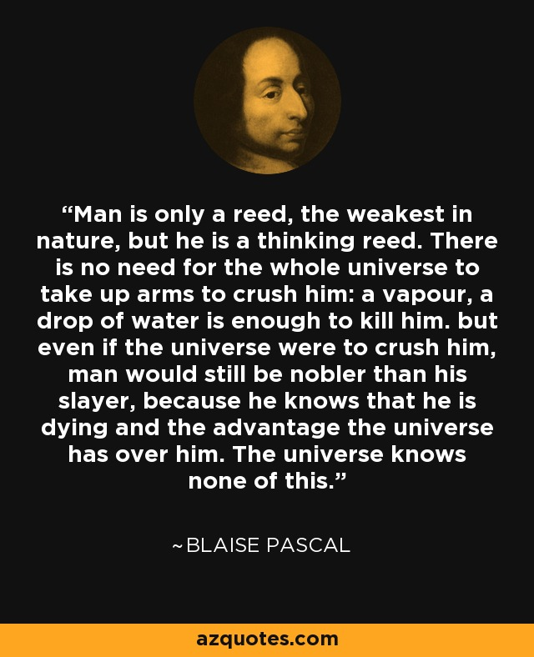

Slide 76
Man without God is pitiful
Montaigne: Stripped of knowledge of God, man is a “pitiful, wretched creature” barely superior to the beasts,
above which he wrongly exults himself
“There is no single proposition which is not subject to controversy”
Cultural differences
“Another region, other witnesses would stamp a contrary belief on us”

Slide 77
Doubting the senses
What about the evidence of the senses?
The different opinions of individuals based on sensing convinces Montaigne that “the senses do not embrace an outside object but only their own impressions of it”
I.e., we see the world through sensory impressions inside ourselves
In our knowledge of the world, we are like the person who only has a portrait of an unknown individual
unable to tell if the portrait resembles the original

Slide 78
Doubting reason
It is argued that reason can establish whether our impressions properly represent the world
1) But reason rests on intuitive certainties of the heart,
and these are in question (Pascal)
2) “Reason and the senses … are engaged in mutual deception” (Pascal)
E.g., what we see can be distorted by what we think we ought to be seeing
We see the sun move, but reason says it is the earth that moves
3) People disagree over what they consider rational principles
“No reason can be established except by another reason. We retreat into infinity.” (Montaigne)

Slide 79
Proofs for God’s existence
What about philosophical proofs for the existence of God of “natural theology”?
At most these are “finger posts … an elementary guide on the road to knowledge” (Montaigne)
Pascal:
The world is full of signs of God’s presence,
but these can only be read by those who are already committed in their faith.
The “proofs” are forgotten after an hour, and they only establish the “God of the philosophers and scholars”
not the God of Abraham, Isaac, and Jacob
i.e., they establish only deism, which is “almost equally abhorrent to Christianity” as is atheism

Slide 80
Following Erasmus’ fideism
Montaigne follows Erasmus, who, in his combat with Luther said he would
“readily take refuge in the opinion of the sceptics wherever this is allowed by … the Holy Scriptures and the decrees of the Church, to which I … willingly submit”
When reason strays from “the beaten track traced for us by the Church, she … becomes inextricably lost; she whirls aimlessly about”
To save myself from “endlessly rolling,” to be “led back home,” I must accept the Church's “choice and remain where God put me”
From the Pyrrhonian sceptical position, this is the more rational choice

Slide 81
Pascal rejects conformism
Pascal however was critical of Catholic orthodoxy
rejecting Montaigne’s half-hearted conformism
which would equally justify Islam for Muslims to the East
In 1654 he experienced “total submission to Jesus Christ” as the only proper one
But his wager argument is good for any religion that promises eternal reward, including Islam

Slide 82
Pascal’s Wager
Since reason cannot decide whether God exists, we must wager, but rationally
1) If we don’t believe, and God exists,
we could lose eternal happiness in the next life
2) If we do believe, but there is no such eternal life,
we lose nothing when we die, because then for the dead person there is nothing
but while we live we “gain even in this life”
by confident expectation of a happy afterlife
and by avoiding “noxious pleasures”

Slide 83
Dignity in our wretchedness
A second argument of Pascal for the Christian religion:
Awareness of our wretchedness leads to a higher truth
It puts us above the animals (admired by Montaigne) who are unaware that they die
Our state of wretchedness is a sign that we “must have fallen from some better state”
Our yearning for this better state is a sign that redemption is possible
Hence, two blazing truths of Christianity:
our fall into corruption
and the promise of redemption

Slide 84
Pascal rejects Descartes
In Jesus Christ the “hidden God” reveals himself
to those “who seek Him with all their heart”
The signs of God’s presence are there for those who are committed to finding him
But they will mean nothing to those who take an abstract, rational approach,
like Descartes, whom he cannot forgive for his conception of a God Who
“at the flick of the fingers … set the world in motion” and “after that he has no more use for God”

Slide 85
Descartes’ Dualism of Spirit and Matter

Slide 86
Descartes’ greatest joy: contemplating God
René Descartes (1596-1650) responds to scepticism
The new science of Copernicus and Galileo was not widely established, and could easily be shot down
Belief in God and immortality were also under attack—sometimes in the name of science
But it is in “the contemplation of the divine majesty” that resides “the supreme happiness in the next life”
And “the greatest joy of which we are capable in this life”
(Pascal must have misunderstood Descartes’ thought
that God just gives the world a “flick” to start it off
and then we can ignore God)

Slide 87
A solid foundation of his own
The version of scepticism that Descartes refutes is more radical than any previous one
Even addressed to beliefs which “no sane man has every seriously doubted”
E.g., the existence of a world outside of our own thoughts
Descartes aims at resting knowledge on “a foundation which is all my own”
And so “cast aside the loose earth and sand so as to come upon rock or clay”
And then building from this solid ground by “small but certain steps”

Slide 88
The senses can deceive us
But first he presents the sceptic’s position as coherently and as forcefully as possible
resolving to “reject as if absolutely false everything in which I could imagine the least doubt”
1) The senses sometimes deceive us
E.g. A person with jaundice perceives something white as yellow
And so it is prudent “never to trust” them

Slide 89
I could be dreaming
2) I could be dreaming
I am having a vivid experience of myself “sitting by the fire, wearing a winter dressing gown”
But I have had similar vivid experiences in dreams
And so since there are “never any sure signs” of waking experiences versus dreaming ones, I can never be certain of even such vivid experiences
Recall Chuang-tzu’s dream of being a butterfly

Slide 90
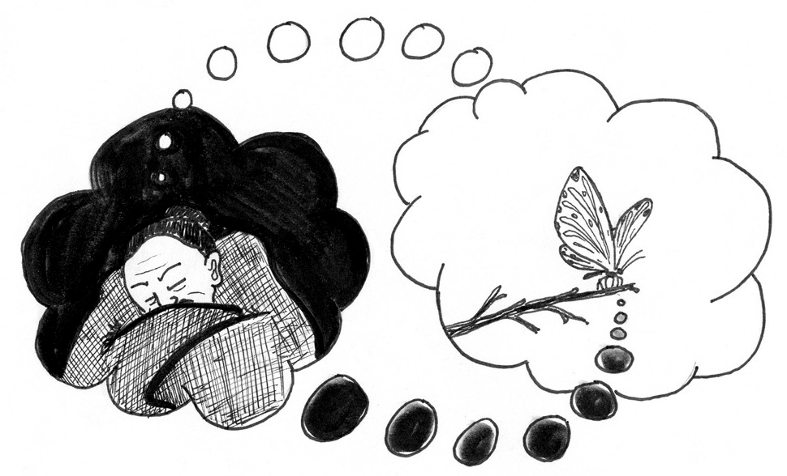

Slide 91
I might be deceived by a demon
3) But for me to dream surely there must exist a corporeal world with extension and shape
to provide the materials for my dreams
But suppose that God, or “a malicious demon of the utmost power and cunning” “has employed all his energies in order to deceive me”
He could have invented these ideas of sky, earth, flesh and blood—to which nothing corresponds in external reality
He could have made me “go wrong every time I add two and three or count the sides of a square”

Slide 92
Cogito ergo sum
And so he must “reject as if absolutely false” all his previous beliefs about the world
including its geometry and mathematics
But there is one thing that he cannot reject:
“We cannot suppose … that we, who are having such [doubts] are nothing. For it is a contradiction to suppose that what thinks does not, at the very time when it is thinking, exist.
“Accordingly, this piece of knowledge—I am thinking, therefore I exist [cogito ergo sum]—is the first and most certain of all to occur to anyone who philosophizes in an orderly way”

Slide 93
What I am and that I am
What I am is still in doubt
My “essence”
Maybe I am a butterfly
But that I am cannot be doubted
My existence or being
What is being? Recall previous thought:
It vanishes before you can even grasp it (Heraclitus)
It is the unmoving framework or movie screen within which your life takes place (Avaita Vedanta, Parmenides)

Slide 94
Clear and distinct ideas
This concept, that I am thinking (or dreaming) and therefore I am, is clear and distinct
I.e., directly evident (clear) to me,
and stands out distinctly from all the beliefs he previously held in a confused way
He therefore adopts “a general rule that the things we conceive very clearly and very distinctly are all true”

Slide 95
From imperfection toward perfection
There is another such clear and distinct idea to be extracted here
I was doubting and uncertain, and so an imperfect being
But I arrived at an indubitable truth, and seek to find more such so as to perfect my knowledge and my life
I am therefore a being who is capable of moving from imperfection to greater perfection:
I.e., I am striving to become all-knowing, God-like

Slide 96
Humans are different
Do butterflies doubt, worry about what is true?
Plants and animals simply are what they are.
Cows eat grass and chew their cud. They do not worry about whether the grass is real or an illusion
It is the nature of human beings to have such worries, to doubt and strive to truth
I.e., we want to be more than what we are: we are/exist but have no fixed essence
Not “essentialism” but “existentialism” or “beingism”

Slide 97
What do I want?
Implicit conclusion:
I am an evolving, aspiring human being,
not a contented butterfly or a cow, not a plant or an animal
There is in me therefore an idea of perfection, an ideal that stimulates this process of my thinking
I want to be more than what I am. How much more?
There is no fixed limit: We humans want to go beyond all limits
We aspire to perfect, unlimited being beyond all restricting essences, going “where no man has ever gone before” (Star Trek)

Slide 98
What is the cause of this idea or ideal?
I then ask: where does this idea come from?
1) from the world outside me?
2) from myself?
1) Does this idea of perfection or perfect being come from my experience of the world?
But this experience of the world outside me was doubtful, i.e., imperfect
It was the idea of perfection that made me discontented with given ideas about the world
I recognize that my ideas about the world are imperfect because of the idea of perfection within me

Slide 99
I don’t create it; I find it in myself
2) Does it come from me myself?
But I too am imperfect, and yet I am not content with this imperfection because of the ideal of perfection that I find within myself
It is evident that “what is more perfect cannot be produced … by what is less perfect”

Slide 100
Why you are here
Morpheus: “Let me tell you why you're here. You're here because you know something. What you know you can't explain. But you feel it. You've felt it your entire life. That there's something wrong with the world. You don't know what it is but it’s there, like a splinter in your mind driving you mad. It is this feeling that has brought you to me. Do you know what I'm talking about?”
Neo: The Matrix?
→ Plato’s Cave
→ The pre-Copernican world of direct experience

Slide 101
Perfect Being in Itself
3) The idea or ideal of perfection must therefore have been placed in me by Perfect Being Itself
Who created me with His image stamped in me
It is Being in itself, unlimited by any essence, that is the basis in me of my discontent with all limitations
The name we give to this Being of beings: God

Slide 102
Descartes’ first proof for the existence of God
=Descartes’ first proof for the existence of God
I have in me an idea of perfection or of perfect being
It cannot have been caused in me by the outside world
Or by myself
This idea can only have been caused in me by perfect being itself, “God”
And so God must exist

Slide 103
2nd argument: the Cause of my being
I think, therefore I am
Divides into two parts: 1) my thinking, and 2) my being
1) My thinking involves a movement
from ignorance and doubt to truth
And from a little truth to greater truth with the progress of my knowledge
My ultimate goal is to have perfect knowledge, to know everything there is to know,
thanks to the idea of perfection, which is caused in me by a perfect being
2) What then explains my being?

Slide 104
The chain of causes
1) Explain present being from chain of causes going back to 1st Uncaused Cause at time of creation
I am tall because my parents were tall (essence)
Recall: Argument of Nyaya/Vaisheshika
But Being (now) cannot come from some cause in the past, which no longer is:
Something cannot come from nothing
But the past no longer is
And so a cause in the past cannot explain why something is in the present (existence)

Slide 105
Not myself either
2) I myself am not the cause of my being
If I were, why would I not make myself better than I am?
3) Only a present Being that is the cause of Its own Being can cause my being.
Therefore God (self-causing Being) exists

Slide 106
Ontological argument for the existence of God
Recall the “ontological argument” of Pantanjali’s Yoga (Samkhya/Yoga school)
proving the being (being= ōn in Greek) of God from the logic of ideas about God
1) In moving toward liberation we have an idea of a perfect being
This idea is implicit in all our striving to be better than we are, our striving for happiness, liberation: an idea of Perfect being

Slide 107
From idea to being
2) This idea implies the existence of such a being for if it did not exist, it would not be perfect
(1) If our idea of the Perfect Being was not real, did not exist
(2) then we could think of an even better being than the non-existing Being we are thinking about: a Perfect Being that did exist.
(3) And so our idea of the non-existing Perfect Being would not have been an idea of a Perfect Being.
(4) And so since we do have an idea of a Perfect Being, we must think of this Being as existing.
3) Hence a perfect being, God, must exist

Slide 108
The meaning of life
Where are we going?
Idea of perfection moves us on, like a splinter in the mind
To go beyond what we are
To know more
To become better people
→ To be more fully
inspired by the Being that is within and around us

Slide 109
The external world must exist
A Perfect Being cannot be a deceiver
And so the notions of an external world, with the properties of extension and motion,
“as comprised within the subject-matter of pure mathematics” (the “primary” properties of things)
must be true
“I do not see how God could be understood to be anything but a deceiver if the ideas [of extension and motion] were transmitted from a source other than corporeal things”

Slide 110
What is really real out there?
Not everything in my experience however is real
I see the sun come up in the morning, but it is the earth that turns
Secondary properties of things, such as color and smell, are not objective realities.
They are effects in us produced by the things in their primary properties, such as motion, extension, shape, number, etc.
– i.e., the properties of the world for the new sciences
→ Only the material world as represented in the new science is real
I.e., the post-Copernican world of Galileo’s science
And later, Newton

Slide 111
The skeptical argument
The ancient skeptical argument held that atomism makes knowledge impossible
because our knowledge starts with sensory experience
Hence atomism leads to skepticism (and relativism)
Atomism holds that reality consists in atoms and the void (Democritus)
But sensory experience is radically different
How could atomism then be derived from sensory experience?
Modern science even more strongly stresses the difference between
how things appear (the sun seems to go around the earth)
and what is real (the earth goes around the sun)

Slide 112
Descartes’ reply
Some of our experience is purely subjective
E.g., colors and smells
= secondary properties produced by things in us our experience of the world
But some of our direct sensory experience is objective
E.g., motion, extension, shape, number
Science can be built up from such properties
relying on our reasoning ability
whose reliability is guaranteed by the Perfect Being Who made us

Slide 113
Arnaud’s Circle
Antoine Arnaud objected to this reasoning
1) Descartes argues that we need the existence of God to be certain that our reasoning is valid
2) But the proof for God’s existence is based on the validity of our reasoning in the first place
And so Descartes reasons in a circle
He bases the existence of God on certain prior ideas and reasoning about them
But then he argues that the truth of this reasoning presupposes the existence of God

Slide 114
Intuition and reason
Descartes replies
We have direct intuition of the basic ideas. These ideas are not the result of reasoning, but the basis of it.
I think, therefore I am
I am an imperfect being (I doubt) seeking perfection (I discover an indubitable truth)
This idea of perfection is not invented by me, but found in me

Slide 115
Direct knowledge of God
= I have a direct intuition of God
My being, my thinking are directly evident
Perfect Being is directly evident
In my thinking
In my being
Reasoning simply clarifies what we directly know
It is the truths about the external world that we don’t directly intuit that require confidence in our reasoning abilities

Slide 116
Other weaknesses
How do we know when we have a clear and distinct idea? Some of Descartes’ examples of this may seem dubious:
1) “What is more perfect cannot be produced by what is less perfect”
E.g., can a body whose temperature is 100 degrees produce a body that is 120 degrees?
Denying this leads ultimately to the claim that something can come from nothing. But isn’t it obvious that this is impossible?
If there once was nothing, now there would be nothing, and so there always must have been something. Being is eternal!

Slide 117
Our judgments are free
2) Our judgments “are not determined by any external force”
= Descartes’ idea that our intellectual judgments are free—not produced in us by external causes
Sensation is produced in us by external causes
When looking in a certain direction I cannot help but see a tree
Are our rational judgments externally determined like this?

Slide 118
Thinking is free
But my judgments regarding the tree
Does it really exist? Are its leaves really green? Does it move itself or is it produced by other things?
depend on my consciously following a method of reasoning
and a choice on my part to do so.

Slide 119
Science presupposes freedom of the thinker
Science itself requires a free commitment to pursue the truth
Modern science requires the freedom of thought to doubt
to suspend belief in the direct evidence of senses (e.g., that the sun comes up)
so as to situate the sensory data in a larger intellectual framework (the Copernican astronomy) created by thinking
Recall Bacon’s method of the bee

Slide 120
Could God deceive us?
3) “God is not a deceiver”
If God sometimes works in mysterious ways, why might he not sometimes deceive us? (Cooper)
But Descartes’s argument is that a Perfect Being would not create
rational beings whose reason was not reliable, i.e., not rational
i.e., imperfect beings whose nature consists in striving for perfect knowledge but who, in exercising their reason following rational method, become less perfect rather than more so

Slide 121
From simple to complex
Rational thought proceeds in steps
from simple (I think)
to complex (because of an idea of perfection within me …)
Since we can rely on the method of reasoning to understand the world outside of us
the external world must develop in a manner that corresponds to the method of our thinking
Otherwise the way we think would be discordant with the way of the world itself
But then we could not understand it

Slide 122
The beginning of the world
And so the world itself must evolve from simple to complex
→ Descartes’ cosmological work, The World
The starting point of the universe must also be simple elements, atoms or corpuscles
which are moved by other corpuscles acting upon them in accord with physical law
External reality too moves from simple to complex: evolution!

Slide 123
The evolution of the universe
Their motion is not arbitrary swerving (Epicurus), but a lawful process
There are atoms, but there is no void!
“Nature abhors a vacuum,” and so the elementary particles are in contact with one another
As one moves another is drawn in to take its place

Slide 124
Vortices of swirling elements
And the result of this movement consists of particles swirling around one another, producing great vortices
in which the fundamental elements are drawn together,
Later science: this is the result of gravity
and through friction heat up, merge with one another,
explode outward
and evolve into the movements of galaxies, stars and planets of the Copernican system

Slide 126
Reason-based Maxims of Morality
If we know what is good, we will love it, and act to realize the good
Recall Diotema’s teaching to Socrates: philosophy begins with love
But at this early stage in the growth of science (the tree of knowledge) we know very little
Therefore we need a provisional morality
to orient us while we develop our knowledge to greater levels

Slide 127
Provisional morality #1
“to obey the laws and the customs of my country, adhering constantly to the religion in which by God’s grace I had been instructed since my childhood,
and in all other things directing my conduct by opinions the most moderate in nature, and the farthest removed from excess in all those which are commonly received and acted upon by the most judicious of those with whom I might come in contact.”
→Apparent conservativism of this initial maxim

Slide 128
Implicit revolutionary
Descartes implicitly qualifies this conservativism in light of his position that truth is possible and motivational
Follow customs, laws, and religion until you know some truth, and then follow that
So his apparently conservative ethics is implicitly revolutionary
He protects himself from authorities while implicitly opposing “the corrupt state of our manners”

Slide 129
Qualifications to conservativism
Don’t go to extremes (recall Aristotle’s ethics)
It is extreme to make agreements that limit one’s liberty
Imitate the most judicious individuals
not the behavior of the majority
Follow a given practice only until a better one comes along

Slide 130
Maxim #2: Probable truth
Decide what is good based on probability,
not only when there is absolute certainty
And then act on this unwaveringly, as if it were absolutely certain
If you are lost in a forest, go in one direction and you will eventually find your way out
This maxim produces (Stoic) calm

Slide 131
Maxim #3: Descartes’ Stoicism?
Maxim #3: “to try always to conquer myself rather than fortune, and to alter my desires rather than change the order of the world, and generally to accustom myself to believe that there is nothing entirely within our power but our own thoughts: so that after we have done our best in regard to the things that are without us, our ill-success cannot possibly be failure on our part.”

Slide 132
Descartes’ Activism
1) Begin by changing oneself: know the truth (even if only probable) and follow it
2) This leads to changing the world outside
3) We do our best to do what is right
4) and if we fail, we accept the results calmly (“philosophically,” Stoically)

Slide 133
He’s not a Stoic
This is not Stoical acquiescence in a world that is outside of our control, but an activism based on reason and choice
Resignation comes only after our efforts to change things for the better have failed
He does not advise Stoical (or Buddhist) detachment from desire and love,
but altering the direction of our desires to accord with our thoughts
altering our thoughts in accord with truth
and maintaining the highest degree of love for this truth
What the love-worthy objects are is determined by the fourth maxim

Slide 134
Maxim #4 A life in pursuit of truth
“And, besides, the three preceding maxims were founded solely on the plan which I had formed of continuing to instruct myself. For since God has given to each of us some light with which to distinguish truth from error, I could not believe that I ought for a single moment to content myself with accepting the opinions held by others unless I had in view the employment of my own judgment in examining them at the proper time;

Slide 135
“and I could not have held myself free of scruple in following such opinions, if nevertheless I had not intended to lose no occasion of finding superior opinions, supposing them to exist;
and finally, I should not have been able to restrain my desires nor to remain content, if I had not followed a road by which, thinking that I should be certain to be able to acquire all the knowledge of which I was capable, I also thought I should likewise be certain of obtaining all the best things which could ever come within my power.

Slide 136
“And inasmuch as our will impels us neither to follow after nor to flee from anything, excepting as our understanding represents it as good or evil, it is sufficient to judge wisely in order to act well, and the best judgment brings the best action—that is to say, the acquisition of all the virtues and all the other good things that it is possible to attain.”

Slide 137
The sweetness of truth
Conclusion: “I had experienced so much satisfaction since beginning to use this method, that I did not believe that any sweeter or more innocent could in this life be found—every day discovering by its means some truths which seemed to be sufficiently important, although commonly ignored by other men. The satisfaction that I had so filled my mind that all else seemed of no account.”

Slide 138
True basis of morality
Our own self-determined understanding of truth to the extent we have attained it.
Not external customs, laws, and religious beliefs.
An overriding moral imperative:
to devote himself to the pursuit of truth,
following scientific method
Action follows inevitably

Slide 139
Knowledge and free will
Knowledge itself requires the virtues of persistence, self-discipline, and courage
When we know something is true, we automatically love it, and want to pursue it
But only as long as we keep our mind focused on this truth
We must freely choose to do this
We are free to turn away, abandon the quest

Slide 140
Proof of freedom in science
Objection: Where is the free choice if we must do that which we know to be good?
Reply:
1) We can do that which we know is not good if we intend to demonstrate free will
2) And, moved by fear, we can turn away from contemplation of the good and thereby fail to act under the power of love that it inspires in us
Recall the dwellers in Plato’s cave
They turn around and their eyes hurt
They are afraid of seeking the truth!

Slide 141
Courage and commitment
Hence to focus on truth, and to be inspired by the love of the good
requires courage and commitment
And this presupposes the free will choice to focus on truth
and so to love it, and thereby be moved by this love

Slide 142
Hume’s empiricism
Hume’s empiricism
reason in human affairs consists in describing the sequence of impressions and ideas that pass within ourselves
We are incapable of knowing reality outside of ourselves
→ All our knowledge of the world consists in associations of impressions,
one happening to occur after another
All our passions are formed in this manner

Slide 143
Descartes’ rationalism
Descartes’ rationalism
Overcoming the appearances stemming from sensory impressions
1) We begin with a confused awareness of the world before us
2) We break it down it into its parts--analysis
3) and then build up--synthesis
Going from simple to complex,
from approximate and probable to more and more complete and certain.

Slide 144
Method of the bee
4) and at last return to the world of direct experience, which we now comprehend scientifically
= Bacon’s method of the bee
Sensory data from outside of us (pollen)
Reorganized by a rational method coming from inside us (inner transformation)
Producing the honey of knowledge

Slide 145
Loving a cross-eyed girl
Descartes says he used to love cross-eyed women
He remembered that the first girl he loved was cross-eyed.
He then recognized that
he has formed an habitual association between the appearance of cross-eyed women and the feeling of love
(as in Hume’s empiricism)
This knowledge freed him from the association
And so he is now able to love for more worthy reasons
Thanks to this knowledge

Slide 146
The Goods of Body and Soul
Materialism: primacy of the body
→ From Hobbes to Adam Smith: primacy of the self-interested individual
Individualism of the modern commercial society
But Descartes begins his science with spirit, not matter
Goods of spirit take precedence over goods of body
Begin with “I,” the individual, but go beyond this “I”
→ Primacy of the whole over the part
→ overcoming the individualism of his social world

Slide 147
Recall: Atomism and relativism
Recall the ancient atomists posit a world quite different from the world of sensory experience
And so how can we rely on sensory experience to know the atoms?
Descartes replies:
1) begin with sensory experience
2) break this down into its elements by analysis to fundamental starting points
3) build up from solid foundation in steps
Subjective experience (spirit): I think → I am → I am imperfect → I have an idea of perfection →
Objective world (matter): atoms → swirling around each other → exploding outward → galaxies, stars, planets

Slide 148
Comprehending the world
4) Come back to the world of sensory experience in steps going from simple to complex (synthesis)
→ On the side of consciousness: Development of scientific knowledge from simple to complex
→ On the side of external reality: Evolution of the universe from the simple elements of matter to the complexity of galaxies, stars and planets of our present world

Slide 149
Return to the beginning
I.e., we begin
with the confused impressions of the sensory world of direct experience
And then, thanks to scientific method of analysis and synthesis
we come back to this world in direct experience clearly comprehended in thought

Slide 150
Real beginning: a unity
Begin with the confused whole given in immediate experience and analyze it down to its elements
Synthetic method moves
from the spirit of the knower “I” (movement of consciousness)
to the development of matter (evolution of the natural world)
and back to the human being, as a unity of spirit and matter
Both the starting point and the final result of science
is the human being
as a unity of soul and body

Slide 151
Begin with the joy of existence
“I think that the soul’s first passion was joy, because it is not credible that the soul was put into the body at a time when the body was not in a good condition; and a good condition of the body naturally gives us joy.”
Starting point of science of the human being: joyful incarnation of the soul in the body

Slide 152
Descartes’ dualism
Matter is governed by outside causes
Galileo’s principle of inertia
Everything moves in straight lines until something else causes it to change
= all change of motion is due to outside causes
But human beings freely move themselves
We are free to change our minds
We receive impressions on our senses from the outside world
The sun comes up in the east
And then we reorganize our experience to understand it
The earth turns
And so we get the appearance of the sun coming up in the east

Slide 153
Body and soul
But the human being is a unity of
Soul, which is free
Indivisible
Self-determining
Immortal
Body, which is determined
Divisible
Externally determined
Mortal
How can we be both of these things?

Slide 154
Science and ethics of health care
1) I desire to eat certain foods (conditioning, determinism, caused by external forces and conditioning)
E.g., sweet founds naturally cause me to desire them
I love cream puffs
2) I come to understand (medical science) that such foods can be harmful to me.
Recall science requires free choice to follow a method of thinking
3) My feelings for these harmful foods changes: I become ambiguous, conflicted
Now the sight of cream puffs is not as attractive as before

Slide 155
Changing habits
4) I begin to change my habits, directing my attention to more beneficial foods,
loving them more because of their healthful characteristics
Apples taste good too
And so new desires arise in me
→The goods of the body depends on the goods of soul:
above all: knowledge

Slide 156
Bodies separate, spirits unite
A body occupies space, separate from that of other bodies.
→Focusing on one’s body separates us
Knowledge transcends spatial limits
→I can know the universe as an expanding whole
Recall Pascal: “The universe knows none of this.”
In that knowledge I feel an identity with this whole (love)

Slide 157
The nature of love
“It is the nature of love to make one consider oneself and the object loved as a single whole of which one is but a part; and to transfer the care one previously took of oneself to the preservation of this whole.
One keeps for oneself only a part of one’s care, a part which is great or little in proportion to whether one thinks oneself a larger or smaller part of the whole to which one has given one’s affection…”

Slide 158
How large is the self?
I surround myself with beautiful things
But in a fire I recognize that I am greater than these things and abandon them to save myself
If I give my affection to another person, I am ready to sacrifice myself for that person.
The greater the whole with which I identify myself, the greater I feel myself to be
Recall: our aspiration to be perfect
→ become more than what we are through knowledge and love

Slide 159
Two kinds of goods
“But I distinguish between those of our goods which can be lessened through others possessing the like, and those which cannot be so lessened.
A man who has only a thousand pistoles would be very rich if there were no one else in the world who had as much; and the same man would be very poor if everyone else had much more.
Pistole: gold coin worth about $30
1000 pistols = $30,000

Slide 160
“Similarly, all praise-worthy qualities give so much more glory to those who have them, the fewer the people who share them; that is why we commonly envy the glory and riches of others.

Slide 161
“But virtue, knowledge, health, and in general all other goods considered in themselves without regard to glory are not in any way lessened in us through being found in many others; and so we have no grounds for being distressed because they are shared by others.”

Slide 162
Final meta-ethical principle
1) Material goods
Goods that diminish when compared with the goods of others, or shared with others:
2) Spiritual goods
Goods that increase when shared: knowledge, health, virtue:
Therefore, pursue the goods of spirit
that do not diminish when shared,
above the goods of the body
that separate us and diminish when shared physically or compared.

