Slide 1
2 India
The Schools
and Their Framework

Slide 2
Historical backgrounds
The Caste System
and the Iron Age

Slide 3
Caste System is a Kinship System
A caste (varna) is an intermarrying group
  Kinship; hereditary membership
A caste eats together
  A high-caste Brahmin does not eat with someone of a lower caste; different diets for different castes
Divided by occupation: priest, warrior, merchant, peasant
Legal status, rights based on caste membership
  Gandhi was refused permission to study in England

Slide 4
Advantages of Caste System
Problem of alienation in West; Middle East
  People from different kin groups move to cities
  Work with strangers
  Legal identity is external; abstract
Caste system precludes alienation
  Live, work with fellow kin
  Side-by-side with other kin groups
  > Requires tolerance of different groups

Slide 5
Origin of Caste system
“Apparently, the Aryan invaders [beginning about 1500 BC] were even then thinking of a social system that separated people by occupation and sanctioned that separation through religion.” (Spodek, The World’s History, 276)
=System of separation of Aryans (light-skinned, twice-born) and others (darker skinned, once-born) (Dravidians)
Caste is a translation of “Varna” which means color
  Striking physical differences
  But also differences in language and culture between the new rulers and the indigenous people

Slide 6
Neo-kinship
Kinship + hierarchy = neo-kinship
  Kinship adapts to “civilization”
“Twice born” castes
  Brahmin; Kshatriya; Vaishya
  Ritual rebirth
“Once born”: Sudra
  The majority of the people
[Outcasts]
Development of caste system:
  Varna → many “jati” castes

Slide 7
Short-lived dynasties
700-600 BCE early states
  Iron age republics; monarchies
  China’s Xia dynasty: Bronze age: 2205-1766 BCE
324-185 BCE Mauryas
320-540 CE Guptas
Conquests by Hunas, Muslims, English
=> Weakness of political system: feudalism
Corollary of difference in forms of neo-kinship

Slide 8
Unity v. Diversity
China’s neo-kinship system unifies
  Clans conquer other clans with similar culture
  Head of ruling clan: father of all
  Unites society under ruler
India’s neo-kinship system divides
  Aryan group rules others of dissimilar culture
  Aim: preserve unity of ruling group versus assimilation by others
  Divides society into different groups

Slide 9
Effects of the Iron Age
Begins about 1000 BC in Egypt and Mesopotamia (83)
  Hittite invention (territory of present-day Turkey)
  High cost of producing bronze from copper and tin—only possible for the rich
Iron ore is abundant, cheaper
> From power of aristocracy to power of peasants
> Freedom from hierarchical state control

Slide 10
China is a Bronze Age Society
Confucius defends primacy of family, kinship
Praises Sage kings of Xia dynasty (2205-1766 BCE)
  Confucius’ birth: 551 BCE
  Xia precedes the hereditary monarchy and the sharper inequalities of Shang (1766-1122 BCE)
Iron age (after 1000 BCE) develops within the Bronze Age society of China
  Hence China maintains its aristocratic character
  Reinforced by huge irrigation projects run by the state and its Confucian bureaucracy

Slide 11
New Elements in History
1) From bronze age to iron age:
  New material technology
2) Growing trade between societies
  New social elements: merchants
  Early Indus River Valley society flourished due to trade links
3) From hieroglyphics to the alphabet:
  New mental technology

Slide 12
Two paths of Iron Age
1) Iron technology is introduced within the old Bronze Age state
  In China and Persia
  The potential of the new technology is confined within the old state system
2) Iron is introduced outside the old framework
  In India and Greece
  Here the potential of republican freedom is not suppressed by an entrenched Bronze-Age state

Slide 13
Republican governments
Historical significance of iron technology
  → freedom from control by bronze-age aristocracy
Historical significance of alphabet versus hieroglyphic writing
  Less time need to learn to read and write
  →more possibility for lower classes to acquire learning
→Republican governments of the Iron Age in both India and Greece
  The common people have power in government

Slide 14
Trade and the philosophical search for deeper truth
Relation between Wheat and Wine?
  Qualitative differences in appearance
Trade: X bushels of Wheat = Y bottles of Wine ??
  What makes two different things equal?
X Wheat = $20
Y Wine = $20
Quantitative calculations of reason replace qualitative experiences
Why are they equal?
  Not because of taste, appearance, amounts but …???
=> Philosophical reason seeks deeper truth under sensuous appearances

Slide 15
Implications of Trade
1) Democracy: What counts is the money, not the person
2) Reasoning, calculating, math is required by merchants
=> Philosophy: rise of independent, individualistic reasoning,
  versus dictates of religious authority, priesthood
  Or the wise man, the sage

Slide 16
The fall of freedom
In India too, the republics are replaced by monarchies
  But the memory of the republican period remains strong
Hence the role of later philosophy:
  Reconcile the memory of republican freedom
  with the current experience of unfreedom

Slide 17
1) The Schools and Their Framework

Slide 18
Continuity of Indian Philosophy
Indian philosophers today continue to refer to ancient texts
  At least to 500 BCE
  The Upanishads for Hindu philosophers
  The sayings of the Buddha for Buddhist philosophers
    But Buddha also studied the Upanishads
Two major philosophical tendencies reflecting two major religions of India

Slide 19
Indian “schools”
8 major schools (darshannas)
  Hence: continuity does not mean conformity
  Indian philosophy: “a furnace of heated debate”
All the issues of Western philosophy are also examined here—with stress on logical rigor
  “naïve realism”
  “idealism”
  “phenomenalism”
But also, appeals to special, “mystical” experiences

Slide 20
Dreamlike?
Hegel: “dreamlike” nature of Indian philosophy
  1960’s hippie “flower people” with glazed eyes
  Beatles’ music – discovery of mystical wisdom of India
Indian philosophy is linked to religion/mysticism
Issue: how can Indian philosophy be both logical/rational and spiritual/mystical?

Slide 21
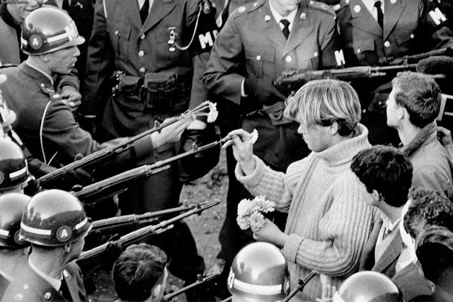
The Historic Photograph
"Flower Power" in 1967

Slide 22
Religion and Philosophy
Religion: organized institutions, with temples, rituals, etc.
  Philosophy is distinct from this
But religions have doctrines, dogmas, authoritative teachings
  Philosophies often provide rational arguments for these teachings
  The philosophies can be very different
    St. Thomas Aquinas and Kierkegaard: two very different Christian philosophers

Slide 23
Existence of God
If religion is defined in relation to the idea of a creator God
  Indian philosophy seems very unreligious
Almost none of the Indian schools defend this idea of a supreme, personal God
  Often “god” = a pure soul
  An Enlightened human being
  A manifestation of an impersonal cosmic principle (Krishna is an “avatar” of the Hindu god Vishnu)

Slide 24
Indian “spirituality”
What do we mean by spiritual?
  The material world is an illusion
    A few Indian schools
  There are other possibilities besides our everyday experiences, and we should seek liberation from this everyday life
    All Indian schools

Slide 25
The mystical
Mysticism: direct experience of a higher order of being through meditation: All Indian schools
  1) But the possibility of this is always argued for on rational grounds
  2) Rational philosophical thought is a prerequisite for the mystical experience
  3) Although this is ineffable, we can argue rationally what it is not:
    “Brahman” is not mind, not a god …

Slide 26
The schools
The 8 main schools
  6 Othodox: accept the Vedas as authoritative
  2 Unorthdox: Buddhism and Jainism
The orthodox schools: divided in pairs
  Nyaya and Vaisheshika
  Samkhya and Yoga
  Vidanta and Mimamsa
The joker: Materialism of Carvaka
  Typical of India v the West: this materialist school does not survive
  Except as a ghostly threat

Slide 27
Authoritative texts
The Vedas (Sanskrit for knowledge)
  Millennium after the Aryan migration into India of 1500 BCE
  Religious verses (mantras), treatises on sacrificial rituals, philosophical speculations (Upanishads)
Upanishads: stimulating, not confining
Later work: Bhagavad Gita—major text for Vedanta
The unorthodox Buddhist and Jains
  They reject the social doctrine of Hinduism: the caste system
  Their teachings however were often closer to the orthodox than some orthodox to each other

Slide 28
1) Tone of Upanishads
Embryonic ideas, stimuli for further development
Tone of intense seriousness
  Tremendous importance for us of a proper understanding of the cosmos and of ourselves
  Not idle curiosity or knowledge for knowledge sake
Our salvation, or true development and ultimate happiness, depends on this knowledge
  Ordinary life is unhappy because we misunderstand ourselves and the nature of reality

Slide 29
2) Main theme, leitmotiv, of Upanishads
Our unhappiness is based on a failure to recognize that
  ordinary experience does not give true reality
  there is a deep connection, even an identity, between ourselves (“atman”) and the cosmos (“Brahman”)

Slide 30
The return home
“I shall remain here [in my everyday existence] only so long as I shall not be released [from the bonds of ignorance]. Then I shall arrive home.”
“That which is the finest essence – this whole world has that as its soul. That is Reality. That is atman. That art thou [Tat tvam asi].”
  Chandogya Upanishad
“I was no stranger in the world, that the inscrutable without name and form had taken me in its arms.” (Tagore—modern Bengali poet)

Slide 31
Loss of innocence
Because of false beliefs and concepts, we feel ourselves to be insecure strangers and aliens in the world
  Because: “man’s naïve at-oneness with the living universe, his essential innocence or sense of fellow feeling, is lost.” Sarvepalli Radhakrishnan
Recall also: Book of Genesis
  Original state of humanity is oneness with the natural world
  But this has been lost because of “knowledge of good and evil”

Slide 32
3) More specific doctrines
1) Tone
2) General theme
3) Specific doctrines
  (1) Samsara
  (2) Karma
  (3) Dharma
  (4) Moksha
  (5) Avidya
  (6) Duhkha

Slide 33
(1) Samsara (reincarnation)
Ordinary experience, the world of becoming
  In which all living creatures undergo cycles of rebirth (reincarnation, transmigration)
  Each creature has countless lives until liberated
This belief is not found in the early Vedas (texts of the Aryan migrants from the north)
  Hence: it is inherited from an even earlier Indian civilization before 1500 BCE
  => Indus River Valley (Harappan) civilization: 2500-1500 BCE
  An egalitarian society, and yet with cities and developed technology (republics!)

Slide 34
Continuity with the early societies
So we see evidence of an earlier philosophy or concept of life
  Closer to the early egalitarianism of hunter/gatherers
  Before the rise of hierarchical states
There were clan republics in the early rise of iron age Aryan society 700-600 BCE
  centered on the Ganges River

Slide 35
What is it that transmigrates?
Rational argumentation enters into the picture with different theories
  The “creature” that transmigrates cannot be a body
  But to say it is a “self” or “soul” is too simple
    Not the ordinary self or soul
    But “the elemental soul” (bhutatman)
This teaching of the transmigrating soul (Atman) is criticized by Buddhism,
  with its doctrine of anatman (no atman or soul)
  which argues against any fundamental soul

Slide 36
Three questions
1) What evidence for this cycle?
  Not generally because we remember past lives
  Though Buddha was said on the night of his enlightenment to have remembered 500 past lives
2) What permits us to say that the elemental soul in creature Y today is the same as that in creature X in a past life?
3) Why does the elemental soul occupy this particular body?
  Good or bad luck?

Slide 37
(2) Karma
“According as one acts so does he become … One becomes virtuous by virtuous action, bad by bad action.” (Brihad-Aranyaka Upanishad)
  I.e., we become who/what we are through our own actions.
  Our actions bear fruit in our future
  And so we must be reincarnated since one lifetime is not enough for this to happen

Slide 38
Our character/dispositions created by our actions
What makes the elemental soul in Y in this life the same as that in X in a previous life?
  The “load” of Karmic effects that Y carries because of actions as X
The individual’s character and set of dispositions are deserved,
  necessary, not accidental or arbitrary
  Cooper cites law of conservation of energy (19): no energy is created or lost, but only transformed
“There is indeed the elemental soul—he, who, being overcome by the bright or the dark fruits of action, enters a good or evil womb, so that his course is downward or upward.” Maitri Upanishad

Slide 39
Arguments for Karma?
Almost none
How does Karma work?
  Also unexplained
But this is true in Western philosophy too
  The law of causality is presupposed, not demonstrated
    Causality: outside forces determine us (materialism)
    India: we determine ourselves!
  How does one thing cause another? (e.g., how does gravity cause the thing to fall?) Also unexplained

Slide 40
Implicit, presupposed moral argument
1) We are responsible for our actions (basic principle of morality)
2) but these are strongly conditioned by the conditions of our birth
  If we were unlucky to be born from an “evil womb” (poverty, criminal parents, genetic disease, etc.)
  then our responsibility would be very limited or nil
But the doctrine of karma says we are responsible for the conditions of our birth as well
  Plato too says this in the Republic when he recounts the Near Death Experience of the soldier Er

Slide 41
Historical context
Iron-age India has the experience of republican governments
  People ruling themselves, without hierarchy
  within their family arrangements (neo-kinship)
But the republics were short-lived, replaced by kingdoms
Q: How do people who have the historical memory of freedom reconcile themselves with this loss of freedom?

Slide 42
Karma = freedom
A: Karma:
  we seem to be unfree, subject to others,
  but we ourselves caused our present state by our own actions
  in another lifetime
Hence we are still free!
  We can change, improve, our state by fulfilling our duties in this lifetime
  → Dharma

Slide 43
(3) Dharma
Cooper says that karma is embedded in or presupposed to the next doctrine: Dharma
  “duty” or “moral obligation”
  Connected to one’s station in life
    Arjuna in the Bhavagad-Gita is a warrior, and so has the duty to fight in battle
    He is a member of the Kshatrya (warrior, political) caste

Slide 44
The world is intelligible
Dharma: the world is an intelligible whole
  “God does not play dice with the universe” (Einstein)
  Objection: “But we can’t explain an individual’s character, feelings and tendencies to act in one way or another”
  Reply: One’s character has been shaped by actions in past lives
  Dharma takes up the slack: we have certain duties because of our karma (the fruits of our actions in the past)

Slide 45
Is Karma unscientific?
Modern scientific-materialist explanation: genes
  But this is not proven in detail
    There are certain inherited genetic diseases
    But is all our psychology inherited?
  It implies determinism: we are not responsible for our actions
Hence, a strong defense of moral responsibility (Dharma)
  presupposes Karma
  as well as Samsara (reincarnation)

Slide 46
(4) Moksha
There is the assumption that Karma is a fatalistic doctrine
  Something bad happens, and some say that that’s your karma
  But we make our karma through our own actions
Moksha
  liberation from Samara = happiness, bliss
Presupposes freedom, responsibility for our actions
  Our dispositions based on past actions incline us (not determine us) to certain future ones
  But we can overcome this, change direction, transcend our past: become happy fulfilled individuals

Slide 47
(5) Avidya
Overcoming Samsara depends on overcoming ignorance (Avidya) regarding our true relation to the cosmos
  E.g., the false belief that the self is necessarily connected to the body (materialism)
What immediately binds us to Samsara are our desires and motives for action
  feeding off a false conception of self
With enlightenment this will evaporate
  leading to disinterested action

Slide 48
Cessation of illusions
With “cessation of every illusion there is a falling off of all fetters [i.e., desires that bind us to certain actions] … (and so) cessation of birth and death.”
  Svetasvatara Upanishad (21)

Slide 49
(6) Duhkha
But why isn’t ignorance bliss?
Maybe it’s a good thing to be reincarnated
Q: What is the problem that makes us want to be liberated from Samsara?
A: Duhkha (Suffering)
  Pleasures are ephemeral, soon over, and then we crave new ones
  We are addicted to them, and soon bored
All these ordinary pleasures that we crave are nothing compared to the true bliss and happiness, Moksha
  Samsara is a prison house, a wheel of birth and rebirth
  Cessation of Duhkha is a state of blissful freedom

Slide 50
Avidya: Bad faith (wilful ignorance)
We can hide all this from ourselves, thinking that in our ordinary lives we are content
  with our grasping at things, our attachments
  our identity with our bodily existence
Ignorance (Avidya) of our true nature may be bliss
  But it is a culpable ignorance
  We live in bad faith regarding who we really are and what we are really feeling

Slide 51
The framework and the schools
These sets of doctrines are the framework
The task of the schools:
  To provide a comprehensive account of ourselves and our relation to the universe
  to dispel the ignorance (Avidya) inherent in our everyday beliefs
  To show the unsatisfactoriness (Duhkha) of this ordinary life
  This account must be so communicated and meditated on that we no longer want to perform actions that produce Karma and bind us to Samsara
  So that we consciously, purely, follow the moral law (Dharma)
  And attain (Moksha)

Slide 52
2) Nyaya and Vaisheshika

Slide 53
Common sense view of reality
Westerners who follow the tradition of “common sense” empiricist philosophy will find Nyaya (“logic” or “reasoning”) more congenial to them
  with its emphasis on perception and logic
But the “soteriological” (salvation) context is in the background of Nyaya
  Perception and logic are necessary for the cessation of Duhkha and for Moksha
  The means of right knowledge (pramanas) involving perception and logic are important steps in overcoming ignorance (Avidya)

Slide 54
Two sides: ontology and epistemology
Major author: Vatsyayana (4th c. CE)
  Famous author of the Kama-sutra
  Also wrote the Nyaya-sutras
Two stages culminate in the 11th c. in a single doctrine
  Vaisheshika ontology (atomism, plural realism)
  Nyaya epistemology (theory of knowledge based on ordinary perception and reasoning)

Slide 55
The nature of the world
The world is
  independent of thought and perception
    i.e., not dependent on our points of view
  and composed of many different substances underlying the properties we perceive
The separate nature of these substances corresponds to our clear, direct perceptions of the world
  These substances that we perceive can in turn can be divided
  The ultimate limit of division: the atom

Slide 56
Different kinds of substances
Substance:
  1) Indestructible material atoms → compounds
    → Chairs and trees of ordinary experience
  2) Space and time
  3) Immaterial eternal souls (atman)
    underlying consciousness and feeling
Absence is also a substance
  Jean-Paul Sartre defends this too: I go to the café to meet Pierre, and he is not there
  His absence is a reality in my world, alongside the people, tables and chairs of the cafe

Slide 57
Epistemological battles
Skeptics and idealists would reject these ideas and claim otherwise
  based on a theory of knowledge
  E.g., the world seems to be independent of consciousness, but an adequate theory of knowledge refutes this
Against such skepticism, the Nyaya epistemologists are the allies of the Vaisheshika ontology
  Our ways of knowing do indeed support plural realism

Slide 58
Philosophical debate
The Naiyayikas (defenders of Nyaya) opposed alternative theories of knowing that were more commonly held
  The Samkhyans say that the apparent differences in the world are expressions of a single underlying nature
  which we divide through our conventional mental distinctions
Recall Taoism of Chuang Tzu

Slide 59
Pramanas
But the pramanas (means of right knowledge) refute these positions:
  1) Perception,
  2) inference,
  3) comparison, and
  4) word

Slide 60
Perception and Inference
1) Perception – direct experience of reality
2) Inference – reasoning from this to something not directly perceived
  An event is perceived
  We infer that it must have been caused by something prior to it
  E.g., we infer the existence of a God (Ishvara) as the cause of the material world

Slide 61
Proof of God from effects to cause
One of the nine Nyaya proofs of the existence of God: Kāryāt ("from effect"):
1) An effect is produced by an efficient cause,
  Z ← Y ← X ← W … ← A (?)
  If the chain is endless nothing is ever caused
  Hence A must be an Uncaused Cause
2) The world is an effect
3) and so must have a cause, ← God
  which is not caused by something else

Slide 62
Big Bang
Compare to Big Bang theory:
  The present expanded universe comes out of a previous state that is smaller
  The previous state comes from an earlier one that is smaller yet
  The first state is a Big Bang explosion from a single point
Nyaya/Vaisheshika: Something must cause this first event, and that is God

Slide 63
3) Comparison
I directly perceive something in sensory experience
  independently of words or concepts: There is this
But when I know this as an ox I employ comparison with other objects of experience
  I use concepts based on other experiences
  And form a judgment: “This is an ox before me.”
This mental process of combining (Nyaya) corresponds to objective physical processes (Vaisheshika)

Slide 64
Proof of God from combination
The Āyojanāt Proof (from combination)
1) Atoms (corresponding to bare thises) are inactive.
2) To form a substance, they must combine (corresponding to judgments)
3) To combine, they must move (inference 1)

Slide 65
4) Nothing moves without intelligence and a source of motion. (inference 2)
  Pure blind combinations would result in chaos
5) Since we perceive organized substances, some intelligent source must have moved the inactive, unintelligent atoms (inference 3)
→That intelligent source is God

Slide 66
4) Word: Testimony
Verbal Testimony (sabda) is a fourth source of knowledge
  Not commonly admitted in western philosophy
Why not?
  Western philosophy is individualistic because the early states (e.g. Greece) replaced kinship with legal systems governing separate independent individuals
  But Eastern philosophy supposes kinship as an essential condition of experience: interdependence of individuals

Slide 67
We depend on others
The assumption is that verbal testimony is reliable
  No individual can achieve adequate knowledge by herself
  We depend on others for our knowledge
  Hence the scriptures, the testimony of mystics, can play a legitimate role in knowledge
Hence knowledge depends on matters seen by others, not only by the separate individual
  → reasoning regarding the unforeseen

Slide 68
Proof of God from Karma
Adŗişhţāt (lit., from the unforeseen):
  Perception, judgment, and comparison: It is seen that some people in this world are happy, some are in misery.
    Some are rich, and some are poor.
  Testimony: The Naiyayikas explain this by the concept of Karma and reincarnation
Naiyayikas base their argument on inference for the future

Slide 69
Inference for the future
The fruit of an individual's actions does not always lie within the reach of the individual who is the agent.
  E.g., we perform a kind deed for someone else
  But this does not always result in a benefit for ourselves
  But our actions should bare fruit for ourselves, whether good or evil (karma)
There ought to be, therefore, a dispenser of the fruits of actions, and this supreme dispenser is God.
  But it is still our own actions that are responsible for these fruits in the future (in our next lives)

Slide 70
Bootstrapping?
Objection: these pramanas are interdependent and circular
  Q: How establish the validity of testimony?
  A: By accepting the testimony of the Naiyayikas
  = “bootstrapping”
I.e., the Naiyayikas argue that their way of reasoning is the correct one
  by appealing to the testimony of their own tradition
  i.e., they are lifting themselves up by their own bootstraps

Slide 71


Slide 72
The truth that there is no truth
This objection points in the direction of skepticism
The universal skeptic says there is no truth
  But that is a truth: the truth that there is no truth
  Pure or universal skepticism is self-defeating
A limited skepticism must admit some true means of knowledge to be skeptical of Nyaya
    The skeptic must then justify that by some other means
    including the testimony of others

Slide 73
Are the pramanas lamps or pots?
Some Naiyayikas say that the pramanas do not need to be justified, because they are self-illuminating
  A lamp also illumines itself
Objection: But the pramanas are not necessarily lamps;
  maybe they are like pots, which do not illuminate themselves (Vatsayana)

Slide 74
Mutuality of pramanas
Vatsayana argues: the pramanas “are established by themselves mutually.”
  = Overall coherence
E.g. what we believe on the basis of inference or testimony coheres with other perceptions
  The four pramanas cohere together to produce a large and consistent body of knowledge
  This contributes to overcoming ignorance, duhkha, and the wheel of samsara

Slide 75
No absolute foundation
→There is no need for some absolute foundation for knowledge
  i.e., some direct insight into the truth like that of the Taoist Sage or the mystic
Rational argumentation with its different parts, its steps from one position to another
  is suitable and adequate for attaining truth

Slide 76
Historical context
Recall the historical context
  Why does the bottle of wine have the same monetary value as the bushel of wheat?
  The merchant exchanges goods based on mathematical reasoning rather than intuition
  Assuming that such reasoning corresponds to the nature of the different objects being exchanged

Slide 77
Necessity to go beyond sensations
Sensory experience is not enough
  It is necessary to make judgments based on comparisons (wine and wheat)
  It is necessary to make inferences that go beyond sensory appearances
  It is necessary to rely on the testimony of others regarding the value of the goods

Slide 78
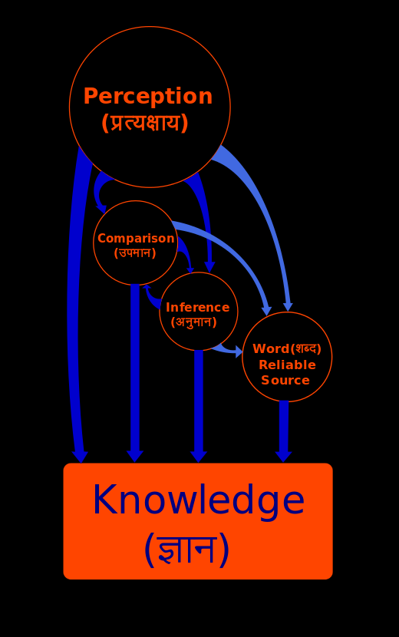

Slide 79
3) Samkhya and Yoga

Slide 80
Samkyhan dualism
Samkhya means “discrimination” or “discernment”
  Samkhyan dualism of soul (purusha) and nature (prakriti)
  Main text of Samkyan thought: Ishvarakrishna’s Samkhya-karika
Yoga means “join” or “yoke” or union
  How do the two sides work together, harmonize
  Main Yoga text, Patanjali’s Yoga-sutra
Samkyha is said to be the oldest Indian school
  But the dualism of “soul” (purusha) and “nature” (prakriti)
  conflicts with the central doctrine of the Upanishads: the oneness of atman (self) and Brahman (“absolute reality”)

Slide 81
Three primordial thoughts
Perhaps the oldest, because it elaborates primordial responses
  Earliest reflections on the nature of the world,
  the nature of human beings,
  and the relation between the two
1) The sense that the world is a single coherent whole
  →Recall: early animism, oneness with nature
2) But human beings are unique, set off from the natural order
  →Recall: Technology and social developments seem to separate us from nature

Slide 82
Unity in difference
3) Everything is for us
  There is some vital link between ourselves and “the ponderous enormity of things” (Tagore)
  i.e., restore the connection while maintaining the separation: connection in separation
Contrast with Taoism
  Chuang-tzu: Connect with the underlying oneness of the Tao
  Recall: China unites; India divides

Slide 83
Three doctrines
1) There is a single material substance, prakriti
2) There are an infinite number of distinct souls or purushas
  Pure immaterial consciousnesses
3) Prakriti exists for the sake of the purushas
  It has evolved so that the purushas may exist in a state of liberation
  by realizing their absolute distinction from prakriti

Slide 84
Where do the elements come from?
Samkhya recognizes that things are composed of elements (the position of Nyaya/Vaisheshika)
  but all elements evolve from a single dynamic substance, the Prakriti
What is the evidence for this?
  Objection (Nyaya): We do not directly perceive this prakriti
  which contradicts our ordinary perceptions
Alternative epistemology of Samkhya:
  But we do not directly perceive things at all, but only pictures or representations, constructed in the mind-organ (manas)

Slide 85
How do we know this?
How do we know the oneness of the material universe?
  Some individuals may have a direct intuition of the oneness of the cosmos in meditation
  But the main argument is reasoning by inference from the nature of causality

Slide 86
Where there’s smoke, there’s fire
E.g., smoke is caused by fire
  It is contained within the fire and then arises from it
    If the effect were not contained in the cause, then anything might cause anything
    There would be no order in the universe—contrary to what we experience
  Fire however comes out of the wood that burns
If every effect arises in this way from out of its cause
  This leads back to one general cause of this “many-sided universe”
  on account of “the difference and the non-difference of cause and effect” (Ishvarakrishna)

Slide 87
Difference from Nyaya-Vaisheshika
N-V: the cause is distinct from the effect
  Leading to a God outside of the world
  Who creates the separate elements
  And then must guide their relation to one another to produce order
  Including the relation between the human action and its effects (Karma)

Slide 88
In the beginning: Prakriti
But Samkhya argues
  that the effect is contained within the cause
  leading to one general cause from which all the effects develop
Prakriti divides into the separate elements,
  which remain related because they all come out of the same source,
  “Prakriti”—
This is the universal “ground of being”
  containing all the effects within herself
It is not possible to refer to an external creator God
  because the cause is not outside of the effect

Slide 89
Big Bang
Compare to Big Bang theory:
  The present expanded universe comes out of a previous state that is smaller
  The previous state comes from an earlier one that is smaller yet
  Everything in nature (Prakriti) is contained within this unitary starting point,
  which expands and self-divides for the purpose of serving souls (Purusha)

Slide 90
Different perspectives
N/V: what caused this starting point?
  Z ← Y ← X ← W … ← A (?)
S/Y: There is no need to raise this question because
  everything is contained within Nature
  which is develops or unfolds itself (Herself)

Slide 91
Nyaya v. Samkhya
Nyaya/Vaisheshika: Something must cause this first event, and that is God
  But this is based on a conception of causality in which effect and cause are separate beings
Samkhya: Everything is contained within the initial moment
  Z is within Y; Y is within X; X is within W etc.
  → all is within A, and there is nothing outside It
  → no need for an external, creator God
  → the material/mental universe is itself divine (Prakriti)

Slide 92
The gunas
Prakriti is composed of three threads (gunas)
  Evolving in stages from an original balance that gets disturbed
  The Big Bang = the Big Disturbance or the Big Unbalancing
1) Elements of the material world arising out of the oneness of Nature
2) More refined matter of the perceptual senses (sight, hearing, etc), the conative (practical) senses of (desire, will, etc.),
3) And the mind-organ, which organizes the data of the senses

Slide 93
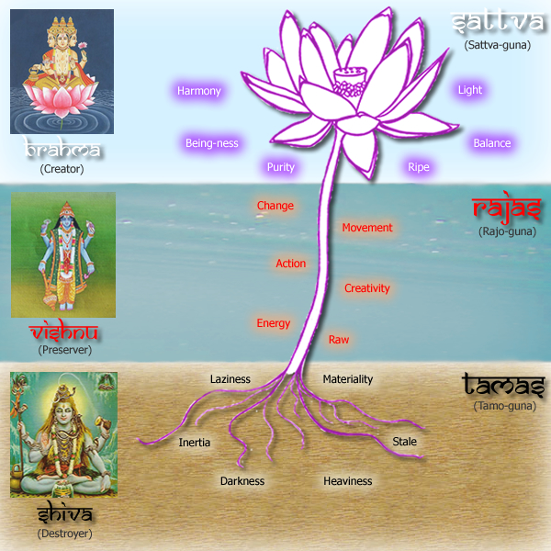

Slide 94
Evolution of matter
Evolution involves increasing refinement of matter
  The Samkhyan dualism is not a dualism of matter and mind
  For mind is a refined kind of matter
  Intelligence (buddhi) is a stage of matter
Prakriti is a single reality that evolves into complexity and refinement, including mind

Slide 95
The witness
Purshua is different; it is not mind
  It is multiple, not single
  Each purusha is simple and passive:
  “a witness, isolated, neutral, cognizing, and inactive” (Samkhya-karika)
What it directly witnesses (knows) are
  mental states, pictures in the mind-organ
  coming from sense data

Slide 96
Analysis of perception
A perception is composed of
  prakriti
    An external object
    and its representation in the mind
  pursha
    The witnessing consciousness
Lower animals can perceive and desire
  And so have minds
But only higher animals and humans have souls (Purushas) and are self-conscious

Slide 97
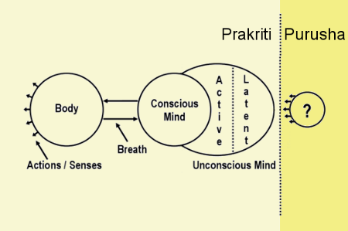

Slide 98
How do we know the purusha?
Normally, we do not directly perceive purusha
  Purusha is like a lamp (flashlight) that shines on other things—the mental objects
  but not on itself
  Recall: some N-V say the pramanas are self-illuminating
We normally only know purusha through rational inference
  “Since the aggregate of things is for the sake of another;
  … since there is superintendence,
  and since there is activity for sake of isolation,
  the soul exists.” (Ishvarakrishna)

Slide 99
How explain the striving for liberation?
1) Mental states are focused on objects
  Hence to be conscious of them (“superintendence”) there must be something else
2) If there were nothing but prakriti, there would be no striving toward liberation (moksha)
  The world (including mental representations and desires) would just be what it is
But we humans do have this striving (unlike cows) (“activity for the sake of isolation”)
  Q How explain this?
  A There is in us something beyond the material/mental world: the soul, the purusha

Slide 100
Liberation
Liberation requires discrimination (Samkhya) between Prakriti and what one truly is—a pure consciousness
  Otherwise there is clinging to the material world of the senses
  and so pleasure and pain
  and entrapment in the cycle of rebirth (samsara)

Slide 101
The purpose of nature
3) The whole evolution of nature (prakriti) must have a purpose
  There is no creator (no external cause)
  But everything is evolving beyond itself to … ?
    E.g., prakriti > wood > fire > smoke …
    the liberation of purusha!
Once all purushas are liberated the material world will have served its purpose, and vanish
  Prakriti is like a dancer who “having exhibited herself on the stage, withdraws.”
  Prakriti “withdraws from the soul when she has manifested herself to it” in all her distinctness from it

Slide 102
The blind man and the cripple
Hence, despite their difference, there is an affinity of prakriti and purusha
  Nature is leading the pursusha to liberation
  Only obstinate clinging to things prevents this
There is a cooperation between prakriti and purusha
  Like that of a blind man and a cripple who work together for the goals of each

Slide 103
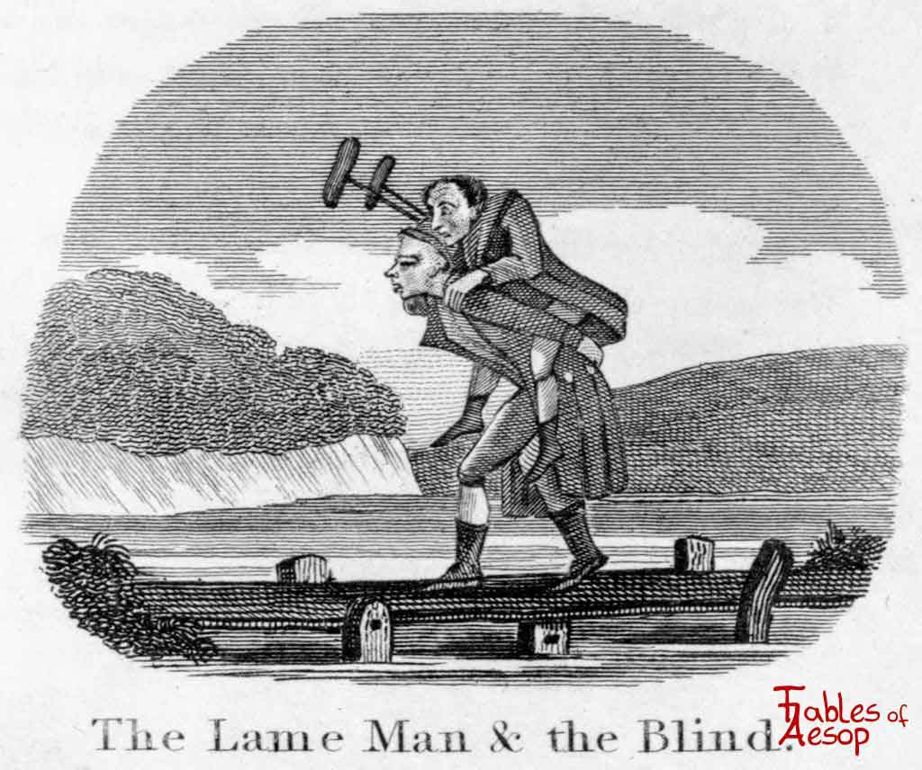

Slide 104
From Samkhya to Yoga
Ishvarakrishna’s Samkhyan duality (Samkhya = discrimination) is complemented Pantanjali’s Yoga (= unity)
  1) a new approach to the existence of God that is internal to consciousness
    Not the argument from causality of the Naiyayika/Vaisheshika school
  2) a new method of attaining liberation (Moksha) based on inner meditation

Slide 105
Ontological argument for the existence of God
Pantanjali’s yoga rejects Samkhyan atheism
His “ontological argument”: proving the being (being= ōn in Greek) of God from the logic of ideas about God
  1) In moving toward liberation we have an idea of a perfect purusha
    one that was never tainted by the material world
  This idea is implicit in all our striving to be better than we are, our striving for happiness, liberation: an idea of Perfect being

Slide 106
From idea to being
2) This idea implies the existence of such a being for if it did not exist, it would not be perfect
  (1) If our idea of the Perfect Being was not real, did not exist
  (2) then we could think of an even better being than the non-existing Being we are thinking about: a Perfect Being that did exist.
  (3) And so our first idea of the Perfect Being would not have been an idea of a Perfect Being.
  (4) And so since we do have an idea of a Perfect Being, we must think of this Being as existing.
3) Hence a perfect being, God, must exist

Slide 107
The God Ishvara
The god Ishvara:
  not the creator, but one of the many purushas
  Helps coordinate the relation of Prakriti and the Purushas
  The model of enlightenment
  One object of meditation, the existence of whom some yogins testify

Slide 108
Purpose of meditation
Purely rational discrimination of the difference between prakriti and purusha
  is insufficient to uproot our attachments
Meditation is a state in which we uproot ourselves from our inherited dispositions (samskaras)
  Yoga stresses that the true nature of purusha is attained in prolonged meditation leading, in 8 steps, to Samadhi
  involving “complete restraint of mental activity” in which purusha rests blissfully in itself (Moksha)
  Buddhism: Samadhi is the last step of the Eightfold Path
  → stop thinking and just dwell on the purusha within yourself

Slide 109
The different tendencies of the two schools
We see here a difference in tendency between
  Samkhyan emphasis on theoretical rational concepts
  and Yogic practical mysticism

Slide 110
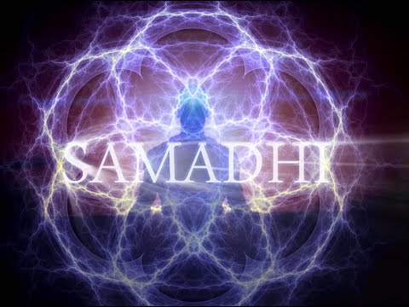

Slide 111
Problems: 1
General problems for all dualisms:
1) How can two radically different worlds interact and be connected?
  Reply: Samkhyans say that matter becomes increasingly refined or translucent so as to reflect purusha
2) If the only objects for a purusha are material ones,
  how do we know other purushas exist?
  Why not believe that everyone else is prakriti, and only I am purusha (solipsism)?

Slide 112
Problems 2
Particular problems for Samkhya-Yoga :
How make sense of this pure, unchanging consciousness?
  We have very different experiences
    A toothache
    Enjoying beautiful music
  How can there be the same consciousness behind these different states?

Slide 113
Different purushas?
If the purushas are absolutely simple how can one be different from another?
  Why not the same pure consciousness in all?
  And if they are different, how do we know that our pure consciousness of one week is the same as our pure consciousness the next week?

Slide 114
Problems 3
Problems relating to the Indian framework:
1) How does all this relate to the goal of moksha?
  If the soul is “eternally free, then there is no bondage and no release” (the non-dualist Vedantin Ramanuja)
Reply: to feel release, one must first experience bondage or the illusion of bondage
  But who/what experiences this? The mind, or the Purusha/soul?

Slide 115
What happens after liberation?
2) If the purpose of purusha is to be conscious of the mental representations, when these dissolve what will it do?
  It is doomed to be a pure nothing

Slide 116
Closing the divide
In the light of these issues,
Samkhya/yoga provides one response to the primordial question of the relation of the human being to the natural world
  stressing the difference
But others try to close this divide

Slide 117
4) Advaita Vedanta

Slide 118
Non-dualism
Vedanta: “end of the Veda”
  Main text: Bhagavad Gita
Versions of Vedanta
  Advaita (non-dualist)
  Vishishtadvaita (qualified non-dualist)
  Dvaita (dualist)
Here we focus on the most well known and influential theory: Advaita (non-dualism)
  This is what is so far new for us

Slide 119
Teachings
Leading Advaitin: Shankara (9th century CE)
  “The Indian Thomas Aquinas”
  Blending scripture and reason like Aquinas
Accepts the six doctrines of the Upanishads
Main teachings:
1) Nothing is real except Brahman
  Unitary
  Ineffable

Slide 120
2) What we ordinarily call reality is an illusion (Maya)
  Physical objects
  Persons
  Gods
3) Individual selves are not real:
  we are reflections of a single Self, Atman
4) Since reality is one, Atman = Brahman
  Hence Brahman must be pure consciousness

Slide 121
5) Belief in the external world is due to ignorance (avidya)
  We superimpose our false believes on Reality (Atman/Brahman)
6) Liberation from our attachment to the world through our desires, based on our false beliefs:
  through experiencing the identity of Atman and Brahman
  in a self-luminous flash

Slide 122
The Great Sentences of the Upanishads
1) Neti, neti
  Not this, not this
2) Tat tvam asi (That thou art)
  i.e. You (as Atman) are That (Brahman)
3) Atman and Brahman are identical

Slide 123
Ritual pegs or truth?
The Mimamsa school:
  these are pegs for performing rituals, not literal truth
  How can two things, “That” and “Thou,” be one?
Shankara: “’That’ and ‘Thou’ refer to one and the same entity.”
  Atman and Brahman are not separate things that can be indicated by these two words
  On this superficial level the sentence is obviously false
  The words indicate a truth that can only be grasped in direct intuition

Slide 124
Role of reason
But reason plays an important role here
  through the critique of the dualism of the Samkhya/Yoga position
It would be depressing if dualism were true
  We would be strangers in the world
  Identity of Self and Reality → “a state beyond fear or danger”
  A doctrine of being a self-awareness that needs nothing else → “a sense of completeness that is also ananda (delight)”.

Slide 125
Agreements with Samkhya
Advaitins agree with certain Samkhya or Yoga assumptions:
1) The Self is a pure consciousness, a witness
  Mental processes are not directly conscious
    They are focused on something else, not on themselves
    Hence a witness consciousness is needed (self-consciousness)
  Shankara adds: “It is inconsistent to deny the Self, for it is the Self that would do the denying” (Shankara)

Slide 126
Prakriti = Maya
2) It is ignorance (avidya)
  to confuse the empirical mind or ego
  with the pure witnessing consciousness
3) The things in the world are contained in a single cause
  But this does not go far enough for the Advaitins: Prakriti is an illusion (Maya)

Slide 127
Disagreements
1) Re: the existence of many souls (purushas, jivas) is unintelligible, because once the self is stripped of what belongs to the world
  Body
  Senses
  Emotions
  Intellect
there is nothing left to distinguish one’s Self from that of another person
  Just as there is only one Space,
  despite the seemingly separate spaces in the different pots and jugs

Slide 128
How can nature and soul be related?
2) Re: the distinctness of Purusha and the natural order (Prakriti)
  Samkhya says that Prakriti exists for the sake of Purusha
  But purpose implies that Prakriti is conscious—which everyone agrees is not the case
  But if Prakriti is not conscious how can it be “for” anything’”?
Hence there can be no relation at all between Purusha or the soul and the natural world
  The lame man and the blind man can help each other because they belong to the same order of nature

Slide 129
Ishvara?
No appeal to a god (Ishvara) to coordinate can help,
  How such a god would be able coordinate two radically different realms is unintelligible
    If Prakriti and Purusha are radically different not even a God would be able to unite them
  Properly understood, Ishvara is only a personification of Brahman

Slide 130
What is real?
Something must be real
  Our illusions must be superimposed on something
We know what this is: Atman
  From scripture
  From experience of ourselves
  From reasoning
Hence Brahman, the whole of reality, must be equated with Atman
  And not divided into Atman and something else, i.e., Purusha and Prakriti
  For then the relation between these two different things would be incomprehensible

Slide 131
All that I really know is my Self
The one thing we do know: our own conscious experience
  And so we must deny the reality of the material world
  which includes minds
Samkhya is right that
  Liberation depends on the discrimination between the Self and everything else
But this is just the first step

Slide 132
Maya
Step 2: recognize that this something else, the material world, is an illusion (Maya)
  The distinction we make between the two is only provisional, only a first step
Then I am no longer a stranger in this world
  And so I experience freedom, self-completeness, bliss (Ananda)

Slide 133
The price of bliss seems too high
The price for “bliss”: reject common sense altogether
  Why not just say that the relation between consciousness and the world is unintelligible?
  Advaitins cannot say that something doesn’t exist because it is not intelligible
  for they admit that Atman/Brahman is unintelligible
Reply: but we directly intuit this in meditation

Slide 134
Idealism?
The idealist route for denying the material world:
  to say that all we know of material objects are the perceptions and ideas we have in our minds (Bishop Berkeley)
  Stable, persisting ideas are caused in us by God
But for Advaita, minds, feelings, and perceptions too are unreal
  “Suffering does not (really) exist.” (Shankara)

Slide 135
Level one
How understand this? Doctrine of Levels:
Level one—lower level
  We can indeed distinguish between real objects and unreal ones (e.g., hallucinations)
  Between causes and effects
  Between this person and the next one
  Between the true god and false ones

Slide 136
Level two
Level two—higher level
  No objects are real
  The effects of the one cause (Brahman) are merely apparent
  No individual selves exist
  Even the “true” god is an appearance

Slide 137
Analogies
Analogies
  Between the sea and the froth
    But if the sea (Brahman) creates the froth (material world), the material world is still real
  Between space and the space in the pot
    Pantheism?
  Between the sun, and its reflection in pools
    There is no sun in the pool, but the reflection of the sun in the pool is real
“No analogy is perfect” (Shankara)
  Cooper: this is an understatement

Slide 138
Define “real”
Shankara: objects at the lower level are unreal because they are not “constant and eternal”
  But this is a special (arbitrary) meaning for “real”
  Anything that changes would then, by this definition, be “unreal”
Is “maya” then
  an ordinary doctrine that everything changes dressed up in exciting, but misleading, terminology?
  A mad doctrine?
  A dull one that only seems mad?

Slide 139
An ordinary doctrine?
1) An ordinary, dull, doctrine, dressed up in exciting terms?
  “Reality” means that which is eternal and unchanging
    E.g., Pythagoras’ theorem
  Hence temporal things would be “unreal” or “maya”
But this is just using misleading terms to describe the ordinary, dull, common sense position

Slide 140
A mad doctrine?
2) But if it means what it says, it at first sounds completely crazy
  It says that the world of things around us are not real; are illusions, hallucinations, dreams
  So it is important to think about the nature of dreams and reality
Recall Chuang-tzu

Slide 141
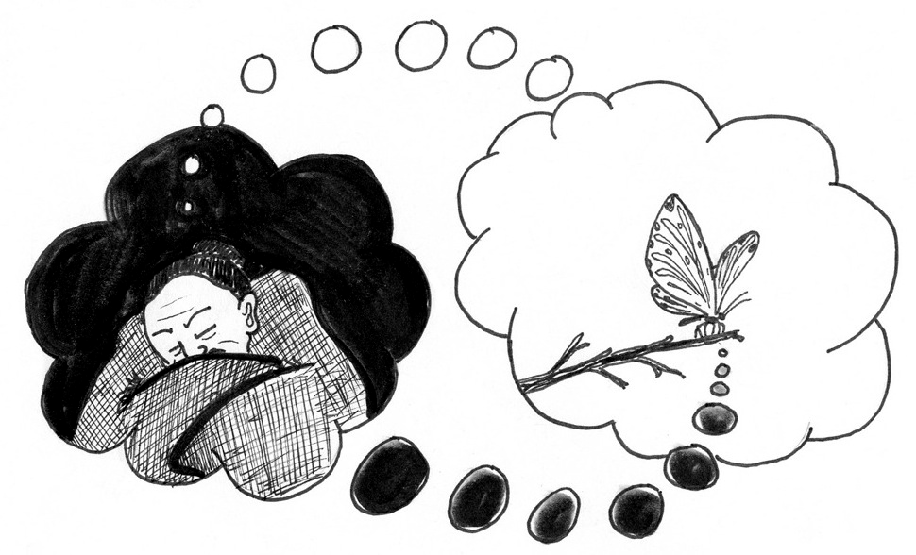

Slide 142
Maybe it’s all a dream
When we are dreaming, we think the dream is real
  But on waking we realize it is unreal
  But then, might not our waking life be another dream, once removed?
  from which we will one day wake up, when we are enlightened?

Slide 143
Seeking pink elephants
1) Distinction between hallucination and reality
  The drunkard sees pink elephants
  But they disappear when he sobers up
What makes the hallucination unreal?
  It doesn’t cohere with the rest of experience (when we become sober)
A dream is unreal in this sense: it doesn’t cohere with waking experience

Slide 144
Waking up from ordinary life
2) “The dream world is sublated each morning when we awake, whereas the waking world remains until ultimate realization of Brahman’s identity with the Self (atman).” (Shankara)
  There is a direct intuition, a self-luminous flash
  which contradicts ordinary experience
If we haven’t had this experience, the closest we come is in deep sleep, in which
  there is no dream
  there is no waking world

Slide 145
Words
Hence the special experience is indescribable
But reason supports it
  When we recognize that the world of ordinary experience depends on words (shabda)
  “Gods, men, and the world originate from Shabda, word … Words precede things.” (Shankara)
  = “linguistic idealism” or “linguistic relativism”

Slide 146
Being as such
Being as such is without shape or structure
  We supply these through our words and concepts
  Without these conventions on our part, thought and action would be impossible
  But there are different languages, different conventions
  The categories we use could be different from what they are
How then can we suppose that
  our way of looking at the world
  depicts reality as it is in itself?

Slide 147
What is Being?
Brahman = Being
  We superimpose our constructs on this ultimate Reality, on what is, on Being
  which we experience within ourselves
In the visionary experience that all is one
  words and concepts lose all necessary connection to reality
  and we glimpse the seamless whole which our mental categories have divided
Hence Advaita Vedanta is neither mad nor dull

Slide 148
Some problems
1) too much seems to rely on a special experience of direct intuition
  How tell the difference between a “true” special experience
  and others, involving a different conception of reality?
2) Does Shankara’s conventionalism go far enough?
  He holds that there is a permanent self (atman).
  But perhaps this too is a construction of words

Slide 149
Being at home?
3) How can I feel at home in such a Reality?
  of which there can be no articulate understanding
  of which the closest comparison is deep sleep
All these issues were already raised before Shankara by adherents of the greatest of the unorthodox schools, Buddhism

Slide 150
Bhagavad-Gita
The main text of Advaita is the Bhagavad-Gita (Song of God)
  Krishna on the battlefield of Kurukshetra
  Seeing his cousins and kin on the opposing side
  He cannot fight and kill them
Krishna explains to Arjuna why he must fight

Slide 151
Neo-kinship and legalism
Recall: India is a neo-kinship society
  In Greece the sons of Oedipus do fight and kill one another, and there is no report of their being unwilling to do so
  It’s their sister, Antigone, who cries, but she is a woman, and immersed in the kinship world of the family and home
  But Greece has rejected the kinship system for legalism

Slide 152
Krishna’s Reply
12. It is not true that at any time I was not, nor thou, nor these kings of men; nor is it true that any of us shall ever cease to be hereafter.
13. As the soul passes physically through childhood and youth and age, so it passes on to the changing of the body. The self-composed man does not allow himself to be disturbed and blinded by this.

Slide 153
The transience of matter
14. The material touches, O son of Kunti, giving cold and heat, pleasure and pain, things transient which come and go, these learn to endure, O Bharata.
15. The man whom these do not trouble nor pain, O lion-hearted among men, the firm and wise who is equal in pleasure and suffering, makes himself apt for immortality.

Slide 154
Being and Non-being
16. That which really is, cannot go out of existence, just as that which is non-existent cannot come into being. The end of this opposition of 'is' and 'is not' has been perceived by the seers of essential truths.

Slide 155
Immortality
17. Know that to be imperishable by which all this is extended. Who can slay the immortal spirit?
18. Finite bodies have an end, but that which possesses and uses the body is infinite, illimitable, eternal, indestructible.
Therefore fight, O Bharata.

Slide 156
The true Self does not die
What is killed is not the true Self, but the shadow, the illusion – which does not really exist anyway.
The true Self is eternally linked with the Self of others: this is the true (spiritual, philosophical) meaning of kinship.

Slide 157
Do your duty and fight!
Do your duty (Dharma) as a warrior prince – your destiny in this life as determined by your caste duties
without attachment to consequences (joy over victory, sorrow over deaths etc.)
  (Get off the emotional rollercoaster)

Slide 158
(1) Being
Being cannot come out of non-being
If once there was nothing at all, now there would be nothing.
Hence being is eternal

Slide 159
(2) Non-Being
Inasmuch as anything is not, it cannot be.
Nothing can come out of nothing.
Non-being is nothing and can never become anything

Slide 160
(3) That which changes
Changing beings seem to be a mixture of being and non-being
Changing things come into being from what they no longer are and pass away into what they are not yet.
Change includes both “is” and “is not,” being and non-being
But only being is; non-being is nothing!
So change is an illusion! (Maya)

Slide 161
(4) Who/what are you?
Who are YOU really? A changing being?
  You were a baby but are not one now
  You will be an old woman, but are not this yet.
  As an old woman you will no longer be what you are now.
  Are YOU these changing forms that you tend to identify with?

Slide 162
(5) Illusion of these fleeting forms
Inasmuch as I am a changing being of time, I am focused on past and future, which do not exist.
This mental attitude involves us in Maya (Illusion)
My true being is in the present moment of Now, of Being, the moment of I AM
Inasmuch as I AM, I AM Eternal, Divine
Tat Tvam Asi (Great Sentence of Upanishads)
  That Thou Art
    English and Sanscrit are Indo-European languages
  You are IT
  IT/You ARE!

Slide 163
The Great Sentence
Tat Tvam Asi (Devanagari: तत्त्वमसि, Vedic: tát túvam ási), a Sanskrit phrase, translated variously as "Thou art that," (That thou art, That art thou, You are that, or That you are, or You're it) is one of the Mahāvākyas (Grand Pronouncements) in Vedantic Sanatana Dharma. It originally occurs in the Chandogya Upanishad 6.8.7,^{[1]} in the dialogue between Uddalaka and his son Śvetaketu; it appears at the end of a section, and is repeated at the end of the subsequent sections as a refrain. The meaning of this saying is that the Self - in its original, pure, primordial state - is wholly or partially identifiable or identical with the Ultimate Reality that is the ground and origin of all phenomena.
  https://en.wikipedia.org/wiki/Tat_Tvam_Asi

Slide 164
(6) Practical Conclusions
Focus therefore on what you must do now, your duty in the reality of present Being, not on illusory ideas of past and future.
  The Way for you is determined by your Duty (Dharma)
Don’t dwell excessively on possible future consequences, which exist now only as imaginings in your mind.
Discover your true, immortal Self as a basis for action
This is not about contemplation but action.

Slide 165
Why being, and not nothing?
What is being?
  If at one time there was absolutely nothing, would there be anything now?
  Nothing can come out of nothing
  And so being must be eternal
Hence only being is, and nothing is nothing at all
  “Eternal” is not just about the truths of mathematics
  but it is the nature of being/reality/Brahman itself!
  And yourself, inasmuch as you are.

Slide 166
Are changing things real?
What about ordinary changing things? Aren’t they real?
  But a changing thing is something that is not now what it was before
  A changing thing is something that is not now what it will be later
Hence, changing things are a combination of being and non-being
  But non-being is nothing, only being is real
  Hence changing things are unreal, illusory (Maya)

Slide 167
Past and future
What are you really worried about?
1) Something that happened yesterday
  But yesterday is gone; it no longer is
2) Something that will happen later
  But the future does not yet exist; it is not yet
3) Being in the present?
  Is there anything right now to worry about?
  Just focus on the lecture! (It’s your dharma!)

Slide 168
Imagination
Normally we are caught up in the past or future
  We imagine what happened before or what will happen later
  →We treat what is unreal as real
  We live our lives mostly in our imagination, i.e., in an illusion—maya!
The only reality is what is now

Slide 169
What about now?
But what is happening now?
  Try to focus on something that is purely here and now
  It’s gone before you can grasp it!
Is present being real, if it vanishes in a flash?
But there is reality:
  We intuit this beingness that continues through the vanishing moments of time
  What is it?
Advaita: the oneness of Atman/Brahman

Slide 170
Contemporary analogies
Recall previous analogies of Shankara for Maya
  The froth on the sea
  The space in the pot
  The reflection of the sun in a pool of water
Contemporary analogies from virtual reality
  Video games
  Movies

Slide 171
Avatar
In video games, the player creates an “avatar” to represent him or her in the game
  What is an “avatar”?
  In Indian religion: it is the incarnation of God/Brahman in a human appearance.
Through the avatar the player enters the game as if he/she really participates in it
  Advaita Vedanta: this is how we should see our lives in general
  We are the God behind the avatar that we appear to be in the world
See film, “Avatar”

Slide 172
Jake’s new reality
Jake eventually sides with his new experience,
  In his Avatar Navi body and world
Back in his crippled human body,
  in the metaphorically crippled human world of advanced science and technology,
he is overcome with a sense of unreality:
  “Everything is backwards now. Like out there is the true world, and in here is the dream.”

Slide 173
Trimurti (Hindu Trinity) and Avatars
Brahman (Divine Nature)
Brahma (as Creator) with Saraswati (Knowledge)
Vishnu (as Preserver) with Lakshmi (Love)
Shiva (as Destroyer) with Kali (Transformation) or Parvati
Gods and Goddesses
Krishna with Radha
Human Avatars
Buddha
Ganesh
Arjuna, and YOU--when enlightened

Slide 174
Movies
When we watch a movie, we enter into it as if it were real
  In the film, we go to many places taking days, months, or years
  But “in reality” we have gone nowhere, and it has only taken 2 hours.
We are aware that this is “only a movie.”
  But we “suspend disbelief”
  and enter the experience as if it were real

Slide 175
Mindfulness
Brahman = Being
  Not the being of an instant that vanishes in a flash
  But the being of the framework within which all the events of our lives pass
Being is like the movie screen in which we perform our lives
  Time passes and we go many places
  But everything always takes place in a persisting present or presence
Practical lesson: practice being in the present, or “mindfulness”

Slide 176
Life as the play of God
“The basic recurring theme in Hindu Mythology is the creation of the world by the self-sacrifice of God - 'sacrifice' in the original sense of 'making sacred' - whereby God becomes the world which, in the end becomes again God. This creative activity of the Divine is called *lila*, the play of God, and the world is seen as the stage of the divine play.

Slide 177
Life is magical
“Like most of Hindu mythology, the myth of lila has strong magical flavour. Brahman is the great magician who transforms himself into the world and he performs this feat with his 'magic creative power', which is the original meaning of maya in the Rig Veda. The word maya - one of the most important terms in Indian philosophy - has changed its meaning over the centuries.

Slide 178
“From the 'might', or 'power', of the divine actor and magician, it came to signify the psychological state of anybody under the spell of the magic play. As long as we confuse the myriad forms of the divine lila with reality, without perceiving the unity of Brahman underlying all these forms, we are under the spell of maya.

Slide 179
“Maya, therefore, does not mean that the world is an illusion, as is often wrongly stated. The illusion merely lies in our point of view, if we think that the shapes and structures, things and events, around us are realities of nature, instead of realizing that they are concepts of our measuring and categorizing minds.

Slide 180
“Maya is the illusion of taking these concepts for reality, of confusing the map with the territory.”
From The Tao of Physics by Fritjof Capra.

Slide 181
Maya and Lila
The world of appearances taken to be real, independent of us = Maya
  The appearance results from our way of looking at reality
  Reality as it is for us, not as it is in itself
Recognizing this → The playful creation of Brahman (Lila)
  But Atman is Brahman: it’s our own play
  It is there, but illusorily
Dreams too are there, are real, but as dreams
  Lucid dreaming: being conscious in the dream

Slide 182
Maya
Maya: When we don’t know the truth of Atman/Brahman (Avidya)
  We take the world around us as real
  We are caught up in our desires and fears, and suffer (Duhkha)
  But it is we ourselves, through our ignorant false distinctions, that create the illusion (Karma)
  →We are caught up in Samsara, the wheel of birth and death

Slide 183
Lila
However, when we know that all this is the divine Lila, the play of Brahman
  then we can enjoy the illusion
  and play our role in it (Dharma)
  without getting caught up in it
And so we experience Moksha, liberation
Q: What do we do once we are liberated?
A: We play!

Slide 184
Why does Brahman create the illusion?
If true reality is Atman/Brahman, why is there this play of Maya/Lila?
  I.e., why does God create the world?
  Why does Brahman create the magical illusion?
To experience something it is necessary first to experience the opposite
  A wealthy person can theoretically know what wealth is without having this experience
  But only someone who was poor can really experience wealth

Slide 185
Experiencing divinity
For God to experience being God, He/She/It must create the illusion of not being God
  Hence Brahman creates the illusion of a separate reality, with separate selves, and all their suffering
  in order to come back to the truth of the universal oneness of Being, and experience its bliss
When we discover our true Self, Atman
  when in meditation we experience the inner witness that is our fundamental self-consciousness
  and connect this inner Self with Being
this is the blissful realization of Brahman experiencing being Brahman

Slide 186
Level three
Level one: ordinary life, taken as reality
  Duality of world and self
Level two: Atman/Brahman
  Non-duality
Then what?
Level three: come back to the first level of the illusion
  And enjoy playing your life
→Maya is transformed into Lila

Slide 187
5 Buddhism

Slide 188
Buddhist Philosophy and Religion
The various “Hindu” philosophies just examined are only remotely linked to Hindu religion
Buddhist philosophy is more closely connected to institutional Buddhist religions
  But for Buddhists there is no Creator God
  Gods exist, but are not worshipped: they need Enlightenment too
And Buddhist philosophy,
  with its concern for nirvana,
is distinct from popular Buddhist religious practices
  with concern for acquiring merit (“good karma”) for a desirable rebirth

Slide 189
What does Buddha look like?
“Buddhas” with round stomachs?
  “Budai is a deity in Chinese folklore, with an occasional presence in Japan and Vietnam. He is invariably depicted as a fat and smiling guy, and people may have Budai and the Buddha mixed.”
  “When Did the Buddha Become Fat?” Psychology Today, July 17, 2012
See, Keanu Reeves, Little Buddha (1993)

Slide 190


Slide 191
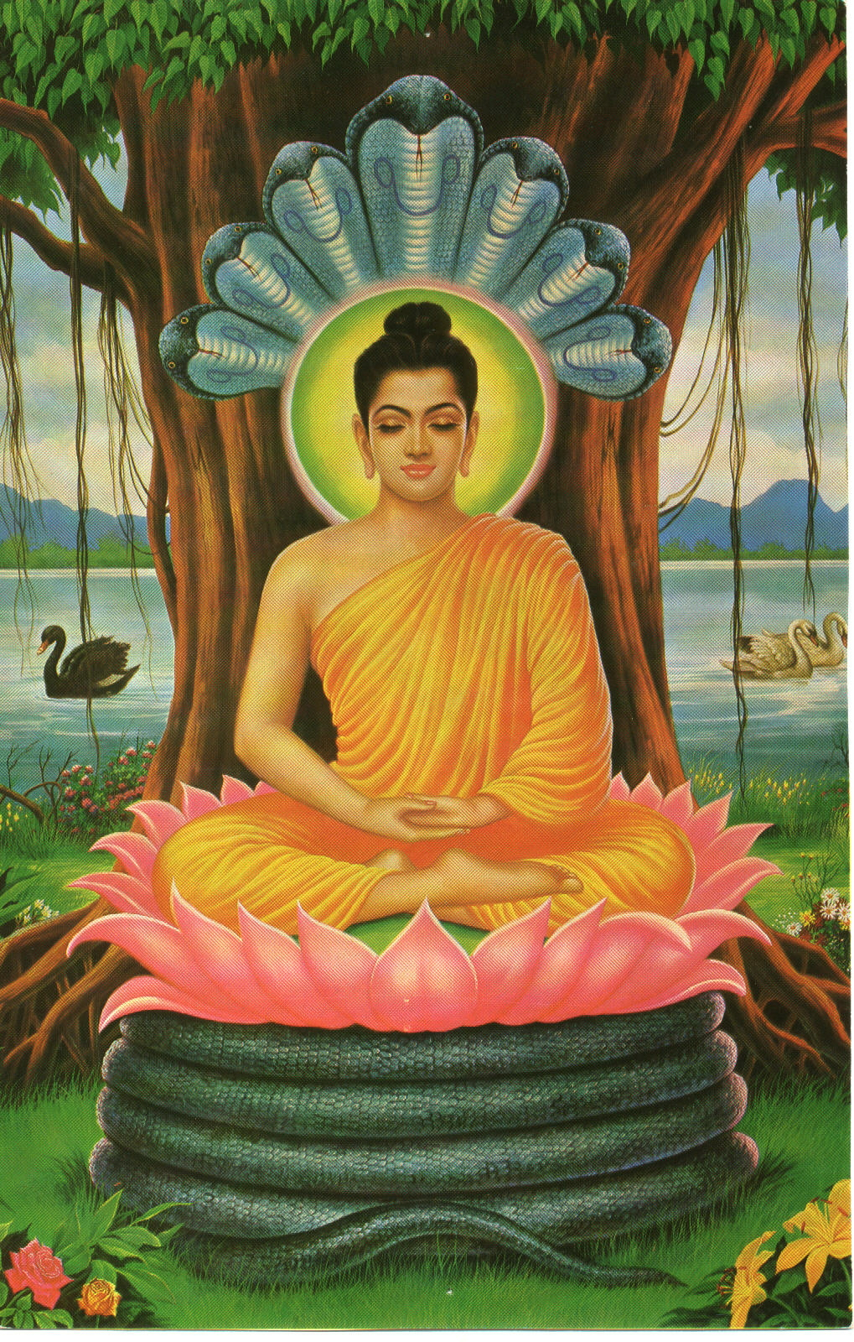

Slide 192
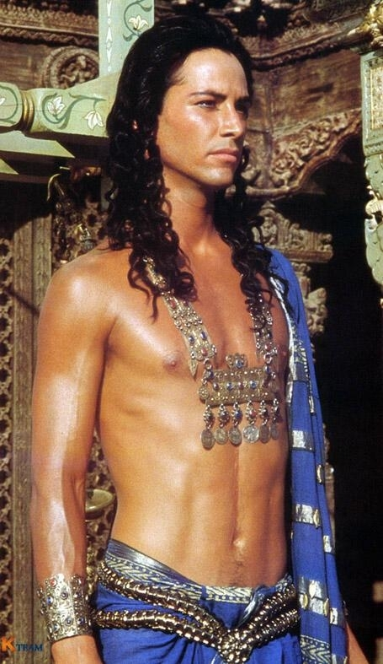

Slide 193
Early life
Founder: Siddartha Gautama (480-400 BCE)
  Protected from the outside world by his father the king, at the age of 29 he went outside the palace and discovered suffering (Duhkha): disease, old age and death
  He studied, wandered and practiced asceticism until his enlightenment: buddha = enlightened
  He founded a community (sangha) who followed his teachings

Slide 194
Larger historical context
1) Original kinship groups, living close to nature
  Animistic outlook: oneness of “spirit” everywhere
2) Rise of hierarchical state societies with developed technology
  Belief in a fall from an earlier state (e.g., Adam and Eve in the Bible)
3) Eastern cultures preserve kinship relations
  The West breaks from them

Slide 195
Buddhism creates a spiritual republic
4) Iron age:
  (1) Freedom of democracy and self-control by the common people, founding kinship republics
  (2) Loss of the republics with triumph of kingdoms
  (3) Caste society of India due to Aryan conquest: neo-kinship
5) Problem of philosophy: reconcile the idea of iron-age freedom with the loss of freedom
  India: the six doctrines and their philosophical interpretations
  Buddhism: reject caste and restore the republic on a spiritual plane: the Sangha

Slide 196
Buddhist “Republics”
The monks were “intellectually and spiritually free. Decisions were made through group discussion, perpetuating the pattern of the early republics of the north Indian hills.” (Spodek 286)

Slide 197
The Teachings
Texts of his teachings (the Pali canon) were written centuries after his death
He was sometimes impatient of esoteric/speculative philosophical issues
  focusing on the practical matter of liberation
The Ten Open Questions: “Is the world finite?”
  He says examining these is not profitable
Buddha’s Teachings
  1) The Four Noble Truths
  2) The Eightfold Path
  3) Nirvana

Slide 198
Four Noble Truths
1) life as a whole is duhkha
  Suffering, sorrow, frustration
2) Duhkha, and the whole cycle of rebirth is due to “craving”
  For pleasure and riches—
  but also for the delights of heaven
  And even for Nirvana
3) To end Duhkha: overcome craving
4) To overcome craving, follow the Eightfold Path

Slide 199
4th Noble Truth: the Eightfold Path
1. Training in wisdom:
  right views, understanding
  right mindedness
2. Training in practical life and ethics:
  right speech,
  right action,
  right livelihood
3. Training in meditation:
  right effort
  right attentiveness
  right concentration

Slide 200
Nirvana
1) “Extinction”
  As a candle is extinguished
2) It exists, but can’t be described
3) It is the negation of the life with which we are familiar
Later Buddhists divide on what this means
  1) total annihilation
  2) a joyous place
  3) something that is not separate from our everyday life

Slide 201
The Six Doctrines again
All these teachings are found in the classic Indian teachings of the six doctrines:
  samsara (cycle of rebirth or reincarnation),
  karma (how our actions keep us on this wheel)
  duhkha (suffering > craving)
  avidya (ignorance—to be overcome through the teachings, right understanding, meditation)
  dharma (moral component of Eightfold Path
  moksha (the release from suffering, called Nirvana)

Slide 202
Distinctive Buddhist ideas: 1
1) No self (anatman)
  Duhkha/Craving is rooted in belief in a persisting self
  The purification of the self in Samkhya and Advaita Vedanta doesn’t go far enough
  Even a pure witness consciousness preserves the notion of a fixed self, and so craving
  All the problems of how the self is related to the reality vanish if there is no self
    Samkhya/Yoga: Cooperation of purusha and prakriti?
    Shankara: How is the Self reflected in the empirical world like the image of the sun in water?

Slide 203
Arguments for Anatman
(1) A chariot seems to be one thing
  But it is really only a composition of various parts
    which are changed over time as they wear out
  The parts of the “Self” (the skandhas)
    Our physical parts: strength, height, weight …
    Our feelings and moods
    Our likes and dislikes
    Our goals in life
    Our ideas about life
  Where is there anything permanent in all this?
    Which of these is the Self (Atman)? All together?
  Changes in all these matters create suffering when we cling to a fixed aspect

Slide 204
Why does Purusha/Atman need eyes?
(2) The Samkhyans and the Vedantins both agree that
  Purusha or Atman is nothing physical, psychological, mental
But if there is a pure witnessing consciousness distinct from all this
how is it that our conscious experiences are constrained by our perceptual apparatus?
  Why should the Self’s awareness of visual data depend on the eyes—i.e., on what is not the Self?
  Why does the Purusha need eyes at all?

Slide 205
The Purusha/Atman is useless
(3) This idea of a pure detached consciousness explains nothing at all in our lives
  It’s useless, pointless
The Six Doctrines do not require such a Self:
Rebirth: not the same self in a different body, but a continuation of the components from the previous life in different configurations
  some old ones continuing
  some new ones added

Slide 206
Continuity, not sameness
This is also true of the continuation within one life
  The young King Milinda is continuous with the older one, without the need for any identical self
  His reborn continuation can enjoy or suffer from the actions of the previous incarnation
Moksha does not require an eternal self
  When the craving ceases, that’s all that matters
  It’s pointless to ask who or what exists then

Slide 207
Distinctive Buddhist ideas: 2
2) Dependent origination: Everything depends on something else
  Not causal dependence
    Nyaya: one thing depends on some other thing happening before
    Samkyha: smoke depends on, comes out of, fire
  But the dependence of a thing on its constituents
    A chariot depends on wheels
  Or logical dependence: the existence of A depends on B if A cannot be conceived of without B
    Suffering depends on ignorance

Slide 208
12 links of the chain
Life is a closed chain of 12 links
  1) Craving for honor, pleasure, etc. (arbitrary starting point)
  2) leads to grasping after things
  3) And this grasping after things through Karma leads to rebirth
  4) and hence further aging, suffering
  5) Craving presupposes feeling
  6) which supposes sensory perception

Slide 209
  7) which depends on embodied agency
  8) Agency depends on the ability to discriminate between different goals
  9) which requires will and motivation
  10) which depend on spiritual ignorance regarding the pointlessness of worldly goals
  11) Ignorance feeds on suffering and confusion
  12) while ignorance leads to more suffering and confusion

Slide 210
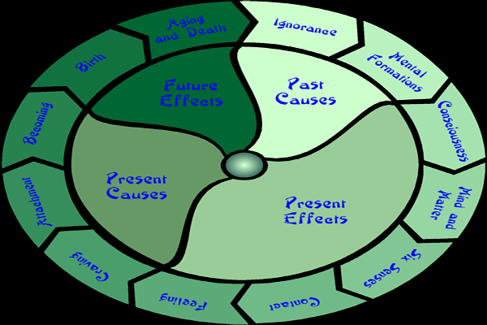
The 12 Nidanas

Slide 211
No role for a Self
There is no role of the soul or Self in all this
  Belief in its reality is due to a distorted need or craving for stability and security
Salvation/liberation:
  If motives > agency > craving > rebirth, etc. presuppose spiritual ignorance
  then heeding the teachings of Buddha breaks the chain
  and the person is freed from the cycle of rebirth and suffering

Slide 212
The Buddhist schism: 1) Theravada
Theravada (Ancient Way of thought)
  Earliest school
  Holds that the goal is individual enlightenment of a “worthy one” (arbat)
  Realist and atomist metaphysics
    Just as the material world is a conglomeration of different elements, so is the “self”
Recall: Nyaya/Vaisheshika
  But the plurality of selves (Purushas) is taken further: the “self” is itself a plurality, a conglomeration

Slide 213
2) Mahayana
Mahayana (Great Vehicle)—later development
  Goal is the bodhisattva committed to lead all beings to absolute nirvana
  Anti-realist and/or anti-atomist: “The external world is merely thought seen as a multiplicity [of objects].”
Historical context
  Buddhism takes on social dimensions
  Is incorporated into Hinduism
  Attacked by Islamic invaders of India
  Becomes a major religion in other countries (China, Tibet, Thailand, Japan …)

Slide 214
The power of dreams
Two main Mahayana schools
  Yogacara or Vijnanavada (consciousness doctrine)
  Madhyamaka (Middle Way)
Vasubandhu (of the Vijnanavada school):
  Even if there were external objects, we could never distinguish them from our own perceptions
  It’s all in our consciousness, a storehouse
Objection: how explain the power of things over us if there are no things?
  Vasubandhu: Consider the power of an erotic dream over the dreamer. Does this prove that the dream is real?

Slide 215
Back to the Self?
But the Madhyamaka school replies to the Vijnanavada:
  They think of the mind as a kind of place in which images exist, a “storehouse consciousness” of all the perceptions
  But this restores the notion of a Self
Main exponent: Nagarjuna (2nd c. CE), and his interpreter, Candrakirti
  Perhaps the most sophisticated Indian school,
  Similar to the Prajnaparamita (perfection of wisdom) sutras of the first few centuries CE

Slide 216
There are no things
Nagarjuna: “There are absolutely no things, nowhere and none, that arise.”
  Not “nihilism”
  But the denial of “substances”: things that have independent existence, not dependent on anything else
The no-self doctrine of dependence of one state on another is extended to “things”
  Nothing has such independent “own being” (svabhava)

Slide 217
What type of dependence?
Not a theory of causal connections between things
  For “cause” and “effect” have distinct being
But logical or conceptual interdependence
  E.g., relatives in a family: cousins, brothers and sisters: each requires the others to be what they are
  Kinship background!
Argument: Substances would have to either
  be beginingless – which they obviously are not –
  or to originate: out of themselves? Out of something else? At random, by chance?

Slide 218
Possible sources of things
Self-causing? Impossible
Caused by something else?
  But if A is distinct from B, why would it cause B, and not C or D?
Random?
  But the natural world is not random but orderly

Slide 219
Emptiness
Hence the phenomenal world is an “emptiness” (sunyata)
  containing no solid, independent substances
  But this is not absolute nothingness
Hence this Madhyamaka is a “middle way” between these extremes
  the atomist Nyaya/Vaisheshikas
  and the Maya of Advaita Vedantins

Slide 220
Relativity
The things we pick out, tables, trees, persons
  carved out of a seamless, monistic network
    according to our practical interests
    and the conventions of our linguistic or conceptual schemes
  They are doubly relative
    Any item depends on its place in the whole, its contrast with other items (as individual words depend on the whole of the language)
    And on human beings: their practices and conceptual schemes

Slide 221
What is nirvana?
Contrary to Samkhya, there are not two worlds
  The world of things (Prakriti)
  The emptiness of the witnessing consciousness (Purusha)
But the world of “things” is the emptiness
  Nirvana = thinglessness and selflessness
  “We call this world phenomenal, but just the same is called nirvana when viewed, sub specie aeternitatis, without the categories of ordinary, conventional experience.” (Candrakirti)

Slide 222
Triple equation
Samsara = sunyata = nirvana
  There is just one world
  viewed from increasingly adequate perspectives
  Speculations about what nirvana is, about a special place or plane separate from the ordinary world, are senseless
The person who recognizes this triple equation is enlightened
  Enlightenment is to recognize that “everything stands in its proper place within the harmonious whole” (Nagarjuna)
  Otherwise it is all “out of joint” (→duhkha)

Slide 223
Liberation in the world, not from it
Liberation is not about escaping the world
  But about obtaining a right philosophical perspective on it
  living the sense of the insubstantiality of things and selves
From this perspective, the person who grasps after the things of the world for the sake of his/her self
  looks pathetic and futile

Slide 224
6 Ethics and Indian Philosophy

Slide 225
Spiritual and Immoral?
Main ethical works: not the above technical schools of philosophy, but
  Kama-Sutra (Pleasure-Sutra)
    A bedroom companion for lovers
  The Bhagavad-Gita (Song of the Lord)
    Discourse on duty and devotion
Paradox of India: “the most spiritual and the most immoral”
  Hegel: in India “the other side of worship consists in a wild tumult of excess.”

Slide 226
Duties in life
Practical Goal of B-G:
  to convince the warrior Arjuna to do his duty and slay his kinsmen
  NB: this is a kinship society: but what is true kinship?
Goal of the Kama-Sutra of Vatsyayana
  To aid individuals to fulfill their marital duty as “householders”

Slide 227
Dharma
Ashrama-varna-dharma: Moral law (governing individuals according to their
  Stage in life (Ashrama): A student or aged person would not have marital duties, but would have a duty of celibacy
    →centrality of the family
  Caste (Varna): Arjuna belongs to the Kshatriya caste. A Brahmin would not have a duty to fight

Slide 228
Detachment
The goal of detachment in both spheres
  The person “acquainted with the true principles of [erotic] science … is sure to obtain mastery over his senses.”
    Kama-Sutra is not about wild sensual abandonment
  In the Gita, duties are to be performed without attachment
    so that the actions hardly are one’s own

Slide 229
Moral uniformity
Lack of a large literature on morality seems due to
1) Indian consensus on these matters (of caste and stage of life)
  An exception: the materialists (Carvaka school, that didn’t survive), with their ideals of “eating delicious food, keeping company of young women, using fine clothes, perfumes, etc.”
General agreement on the virtues: truth-telling, non-violence, temperance, etc.
  Jains: against killing insects

Slide 230
The main goal is moksha
2) The main goal of liberation, moksha
  The duties of life are hardly primary if the goal is to escape life
  Karma: both good and evil actions keep one on the wheel of samsara
  The person who knows Brahman is “devoid of good deeds, devoid of evil deeds” (Kaushitaki Upanishad)

Slide 231
If the primary goal is moksha, why is dharma important?
The problem: if the goal is moksha, why be concerned at all with dharma?
  Some cynics say that dharma is for the masses, to produce an orderly society,
  so that a privileged few can pursue moksha
More common line: Dharma is a means toward moksha:
1) One who follows the moral law has a better future life, where the pursuit of moksha is facilitated
  He will have access to sacred literature
  And not be reborn as an animal or ignorant peasant

Slide 232
Preliminary or auxiliary
2) Virtuous behavior is good training for developing physical and psychological traits
  self-discipline, mastery of the senses, absence of self-centeredness
that facilitate the philosophical and contemplative understanding on which moksha depends
  Dharma is a “preliminary” or “auxiliary to the acquisition of knowledge of the Self” (Shankara)

Slide 233
Instrumental and contingent
But the relation of dharma to moksha is then merely instrumental,
  and so contingent, unnecessary
  Shankara: some people can dispense with the duties of caste and stage of life
  Pantanjali: some yogins can bypass the moral discipline of yoga

Slide 234
An immoral society?
This conflicts with the notion of Western philosophy
  that moral life is that in and through which a person realizes his highest aspirations as a human being
  trumping all other considerations
In this perspective, Max Weber denied that there is any real sense of morality in India

Slide 235
The Gita deepens the connection
But this view (that dharma/morality is only instrumental) is challenged by the Bhagavad-Gita
  which explains why dharma is intrinsic to moksha
Time: 200 CE
Location: a section of the epic Mahabharata
  95 episodes on Indian TV
Arjuna, leader in battle, has doubts about the validity of killing his kin on the other side
  Krishna, his charioteer, an avatar of the god Vishnu: “Think … of the duty and do not waver. There is no greater good for a warrior than to fight in a righteous war.”

Slide 236
Two paths to perfection
Arguments
  1) No one really dies—
    because Being/Brahman is eternal,
    and Atman, your true self, is one with Brahman
  2) There are two roads to perfection: path of action (karma-yoga) and path of wisdom (jnana-yoga)
Recall Daoism:
  path of the sage,
  path of the craftsman

Slide 237
Meditation is also action
Meditation is itself a kind of action
  “For not even for a moment can a man be without action”
  So it cannot be “by refraining from action that a man attains freedom.”

Slide 238
What produces karmic fruit?
It is not actions as such that bear karmic fruit
  but the motives behind them
Arjuna’s actions must be “pure, free from the bonds of desire”: duty for duty’s sake
  not the goal of glory
  not even the prosperity of one’s own people
But why doesn’t the motive of duty for duty’s sake produce karmic fruit?

Slide 239
Who/what is acting?
An action can only bear karmic fruit if they are his actions
1) “all actions take place in time by the interweaving of the forces of Nature”
  But “the deluded person thinks that he himself is the actor”
  Hence it is not Arjuna who is responsible for his actions, but Nature, the beginningless process of cause and effect
Recall: Samkhya/Yoga:
  nature is Prakriti, including your own thoughts and mentally determined actions
  Purusha is beyond these

Slide 240
The real Self
2) Even to grant that, in an everyday sense, Arjuna is the actor, this is not the real Arjuna, the true self,
  the purusha: distinct from the body and intelligence engaged in action (Samkhya and Yoga influence)
  Arjuna should think: “I am not doing any work … It is the servants of my soul that are working.”
Distinguishing himself from the agent of “his” actions
  he no longer suffers or enjoys the fruits of the action
  He is liberated

Slide 241
Overcoming the conflict
Hence dharma is elevated from being an instrumental means to moksha
  into a direct, self-sufficient path of perfection
  overcoming the conflict between spiritual and practical preoccupations

Slide 242
Problems arise
But questions arise
1) Ideal of niskama-karma (total and self-conscious detachment from one’s actions)
  Why not any kind of action?
  E.g., a mafioso who doubts whether to gun down a rival gang member

Slide 243
Western concepts
Western concept of morality:
  You should want to feel responsible for your actions
    Assuming responsibility: part of maturity and dignity
  You become the person you make yourself
    It’s bad faith to pretend your actions are not your own
Chilling portrait of a serene and smiling Arjuna cutting down his enemy
  Gandhi: this is a metaphor for spiritual struggle

Slide 244
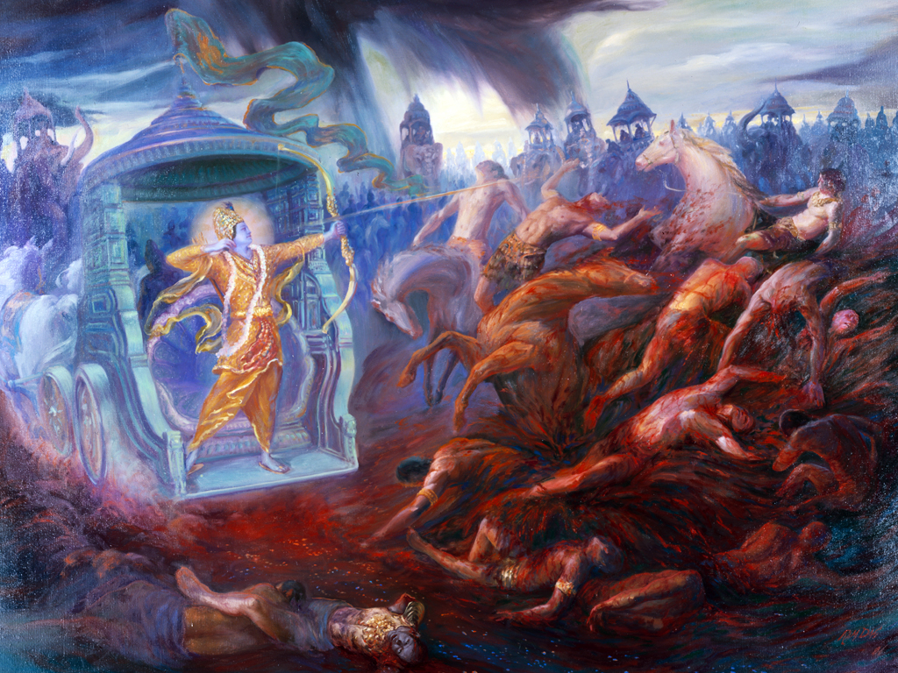

Slide 245
The moral subject
The moral subject in Western thought
  A person of this world, an embodied, motivated agent
  not a victim or creature of fate or natural necessity
  able, within limits, to transcend the constraints of his situation

Slide 246
Two possibilities
But the corresponding moral subject in Indian philosophy
1) is not the embodied person
  The Gita, Samkhyans, etc.: this is a plaything or puppet of nature
2) Is it the purusha or atman?
  But this is not of this world, a spectator or witness,
  which does not engage in acts of willing or moral effort

Slide 247
A third possibility?
Between these two there seems to be no room for
  the moral subject of the West
  A self-responsible individual
Hence the attraction (for the West) of Buddhism
  which does not take these paths
  A Middle Way (Madhyamaka) between
    the atomist Nyaya/Vaisheshikas (→Western Materialism)
    and the Maya of Advaita Vedantins (the spiritualism which hold that world is an illusion)

Slide 248
Room for a moral subject?
But how is Buddhism compatible with the Western moral subject
  when Buddhist doctrine of anatman denies that there is a subject?
Is there room for the moral subject in the doctrine of the Gita?
  We recognize our duty in the present circumstances
  Ultimately our being in these circumstances is our choice (Karma)

Slide 249
Avatar
Recall analogy of the avatar
  The immediate actor is the avatar, not you
  You are behind the avatar who is playing a role decided by You
Ultimately this higher You is Brahman
  playing at not being Brahman
  pretending not to be God
  so as to experience being God
If this is fate, being a plaything of nature
  it is you who have chosen your fate
  It is you who are playing the role you have chosen
  You/Atman are Brahman/God: you create your own life

Slide 250
Expressing the historical situation
Indian experience:
  republican experience of freedom of Iron Age
  This freedom is lost in the rise of the feudal monarchies of India
The role of philosophy:
  explain how seemingly unfree people (maya)
  are really free (lila)

Slide 251
Why not choose to be a Mafioso?
Why not choose to be a Nazi?
  But the member of the mafia is not in charge of his life
  The Nazi says that race is what determines us to be what we are
But these beliefs are incompatible with the ideal of freedom
  We cannot choose not to have a choice!
  Hence our duties must allow for this freedom that is our fundamental truth
  And so not every and any way of life can be a matter of duty

Slide 252
Zen Buddhism 6, 3

Slide 253

Jewel in the Lotus

Slide 254
Origin of Zen Buddhism
Buddha gives a “silent sermon”
He holds up a flower and says nothing
The monks stare at him, uncomfortably
One of his monks, Mahakasyapa, suddenly smiles
  He is enlightened
His smile was handed down to 28 successive masters of “Zen”

Slide 255
Buddhist revolution
Genuine “reformation or revolution in Buddhism”
  Buddha’s Flower Sermon:
  The simplicity of the essential message has become disguised by a crust of abstract doctrine
Hence Zen Buddhists exaggerate the “irrational” nature of Zen
  Its koans: What is the sound of one hand clapping?
  But these practices do not contradict a sophisticated philosophical understanding

Slide 256
A Cup of Tea
Nan-in, a Japanese master during the Meiji era (1868-1912), received a university professor who came to inquire about Zen.
Nan-in served tea. He poured his visitor's cup full, and then kept on pouring.
The professor watched the overflow until he no longer could restrain himself. "It is overfull. No more will go in!"
"Like this cup," Nan-in said, "you are full of your own opinions and speculations. How can I show you Zen unless you first empty your cup?"

Slide 257
Buddhist developments
Zen reflects classic Mahayana Texts, of the Madhyamaka (Middle Way) tendency
  The Diamond and Lankavatara Sutras
but charges these with veering into “transcendentalism,” contrasting
  an empty phenomenal world
  and an eternal nirvana
  leaning toward a “closet Vedantism”
Rejects: The “Pure Land” school pictured Nirvana as a heaven full of divine Buddhas

Slide 258
American Zen
Western versions of Zen
  “Flower power” of the sixties– aspects in accord with Zen
    Attractive message of living simply and spontaneously in our complex and artificial society
    One can live a spiritual life without complex baggage of scriptural scholarship and idols
  But not in accord:
    Zen as a quick fix of spirituality, safer than LSD
    Seeing Zen as an irrationalism against science

Slide 259


Slide 260


Slide 261
Irrationalism?
“Zen is the most irrational, inconceivable thing in the world, not subject to logical analysis or intellectual treatment”
  D. T. Suzuki, once the most influential Zen writer in US
Fails to distinguish
  Zen philosophy and Zen enlightenment
    Intuition does not rule out importance of an articulate philosophical framework
  Zen practice and Zen philosophy
    The philosophy explains the meaning of the koans, the slaps, etc.

Slide 262
History
“Zen” from Chinese “ch’an” and from Sanskrit “dhyana” meaning meditation.
  brought to China in 6th-7th centuries
  but most influential in Japan
    Most acute philosophical articulation in the writings of Dogen (d. 1253), of the Soto sect
    Rival sect: Rinzai, which focused on use of koans
“There is not much in Buddhism after all” (Rinzai)
  I.e., not all the cumbersome baggage that has been developed around Buddhism
  disguising a simple message

Slide 263
Zen teachings
Distinctive contributions of Zen at the level of doctrine
  1) We are Buddha-mind
  2) Mountains are mountains

Slide 264
1) We are the Buddha-Mind
“All beings are already in … nirvana”
  Lankavatara Sutras (Madhyamaka tendency of Mahayana Buddhism)
“Enlightenment and intuitive wisdom are from the outset possessed by men of the world.”
  Hui-Neng – Chan Buddhist (d. 713)
To be enlightened = to possess Buddha-mind?
  Better to say that we are Buddha-mind (Dogen 1200-1253, Japan)

Slide 265
Didn’t Buddha become enlightened?
Hence rejection of “grace,” heaven of Pure Land Buddhism
  But also not Brahman – some state above/beyond the ordinary phenomenal world.
But what about the teaching that our condition is one of ignorance and suffering (Duhkha)?
And isn’t it said that Buddha “attained” enlightenment?
  Meaning that before this point he was ignorant, unenlightened?
  Perhaps: his enlightenment was dormant, or only potential, before this?

Slide 266
What kind of ignorance?
Is this like saying that I am ignorant of chemistry, but have the capacity to learn it?
  So with the right information I can learn that there is no Self?
But enlightenment is not about information: It’s “a turning round of consciousness”
“No Self”
  Not a solution to a problem, or answer to a question
  But a way of rejecting such questions,
  Zen is a dissolution, not a solution

Slide 267
The disease and the medicine
“I merely cure disease and set people free.” Lin-Chi (Linji, d. 866)
  The disease: self-reflection
  “I’m such a jerk”
    Me, the jerk
    I, the witness to the jerk
We divide the world and ourselves into subject and object
  We need “a medicine for the mental paralysis which comes from excessive self-consciousness” (Alan Watts)

Slide 268
Grammar and the Self
The grammar of self-reflective judgments
  Implies that there is a Self that reflects
  And also that acts: a controlling center of will, pilot of the ship of my life
My misunderstanding of myself:
  Confusions of self-reflection
  → way of life which I try to live,
  which reinforces the confusions about the self

Slide 269
Let it all go
How cure the disease?
  “Just let the body and mind drop off.” (Dogen)
  Our decisions and intentions are events that just happen, not the dictates of a controlling subject
“Whatever runs counter to the mind and will of ordinary people hinders … the law of Buddha”
  1) We begin with the simple life of innocence
  2) Then we get the disease of reflection
  3) And so we need to return to this original state

Slide 270
Homecoming
No difference between the simple peasant and the enlightened sage?
  It’s like a higher octave note: a return to “C” but on a higher level
A homecoming
  A return to oneself after a period of seeming division,
  but not a return to a “Self”
  Petern Matthiessen: “to glimpse one’s own true nature is a kind of homegoing … that needs no home, like that waterfall on the upper Suli Gad that turns to mist before touching the earth and rises once again into the sky.”

Slide 271
2) Mountains are once more mountains
Distinctive contributions of Zen at the level of doctrine
  1) We are Buddha-mind
  2) Mountains are mountains
Re the nature of the external world and our relation to it
  Standard idea of Buddhism: the conception of the world is shaped by that of our selves
  “No Self” → the world is not made up of individual substances
Recall the triple equation of Nagarjuna:
  Samsara (empirical world) →
  Sunyata (emptiness, dependent origination) → Nirvana

Slide 272
Removing false categories
Zen seems to share the view that Nirvana is not a different world from samsara
  But only the same world without the false categories of self and substance
    Hence no basis for grasping after things: The craving that is the source of suffering
  Also, the articulation of the world in classes is due to human convention
“All things were originally given rise to by man” (Hui-Neng)
  The world as a seamless network of relations (Nagarjuna’s “dependent origination”)
  within which separate things are picked out by human conventions

Slide 273
The in-itselfness of things
But Dogen tells us
  “to see things properly … accept them the way they are.”
  “Accept things as they come, independent”
Thus we should recognize the “in-itselfness” of things
  Otherwise this is like the Hindu Maya
  and leads to an uncaring indifference to the world
But how reconcile this with the doctrine of samsara as “empty”?

Slide 274
Three stages
Ch’ing-Yuan (Qingyuan Weixin, 9th cent.)
  1) “Before a man studies Zen, to him mountains are mountains …;
  2) after he gets insight into … Zen, mountains are not mountains …;
    I.e., he has read Nagarjuna, and sees mountains as “empty”
    “The mountain is big and beautiful” = human conventions, measurements
  3) but “when he really attains the abode of rest, mountains are once more mountains.”
    Direct experience of the thing, wordless, non-conceptual

Slide 275
Independence and relationship
To say this is a mountain is a human convention
  A Martian may not see three mountains but one “trimountain”
Two positions must be reconciled
  Nothing is except in relation to everything else (Nagarjuna)
  Each thing is independent (Dogen)
Clue: Compare Japanese painting called sumi-e with a Constable landscape

Slide 276


Slide 277


Slide 278
The universe in a tall bamboo
Dogen: the “entire universe manifests itself in … a tall bamboo.”
  It gathers its environment around it
  And through doing so takes on its special identity
The truth of dependent origination does not mean
  that the object is dissolved and has no reality of its own
  = the position of the person at the second stage
But “in the Zen awakening … mountains are really mountains … in themselves … and yet there is no hindrance between [things] – everything is … interfusing.” (Abe, Zen and Western Philosophy)

Slide 279


Slide 280
The world in a grain of sand
“To see a World in a Grain of Sand
And a Heaven in a Wild Flower,
Hold Infinity in the palm of your hand
And Eternity in an hour.”
― William Blake, Auguries of Innocence

Slide 281
From theory to practice
Philosophical contributions of Zen
  Enlightenment is the dissolution of wrong questions that seduce us into a fruitless search for self
    not the overcoming of ignorance and misperception by means of a true, enlightened understanding
  The things of the world maintain concrete individuality as unique nodes in a holistic network of relations
    not logically independent substances
How do these ideas affect practice?
  Meditation, everyday behavior, moral action

Slide 282
Enlightenment
Meditation: not a means to enlightenment
  but an expression of enlightenment—
  the operation of Buddha-nature
Enlightenment is
  not entry into a separate realm
  but thinking without self-reflection and intellectual calculations
The notion of “sudden enlightenment” is misleading
  Sometimes there are intense moments
  But awakening is not a matter of information or theory that can be acquired slowly or suddenly

Slide 283
Koans
Why are there Zen practices, such as koans?
  1) Iconoclastic anecdotes: “If you see the Buddha, kill the Buddha”
    = against theistic conceptions
  2) What is the sound of one hand clapping?
    Seemingly well-formed questions imply false understandings
    E.g., “What is the “I” which is aware of myself?”

Slide 284
Three features of the flowing mind
Mark of zazen (sitting meditation)
  The mind’s “freely flowing from one object to another” without becoming stopped or fixated
    Objection: perhaps spontaneity and lack of concentration is applicable to sword fighting,
    but not to brain surgery
  Three features of “the flowing mind”
    Respect the instruments and not impose alien use on them
    Not an inflexible plan, but openness to contingencies
    Not being preoccupied with oneself

Slide 285
Not “I shot” but “it shot”
These are the features of
  the tea-master, who respects his implements,
  the swordsman, who recognizes that things “just happen”
  and the archer, who is not focused on himself: not “I shot the arrow,” but “it shot”
(But then, how is this compatible, as Cooper claims, with the idea of Western morality?
  The responsible moral subject?)

Slide 286
Why be committed to the liberation of others?
Why not then become a free booting samurai?
  (films of Kurosawa)
  Why be concerned with social obligations?
Argument: one who is committed to his own liberation should be committed to that of others too
  But if the commitment is to one’s own liberation, why be concerned with others?
  Isn’t it a distraction to be concerned with others?
  The call for “compassion” seems tacked on, not fundamental

Slide 287
No Self→ concern for others
The Mahayana ideal of the bodhisattva, committed to others
  doesn’t make sense if the individual is a separate self
  But Mahayana doctrine of dependent origination: there are no separate selves
  One cannot say “This bundle of experiences and its future is my sole concern because it is mine.”
The doctrine of “no Self” (anatman)
  dissolves the false question: Why should I be concerned with the welfare of others?

Slide 288
Recall historical context
Rise of reflective thinking in commerce
  Why is x amount of wheat = y amount of wine?
  The same monetary value
→ Rational thought points to deeper truths underlying ordinary experience
Zen: this is a disease of our modern world for which Zen is the cure
  Return to the time before reflection sets in
  But do so consciously (reflectively)

Slide 289
Buddhism goes to China
Historical context of Zen Buddhism
  Buddhists leave (are driven out of) India
  Zen Buddhism originated in China
  Chinese philosophy arose in a period before the development of commerce, iron, alphabetical writing
Commercial society is the context for a rationally organized philosophy
  Merchants are one of the four basic castes in India
When Buddhism goes to China
  it develops a philosophy that is negative to discursive, step-by-step philosophy
  It goes back to the intuitionism of Daoism

Slide 290
Irrationalism is rational
A philosophy that negates philosophy?
  So maybe D. T. Suzuki was right:
  “Zen is the most irrational, inconceivable thing in the world, not subject to logical analysis or intellectual treatment”

