Slide 2
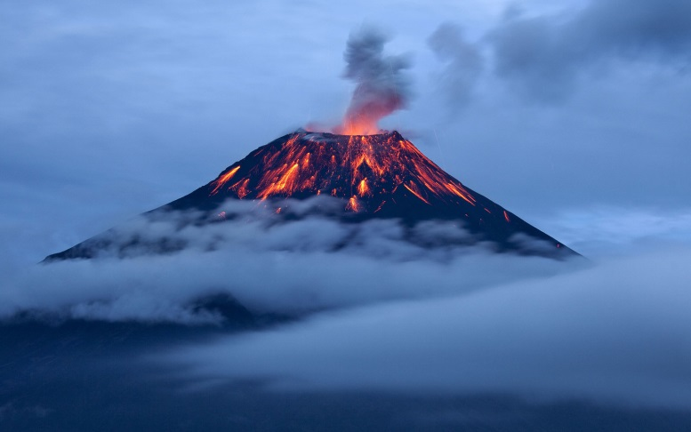
Toponymics
ENG1999
October 2018
David J. Bertuca, Map Librarian
University Libraries
University at Buffalo
dbertuca@buffalo.edu / 645-1332
Notes:
Tungurahua, Ecuador

Slide 3
Aztec Riddles
A little mirror in a house made of fir branches.
The eye with its lashes.
She plays music while moving her head.
A shaker (maraca).
What lives in a black forest and dies on a white stone?
The lice we catch in our hair and crush on our fingernail.

Slide 4
Aztec Riddles
What is it that says to itself, ‘You go this way, I’ll go that way, and we’ll meet on the other side?’
A loincloth.
A blue bowl filled with popcorn.
The sky with its stars.
What are they? Ten flat stones that we carry with us.
A. Our fingernails.

Slide 5
Aztec Riddles
What is it that we enter in three places and leave by only one?
Our shirt.
What stay in caves until you blow them away?
Bogies in your nose!
What makes colorful tortillas while flying in the air?
A butterfly.

Slide 6
Aztec Riddles
What is it always standing by the hearth curving upward?
A dog’s tail.
A single red thing - it plays, talks and sings...
A. Your mouth.

