Slide 1

The influence of stress on laryngeal timing in Itunyoso Triqui
Mariana Quintana Godoy
Dr. Christian DiCanio
University at Buffalo

Slide 2
I. What is stress?
Structural properties
Distributional asymmetries
Occur even when no phonetic properties are observed.
The phonetic correlates of stress may be language-specific – it is categorical.
Phonetic properties
Typically involve suprasegmental properties (duration, F0, spectral balance, intensity).
But they may also include hyperarticulation in stressed positions (de Jong 1995) and phonatory changes (aspiration and glottalization).

Slide 3
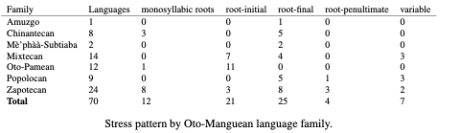
Stress in a tonal language
70 of the 94 Otomanguean languages surveyed in DiCanio and Bennett (2021) include the term stress in addition to tone. All of these are tonal languages.
Of the 58 languages that do not have exclusively monosyllabic roots, 43% exhibit root-final stress and 21% exhibit root-initial stress.

Slide 4
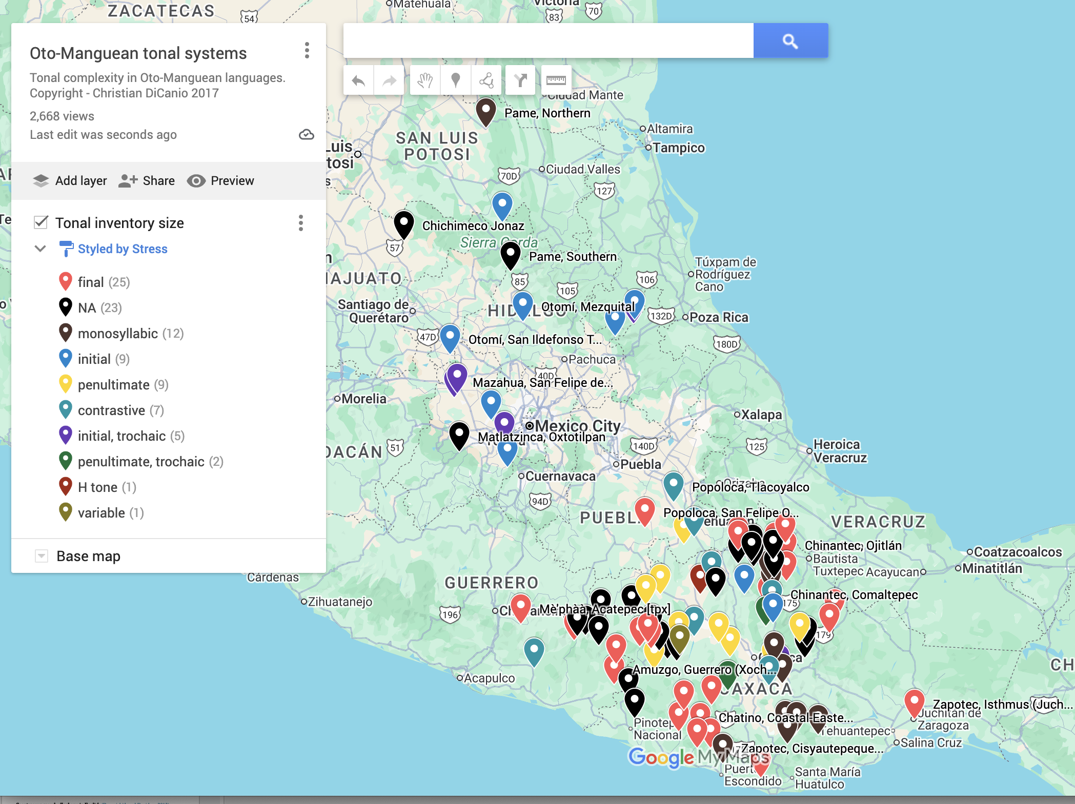
Stress patterns in Otomanguean languages

Slide 5
How is stress manifested in a tonal language?
A language can distribute segmental or tonal contrasts asymmetrically on stressed syllables.
Stressed syllables can be longer than unstressed syllables.
Hyperarticulation may occur on the stressed syllable, while hypoarticulation occurs on unstressed syllables.
  This is a variable process and it is usually most observable on speech produced in context.

Slide 6
Central claims
Stress in Itunyoso Triqui is marked both via structural/distributional asymmetries and via patterns of hypo/hyperarticulation.
While stops are canonically voiceless and unaspirated, this description is inadequate in accounting for variable patterning in context with respect to duration, voicing, and preaspiration.
Stress-related hyperarticulation is a general phonetic principle. It can both explain variable patterns of realization and account for patterns of historical sound change

Slide 7
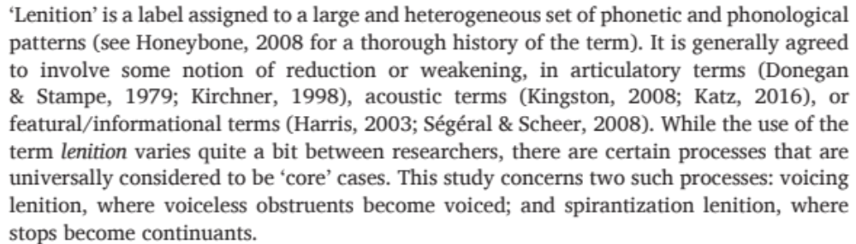
What is lenition?
(p.2, Katz and Pitzanti 2019)

Slide 8
Variation in accounts of variation
Classical allophony in English
/b/ > [p] / %__ (utterance-initial devoicing)
> [b] / elsewhere
Spontaneous speech allophony in English (Bouavichith and Davidson 2013)
/b/ > [p] / %__ (utterance-initial devoicing)
> [b] / in stressed syllables, about 90% of the time
> [β] / in unstressed syllables about 60% of the time (lenition)

Slide 9
Stop lenition is conditioned by many factors
Singleton stops are more likely to lenite than geminate stops (DiCanio 2012, Stevens and Hajek 2004).
Stops in unstressed syllables are more likely to lenite than those in stressed syllables (Davidson and Bouavichith 2013, DiCanio et al. 2022).
Voiced stops are more likely to lenite than voiceless stops in English (Davidson 2016, 2018, Davidson and Bouavichith 2013).
Stops in intervocalic position are more likely to lenite than those in word-initial position (Katz and Fricke 2018, Katz and Pitzanti 2019).
Stops that are in predictable positions in words are more likely to lenite than those in non-predictable positions in words (Cohen Priva and Gleason 2020).

Slide 10
These factors are important!
If both prosody and information content influence stop production, then detecting and understanding how stops vary can aid in identifying what is important in the speech signal.

Slide 11
II. Triqui stress and contrasts
Itunyoso Triqui (Otomanguean: Southern Mexico) has morpheme-final stress in addition to lexical tone.
  Structural – glottalization, prenasalization, nasal vowels, contour tones, etc. are all restricted to stressed syllables.
  Phonetic - Final/stressed syllables are longer than non-final/unstressed syllables (DiCanio 2010).
There is a length contrast in word-initial position of monosyllabic words (DiCanio 2010, 2012), but no other stop contrasts

Slide 12
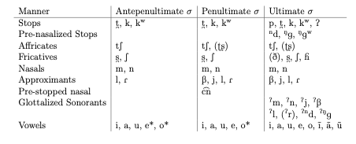
Triqui stress is distributional
Tones /2, 3/ /2, 3, 4/ /1, 2, 3, 4, 5, 43, 32, 31, 13/

Slide 13
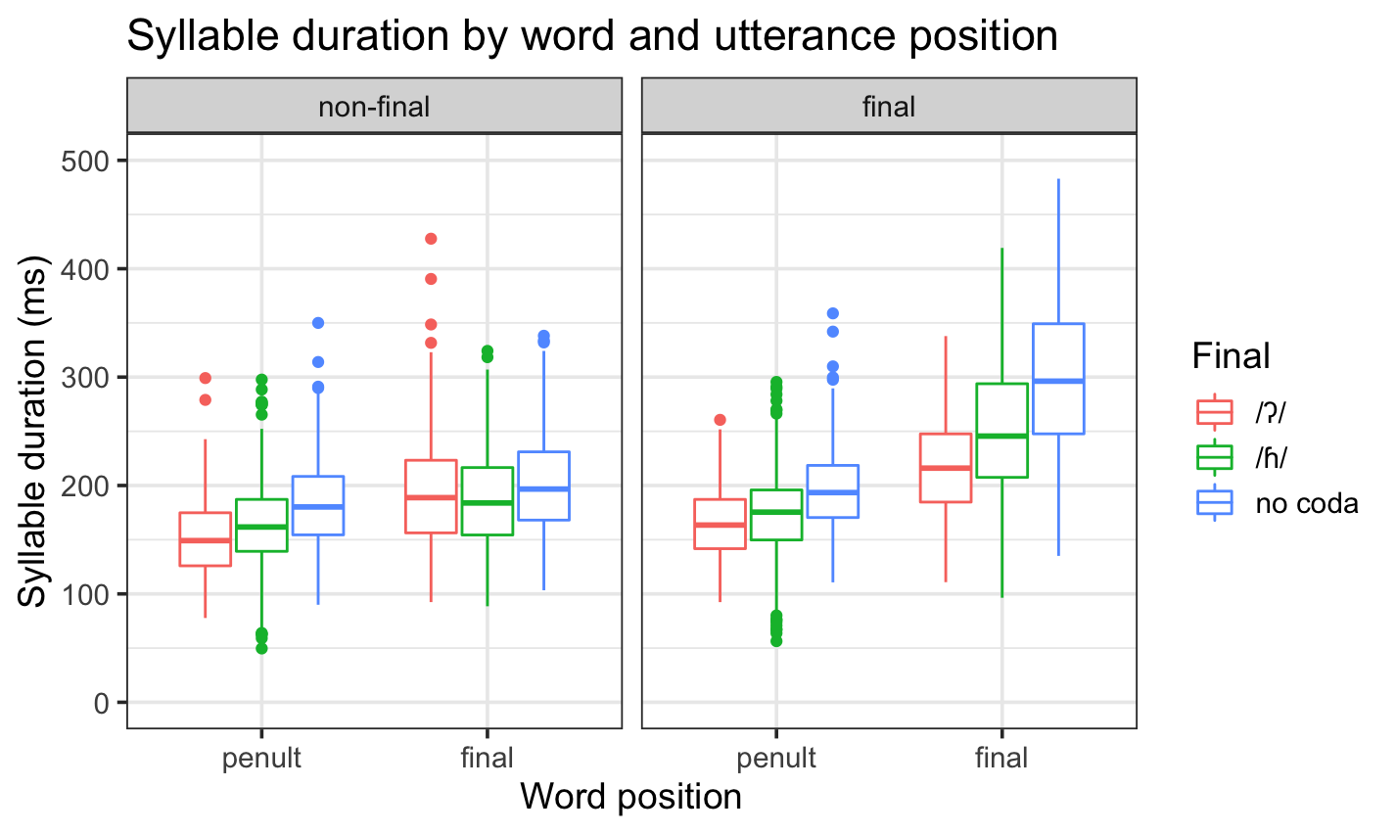
The final syllable is longer too
(DiCanio & Hatcher 2018; in progress)

Slide 14
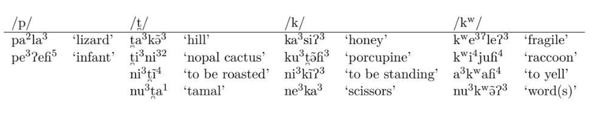

The stop system in polysyllabic words
The stop system includes /p, t̪, k, kʷ/. In the onsets of stressed syllables, they are variably realized with some preaspiration.

Slide 15
Triqui stop phonetics
We distinguish Triqui stops in polysyllabic words where stress can influence their production from Triqui stops in monosyllabic words where there is a phonological length contrast. We focus only on the former here.
All stops are phonologically voiceless with relatively little post-aspiration.
Past work on consonant length found that geminate stops are produced with longer closure and variable preaspiration.
  There is electroglottographic evidence for abrupt glottal spreading in geminates vs. voicing bleed (passive voicing) in singletons (DiCanio 2012).

Slide 16
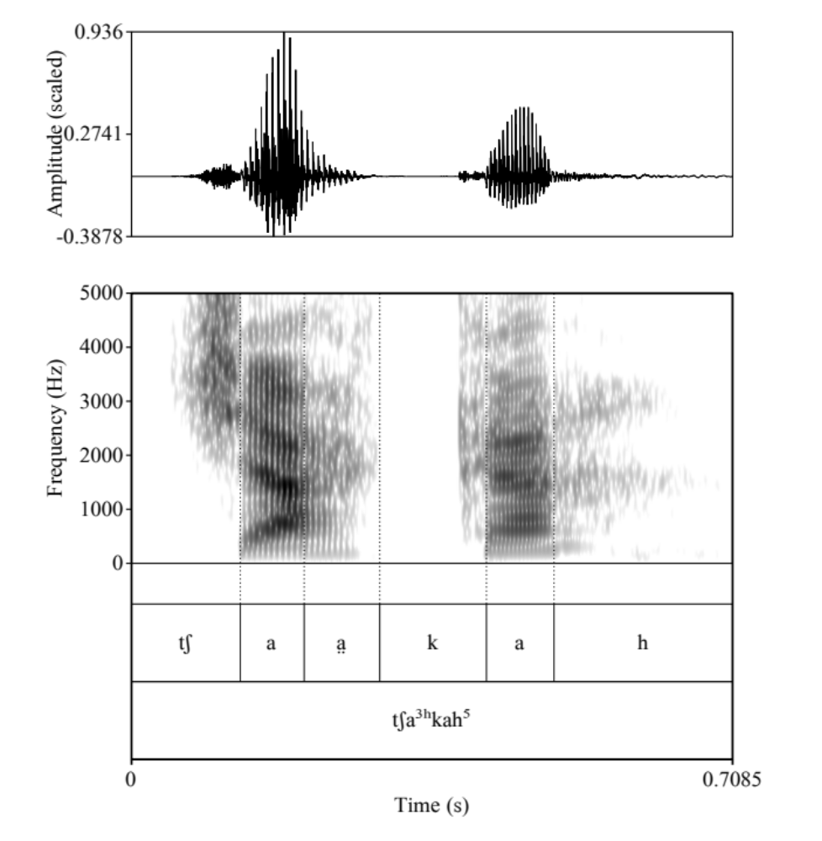
To date, there is no work on stops in polysyllabic words.
Preaspiration and voicing bleed (passive voicing) are additional features which distinguish geminate and singleton stops.
What about stops in polysyllabic words?

Slide 17
III. Methods
Target word elicitation for comprehensive phonological/phonetic analysis – words in isolation and in carrier sentences.
Just 10 target words for investigating stress effect on /p, t̪, k, kʷ, tʃ/ - two per consonant, e.g. t̪a³ˀnĩ⁴³ ‘my children’ vs. tʃa³t̪o³ ‘rabbit.’
Each word was produced in isolation and medially in a carrier sentence preceded by a vowel:
ku³-tʃu⁴mã⁴³ t̪a³ˀnĩ⁴³ t̪u³kʷah⁵
perf-arrive poss.child.1s poss.house.of.1s
‘My children arrived at my house.’

Slide 18
12 speakers were recruited for the study where they either read or repeated the target sentences three times each.
A total of 160 sentences (for all consonant/vowel contrasts) were examined. So, this is a small subset of the larger data set.
A total of 10 x 3 x 12 stimuli were elicited = 360 words with stops in carriers or 720 total (including 3 repetitions of words in isolation).
All data was transcribed in ELAN, force-aligned using a custom-built Triqui forced aligner, hand-corrected by the authors, and individually annotated for stop variant.

Slide 19
We annotated each stop with subphonemic detail several possible ways:
preasp = preaspiration
vlclos = voiceless closure
vdclos = voiced closure
vot = voice onset time
vcls.fric = voiceless frication
vd.fric = voiced frication

Slide 20
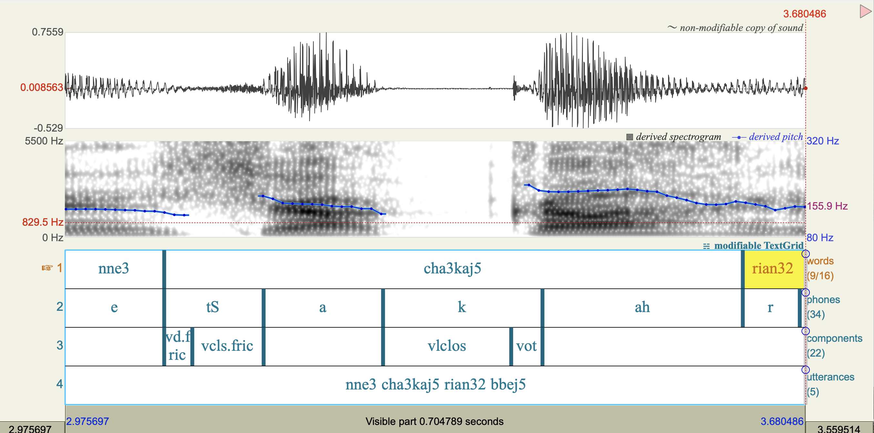
Annotation

Slide 21
The presence/absence of these categories then determined whether the stops were:
voiceless preaspirated
voiceless unaspirated
voiceless unaspirated with some closure voicing
spirantized/lenited with or without voicing
In other words, we used the presence/absence of labels at the sub-phonemic level to construct the category of the stop.

Slide 22
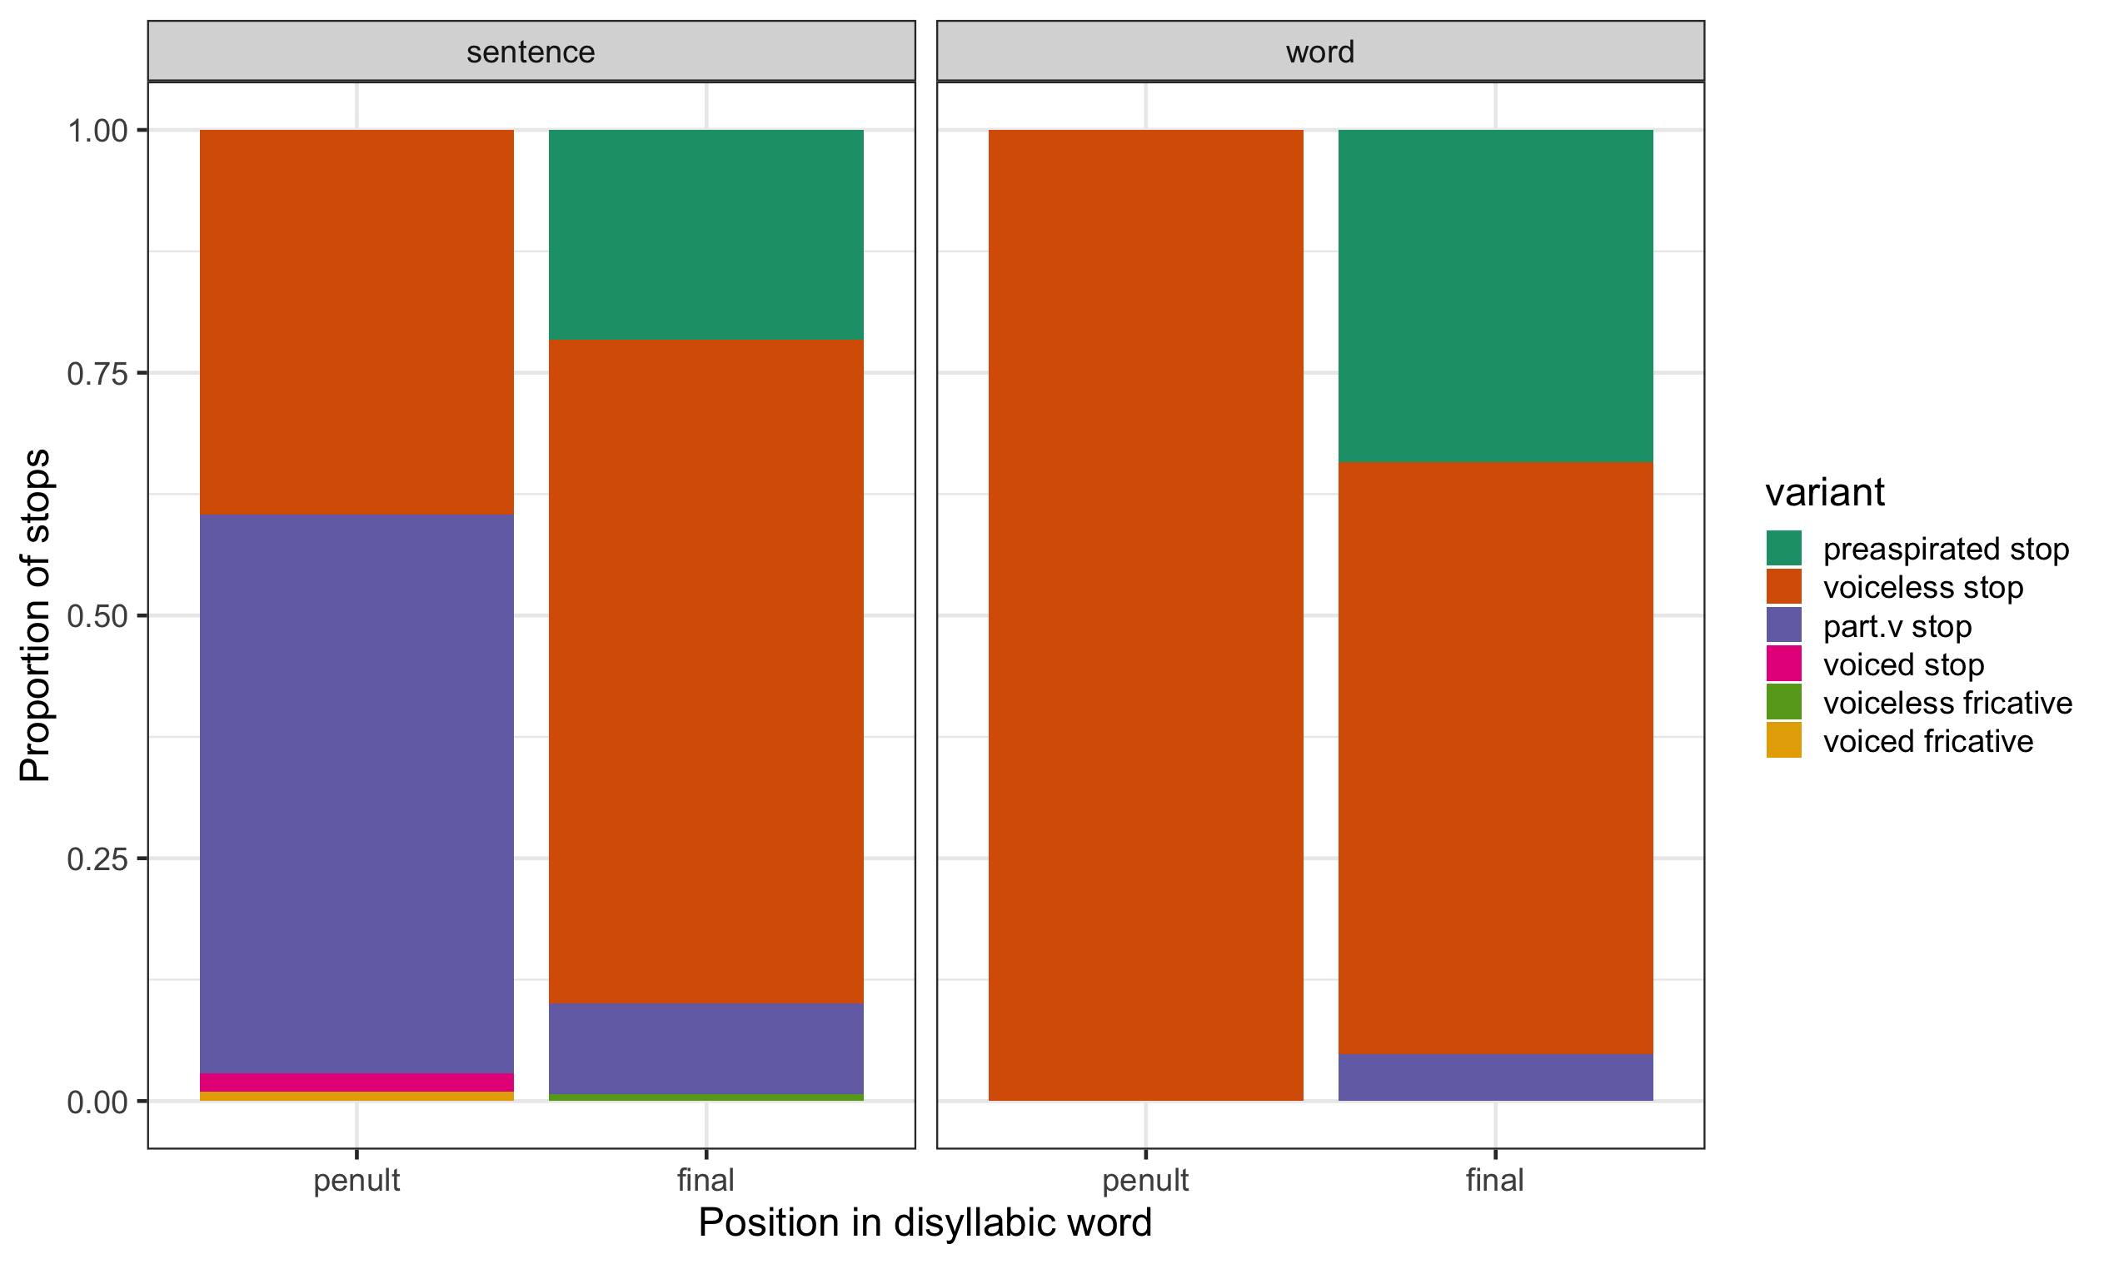
Stop variants by stress position

Slide 23
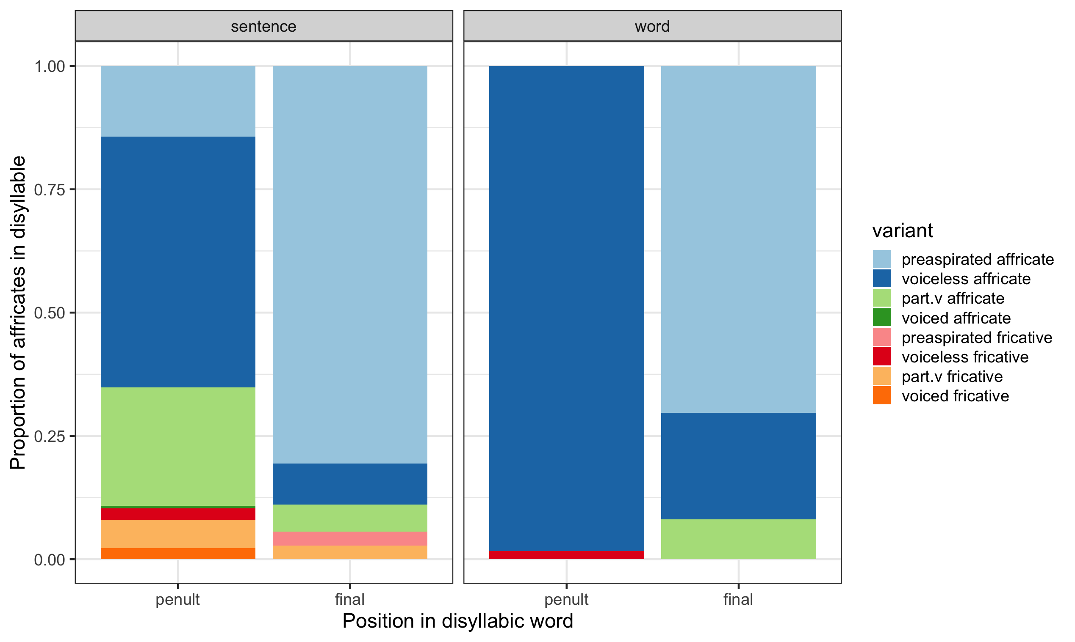
Affricate variants by stress position

Slide 24
Global patterns
The most common variant is a voiceless unaspirated stop, occurring in 66.9% of instances. Voiceless unaspirated affricates occurred 64.9% of the time.
Globally, stops with some measurable amount of voicing during closure (in sentence-medial position) occurred 16.1% of the time, while voiceless stops with measurable preaspiration occurred in 16.3% of the time.
Affricates with some amount of voicing during closure occurred 14.5% of the time, while they occurred with preaspiration 18.8% of the time.

Slide 25
Voicing during closure is mainly in unstressed syllables, while preaspiration is mainly in stressed syllables (in carriers)
In penults, stops have shorter closure and are often (58% of the time) partially voiced, whereas in final syllables, stops have longer closure and sometimes (22% of the time) are preaspirated.
In penults, affricates have shorter closure and are sometimes (32% of the time) partially voiced, whereas in final syllables, affricates have longer closure and are often (81% of the time) preaspirated.
Loss of closure in affricates was rare (10.2%) and occurred only in penults.

Slide 26
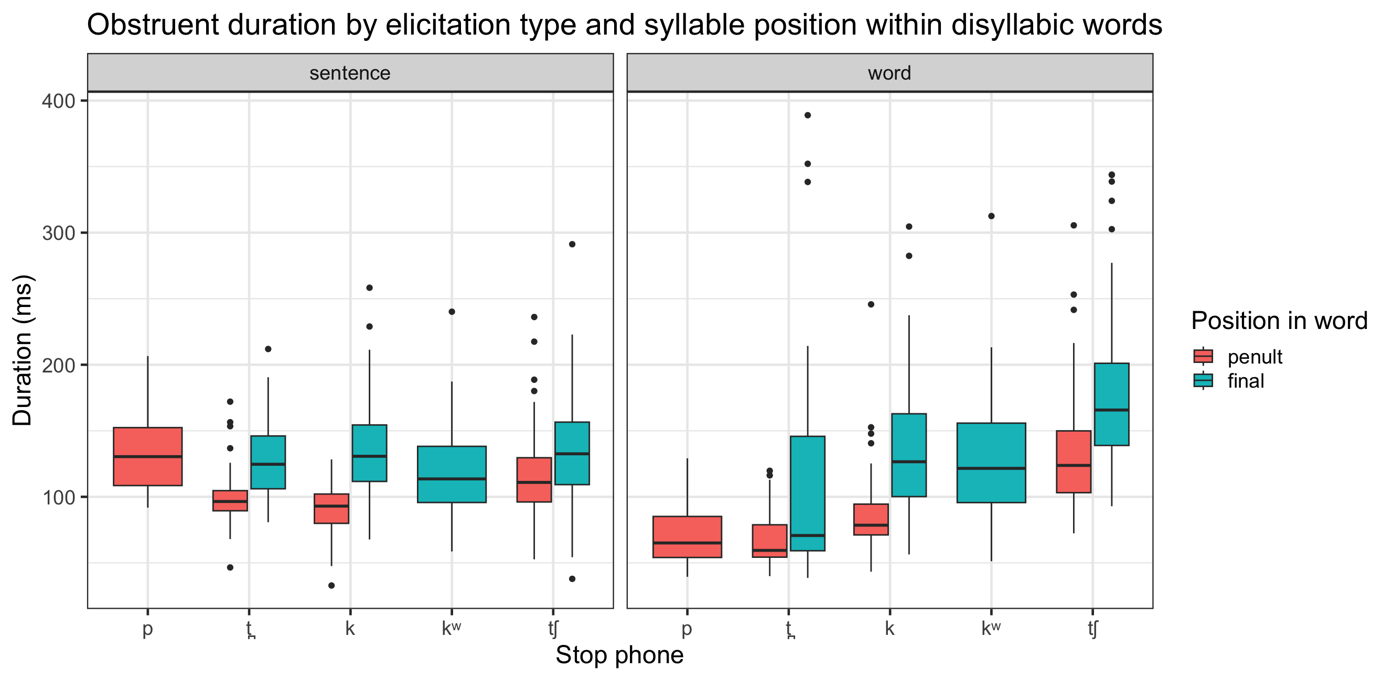
Stops and affricates are longer in stressed position

Slide 27
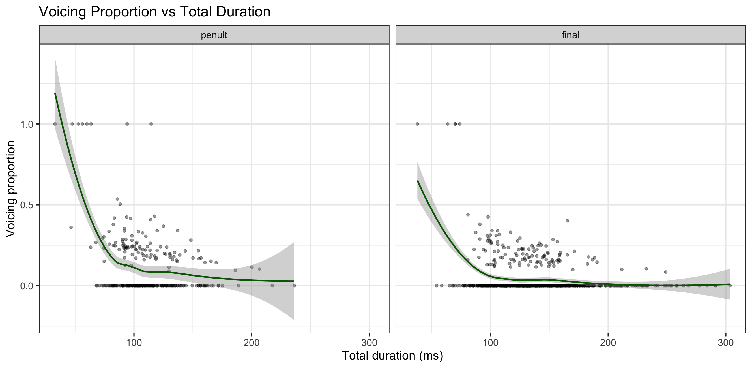
Is voicing more likely with shorter duration? Yes.

Slide 28
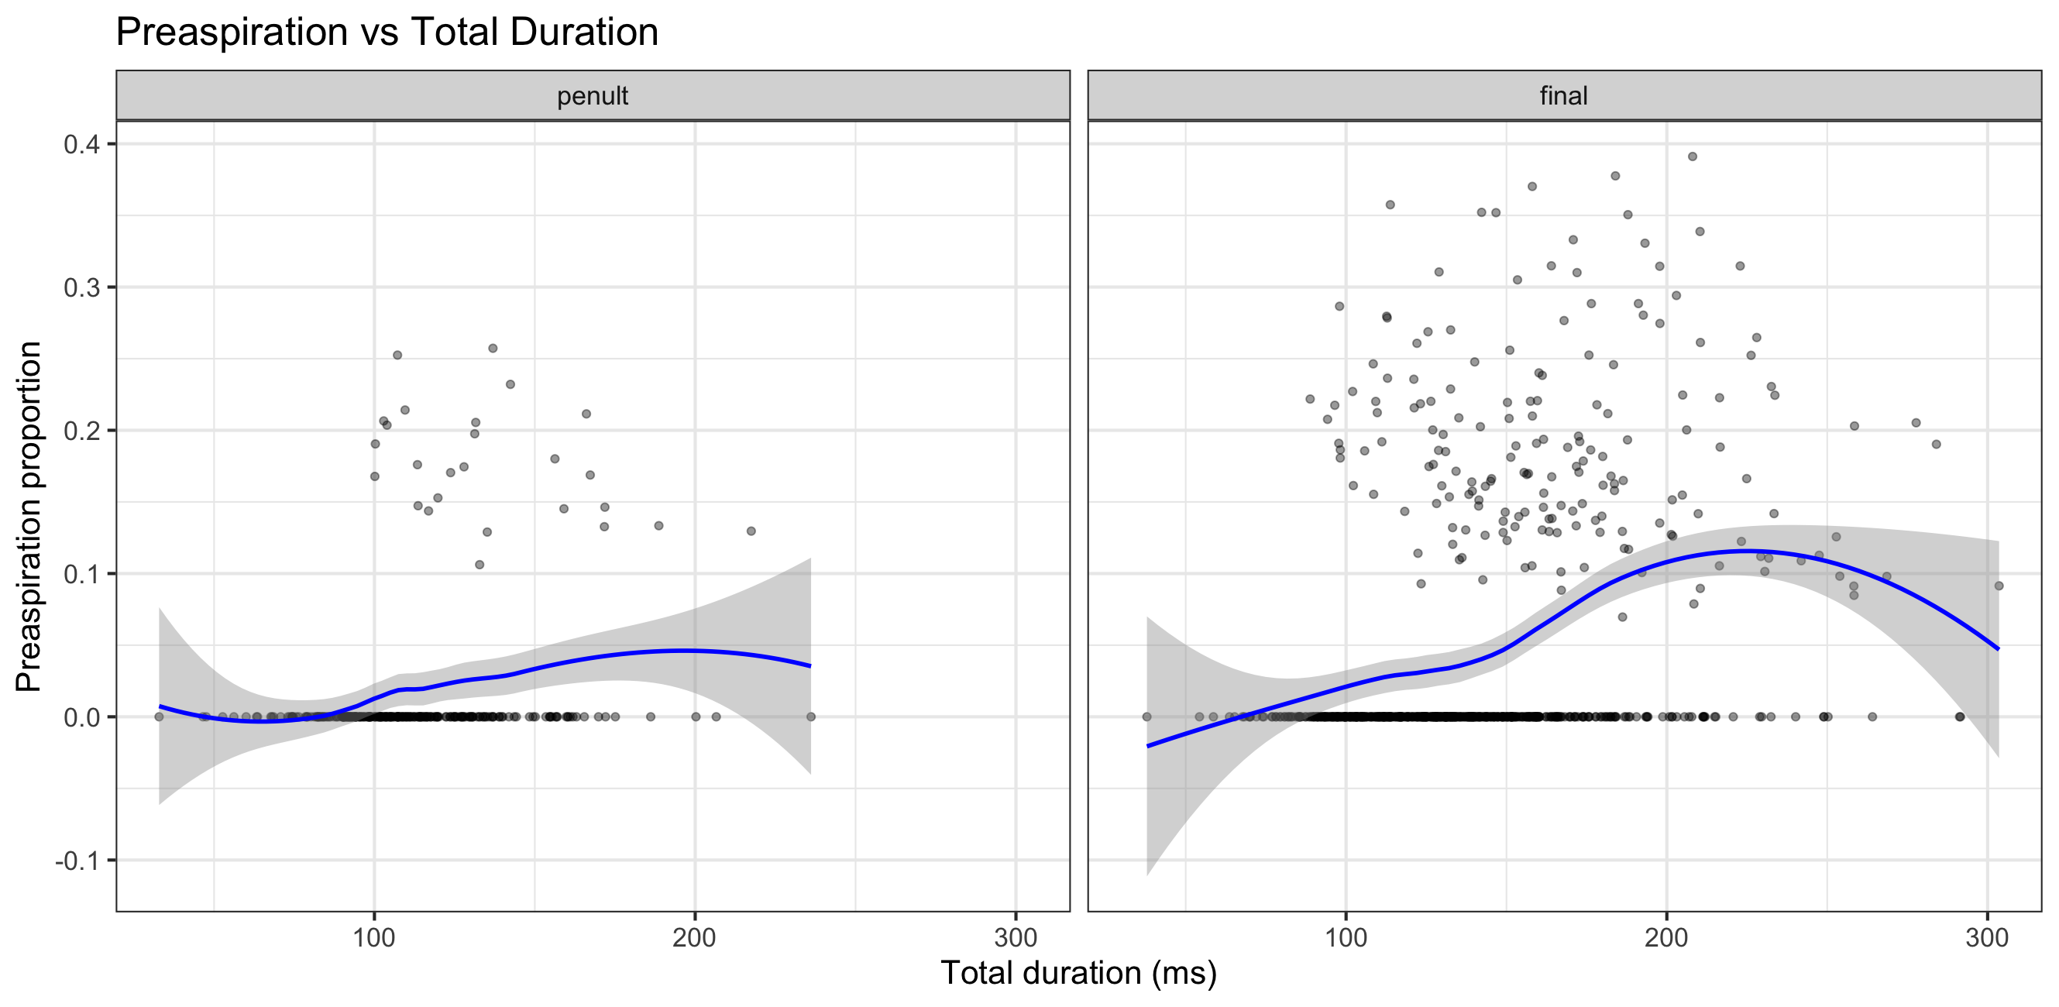
Is preaspiration more likely with longer duration?
Yes and No.

Slide 29
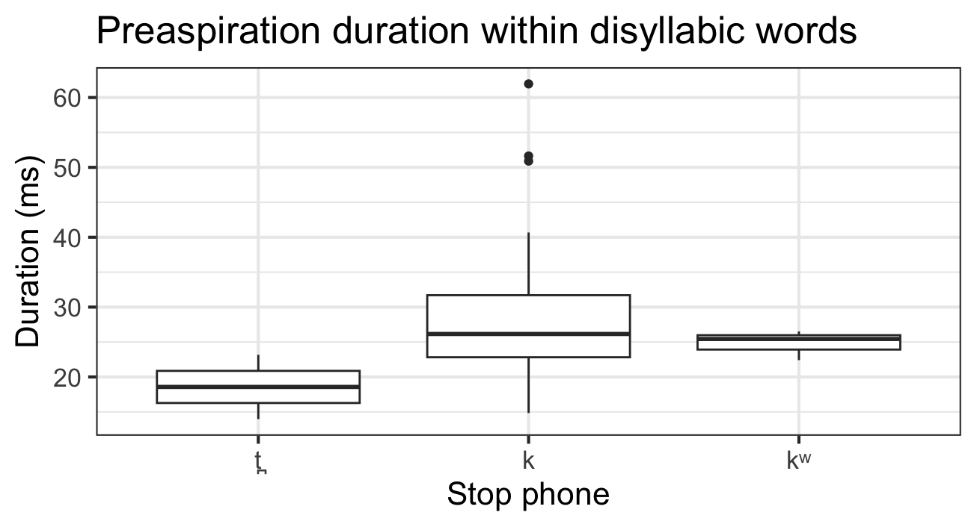
Preaspiration is also usually short (15 – 35 ms).

Slide 30
General patterns
Significant lengthening of stops in stressed position with optional preaspiration.
Stops in unstressed syllables have no preaspiration and often are accompanied by some voicing into their closure.
Preaspiration is an enhancement strategy to maintain voicelessness in stressed position.
This sheds light on a historical pattern whereby pre-tonic stops in related Triqui dialects spirantized/voiced.
  Itunyoso Triqui /tʃu³^{(h)}ku³/ ‘animal’
  Chicahuaxtla Triqui /ʒu³^{(h)}ku³/ ‘animal’

Slide 31
The location of stress
We normally expect lenition to occur intervocalically and fortition to be word-initial, e.g. [kaβe] y [boka] (Katz & Fricke 2018).
The Triqui pattern is the opposite due to the effect of final stress.
  There is a [+fortis] feature in stops in stressed syllables (Hollenbach 1984, Hernández Mendoza 2017).
  The observed effects are predictable via stress-induced hyperarticulation.
Either analysis would need to highlight the importance of these distinct effects of Triqui stress on obstruents.

Slide 32
Against idealized accounts of production
Idealizations of speech production mask complexity and within-language variation.
Idealizations of speech production mask cross-linguistic diversity – many languages have voiceless unaspirated stops but preaspiration is fairly uncommon as a sub-phonemic variant.
  c.f. Kakadelis (2018)
Idealizations of speech production mask important details for historical sound change.

Slide 33

Acknowledgements
Basileo Martínez Cruz and Benigno Cruz Martínez
Funding support from the National Endowment for the Humanities Grant FN-291125-23 A reference grammar of Itunyoso Triqui [ISO 639-3 trq].
ku²ru⁴a⁴³ a³ni²ʔĩh⁵reʔ¹!

Slide 34
References
Beckman, M. and Pierrehumbert, J. (1986). Intonational structure in Japanese and English. Phonology, 3(1):255–309.
Bouavichith, D. and Davidson, L. (2013). Segmental and prosodic effects on intervocalic voiced stop reduction in connected speech. Phonetica, 70:182–206.
Cohen Priva, U. and Gleason, E. (2020). The causal structure of lenition: a case for the causal precedence of durational shortening. Language, 96(2):413–448.
Davidson, L. (2016). Variability in the implementation of voicing in American English obstruents. Journal of Phonetics, 54:35–50.
Davidson, L. (2018). Phonation and laryngeal specification in American English voiceless obstruents. Journal of the International Phonetic Association, 48(3):331–356.
de Jong, K. J. (1995). The supraglottal articulation of prominence in English: Linguistic stress as localized hyperarticulation. Journal of the Acoustical Society of America, 97(1):491–504.
DiCanio, C. (2010). Illustrations of the IPA: San Martín Itunyoso Trique. Journal of the International Phonetic Association, 40(2):227–238.
DiCanio, C. (2012). The Phonetics of Fortis and Lenis Consonants in Itunyoso Trique. International Journal of American Linguistics, 78(2):239–272.
DiCanio, C. and Bennett, R. (2021). Mesoamerica. In Gussenhoven, C. and Chen, A., editors, The Oxford Handbook of Language Prosody, chapter 28, pages 408–427. Oxford University Press.
DiCanio, C., Chen, W.-R., Benn, J., Amith, J. D., and Castillo García, R. (2022). Extreme stop allophony in Mixtec spontaneous speech: Data, word prosody, and modelling. Journal of Phonetics, 92:1–18.

Slide 35
DiCanio, C., Zhang, C., Whalen, D. H., and Castillo García, R. (2020). Phonetic structure in Yoloxóchitl Mixtec consonants. Journal of the International Phonetic Association, 50(3):333– 365.
Gussenhoven, C. (2004). The Phonology of Tone and Intonation. Research Surveys in Linguistics. Cambridge University Press.
Hualde, J. I. and Nadeu, M. (2011). Lenition and phonemic overlap in Rome Italian. Phonetica, 68:215–242.
Kakadelis, S. M. (2018). Phonetic Properties of Oral Stops in Three Languages with No Voicing Distinction. PhD thesis, Graduate Center, City University of New York.
Katz, J. and Fricke, M. (2018). Auditory disruption improves word segmentation: A functional basis for lenition phenomena. Glossa, 3(1):1–25.
Katz, J. and Pitzanti, G. (2019). The phonetics and phonology of lenition: A Campidanese Sardinian case study. Journal of Laboratory Phonology, 10(1):1–40.
Ladd, D. R. (2014). Simultaneous Structure in Phonology. Oxford University Press.
Liberman, M. Y. (2019). Corpus phonetics. Annual Review of Linguistics, 5:91–107.
Parrell, B. (2014). Dynamics of consonant reduction. PhD thesis, University of Southern California.
Parrell, B. and Narayanan, S. (2018). Explaining coronal reduction: Prosodic structure and articulatory posture. Phonetica, 75:151–181.
Phillips, A. and Tucker, B. V. (2022). Context effects on the acoustic realization of stops and affricates in Northern Pwo Karen. Journal of the International Phonetic Association, 52(1):1– 32.

Slide 36
Stevens, M. and Hajek, J. (2004). Comparing voiced and voiceless geminates in Sienese Italian: what role does preaspiration play? In Proceedings of the 10th Australian International Conference on Speech Science & Technology, pages 340–345. Macquarie University, Sydney, Australian Speech Science & Technology Association, Inc.
Warner, N. (2019). Reduced speech: All is variability. WIREs Cognitive Science, e1496:1–7.
Warner, N. and Tucker, B. V. (2011). Phonetic variability of stops and flaps in spontaneous and careful speech. Journal of the Acoustical Society of America, 130(3):1606–1617.

Slide 37
The length contrast (not our focus here)
βa¹ ‘already, yet’ βːa¹ ‘sharp’
tʃaʔ³ ‘music’ tʃːa³ ‘tortilla’
kaʔ³ ‘spool-lifting kːaʔ³ ‘candle’
stick for weaving’
kʷi³ ‘day, sun’ kʷːeh​³² ‘edible green’
li⁴³ ‘small (adj)’ lːih³ ‘small (N)’
mã³ ‘that (distal)’ mːã¹ ‘there is (imp)’
nãh⁵ ‘oblig. final part.’ nːãh⁵ ‘to wash’
t̪a³ ‘this (disc)’ t̪ːa³ ‘field’

Slide 38
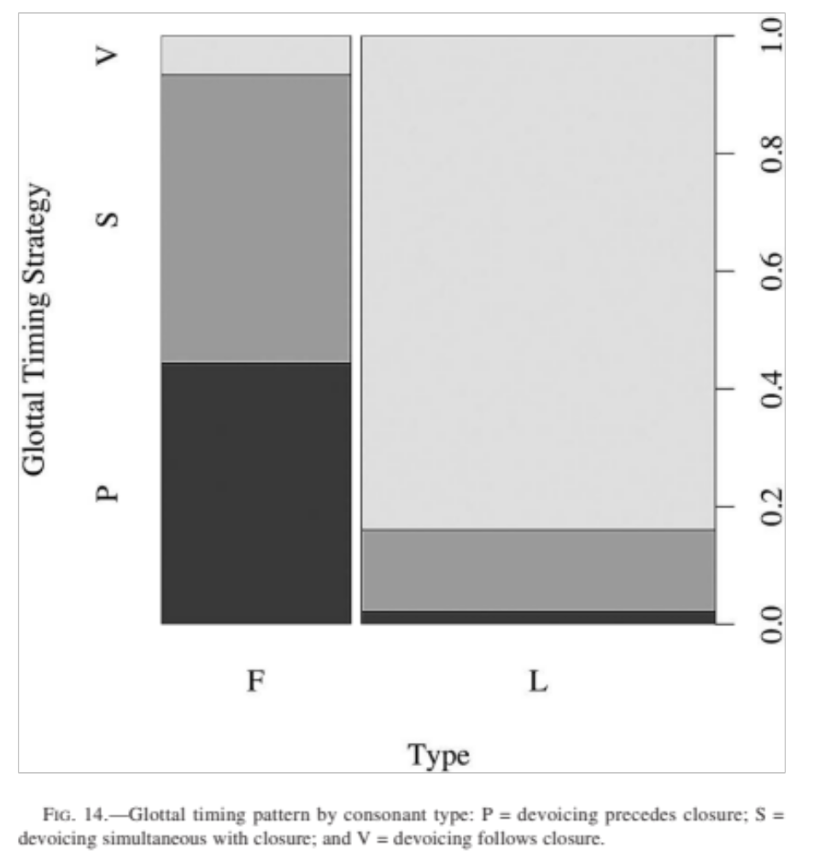
Glottal timing strategies vary by geminate (fortis = F) and singleton (lenis = L) stop type.
P = devoicing precedes closure
S = devoicing is simultaneous with closure
V = devoicing follows closure
Singletons mostly have voicing bleed while geminates devoice before (preaspiration) or at closure.
(DiCanio 2012)

