Slide 1
Labor-saving use of “forced alignment” for two endangered languages
Christian DiCanio, D.H. Whalen, Hosung Nam
Haskins Laboratories
New Haven, Connecticut

Slide 2
The corpus and its use
Language documentation involves the collection and transcription of many hours of recordings.
Are these recordings useful? For what?
How might they be made more useful?
What is involved in doing this?

Slide 3
Tools for extracting data
Computational tools exist for identifying languages, speakers, and for processing text data.
One promising tool, forced alignment, automatically segments speech sounds and words in a recording. One needs only the sound file and a digitized transcription.
How can this tool be used with corpus data from an endangered language? What are the challenges?

Slide 4
Why use forced alignment?
Research in phonetics and phonology involves extracting individual sounds and words from recordings.
This is labor-intensive. Sound segmentation requires 80 hours of work for just 1 hour of speech!
Forced alignment saves time and effort.

Slide 5
What kind of data can we use forced alignment on?
Only data which is comprehensively transcribed.
Narratives and stories are better than elicited speech, which often involves switching between languages.
Most corpora need to be modified if you want to use these tools. How can this be done?

Slide 6
Approach
We examined language data from Yoloxóchitl Mixtec (ISO xty) and Arapaho (ISO arp).
We used an English-based aligner, called P2FA (Yuan & Liberman 2008, 2009) for both languages and an additional aligner (hm-align) for Mixtec (see DiCanio et al. 2013).
We compared hand-alignment on these recordings to forced-alignment.
Notes:
Christian takes over.

Slide 7
Challenges for the aligner
Accuracy depends on the recording matching the transcription, but the transcription does not tell us if sounds are inserted/deleted.
There are no Mixtec or Arapaho aligners yet. Can we use one that is trained on English?
Previous work suggests we can (DiCanio et al. 2013).

Slide 8
Steps in using an aligner
Build a “dictionary” of Mixtec/Arapaho
(This is not a real dictionary – just a list of forms in the text.)
2. Map the existing phone set to the target phone set, e.g. C = CH. By-language adjustments are necessary.
Arapaho word: Coding:
HINOO HH IH1 N AO1
3. Input your digitized transcriptions and your audio.
4. Run the script.

Slide 9
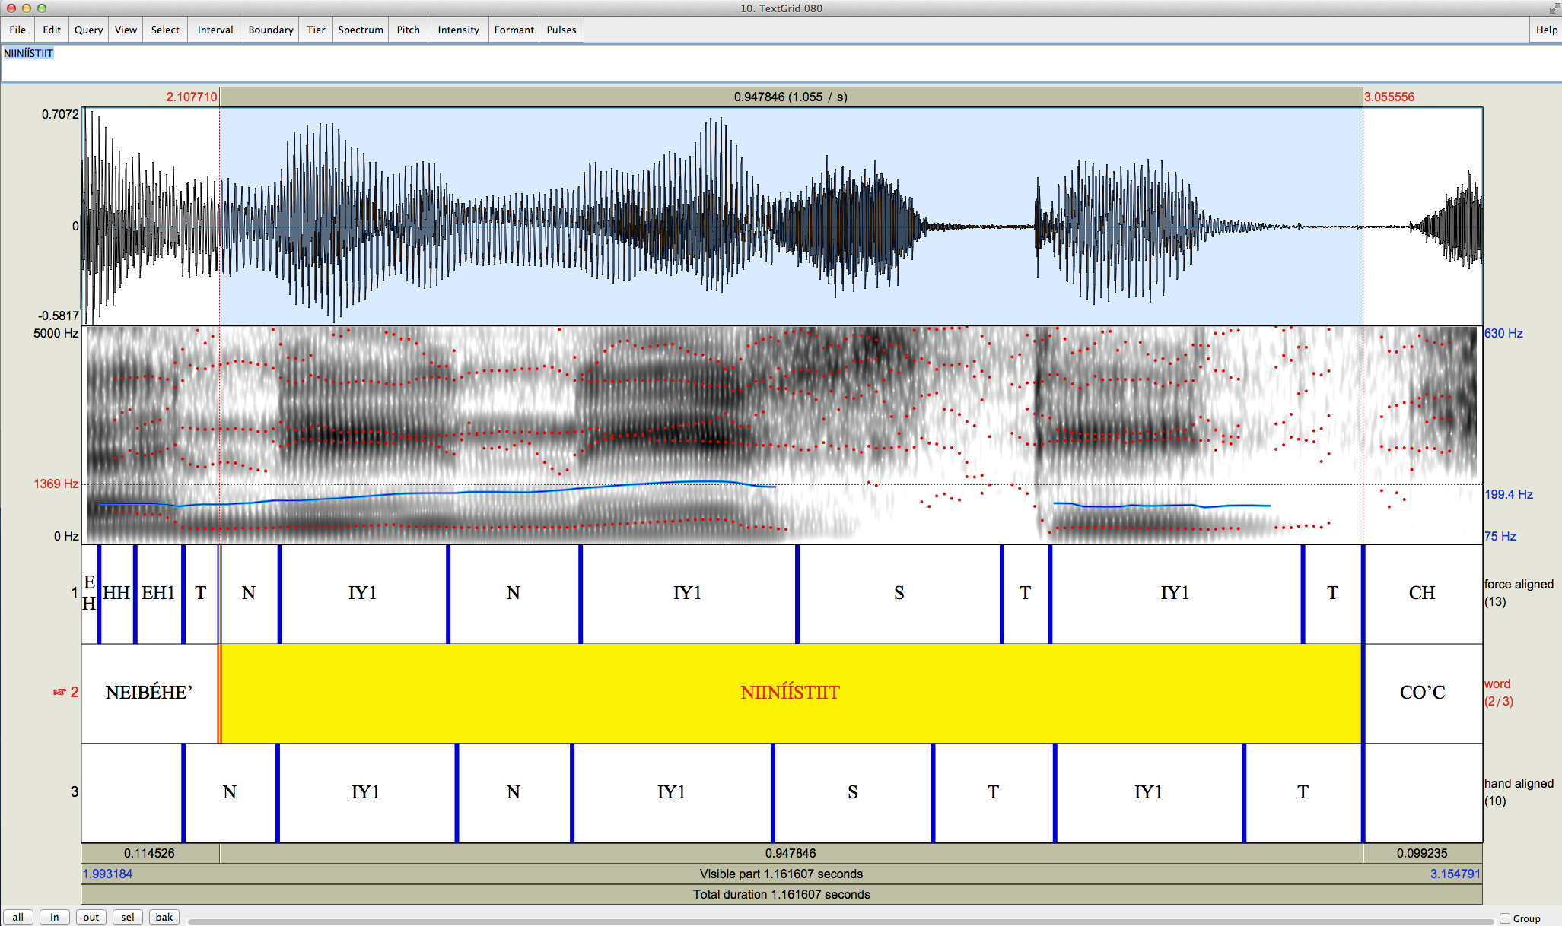
How similar is the output to where a human would place the boundary?

Slide 10
Comparison of N and S
Aligner-placed start point of N
Aligner-placed start point of S
Aligner-placed end point of S
Same end point of N
Hand aligned start point of N
Hand aligned end point of S
Hand aligned start point of S

Slide 11
Yoloxóchitl Mixtec (YM)
Oto-Manguean language spoken in Guerrero, Mexico by 2500 speakers (Castillo García (2007), DiCanio et al., submitted).
Simple syllable structure (CV). Glottalization is a foot-medial feature in final bimoraic feet.
Glottalization, e.g. /yaʔ⁴a¹/ ‘grey’, /saʔ³ma⁴/ ‘cloth to wrap tortillas.’
Complex tonal inventory with up to 20 melodies possible on monosyllables and 28 on disyllables (DiCanio et al, 2014).

Slide 12
YM phonological inventory

Slide 13
Alignment in Yoloxóchitl Mixtec
100+ hours of personal narratives, stories, and folklore (Amith & Castillo García, 2009 – present).
Approximately 30 speakers recorded.
Tested forced alignment accuracy on both elicited speech (15.6K words) and spontaneous speech (3K words).
Two aligners used: P2FA and HM-align

Slide 14
Results: elicited speech
Alignment is better with hm-Align than with P2FA. Generally, agreement between 70-90% at 20 ms, so this is slightly less than ideal (Malfrère et al 2003).

Slide 15
Results: elicited speech
Notes:
Fricatives and nasals aligned well, but glottal stops are problematic.

Slide 16
Results: running speech
Alignment is generally better within a word than between silence and a word. Hence, alignment should be better for running speech. Results here are from 17 min narrative in YM.
This turns out to be true!

Slide 17
Discussion
Alignment is better with hm-Align than with P2FA, but the latter performs well with running speech.
The SCOTUS corpus (P2FA) was trained on spontaneous speech and the TIMIT corpus (hm-Align) was trained on read speech (more similar to the elicited Mixtec speech).
hm-Align phone set had voiceless unaspirated stops and a glottal stop, allowing a better match to Mixtec phonetics than P2FA’s.
It is necessary to find an aligner with a phone set which closely matches the language’s phonological system, like hm-Align for the YM data.
We can presume that direct training on the language would lead to further improvement.

Slide 18
Can we still use this data for phonetic research?
If we have inaccurate alignment, but a lot of data from a corpus, does it match data from careful hand-labelling?
Used data aligned by P2FA and hm-Align and calculated formants and F0 values across each vowel in the elicited data using a script written for Praat.

Slide 19
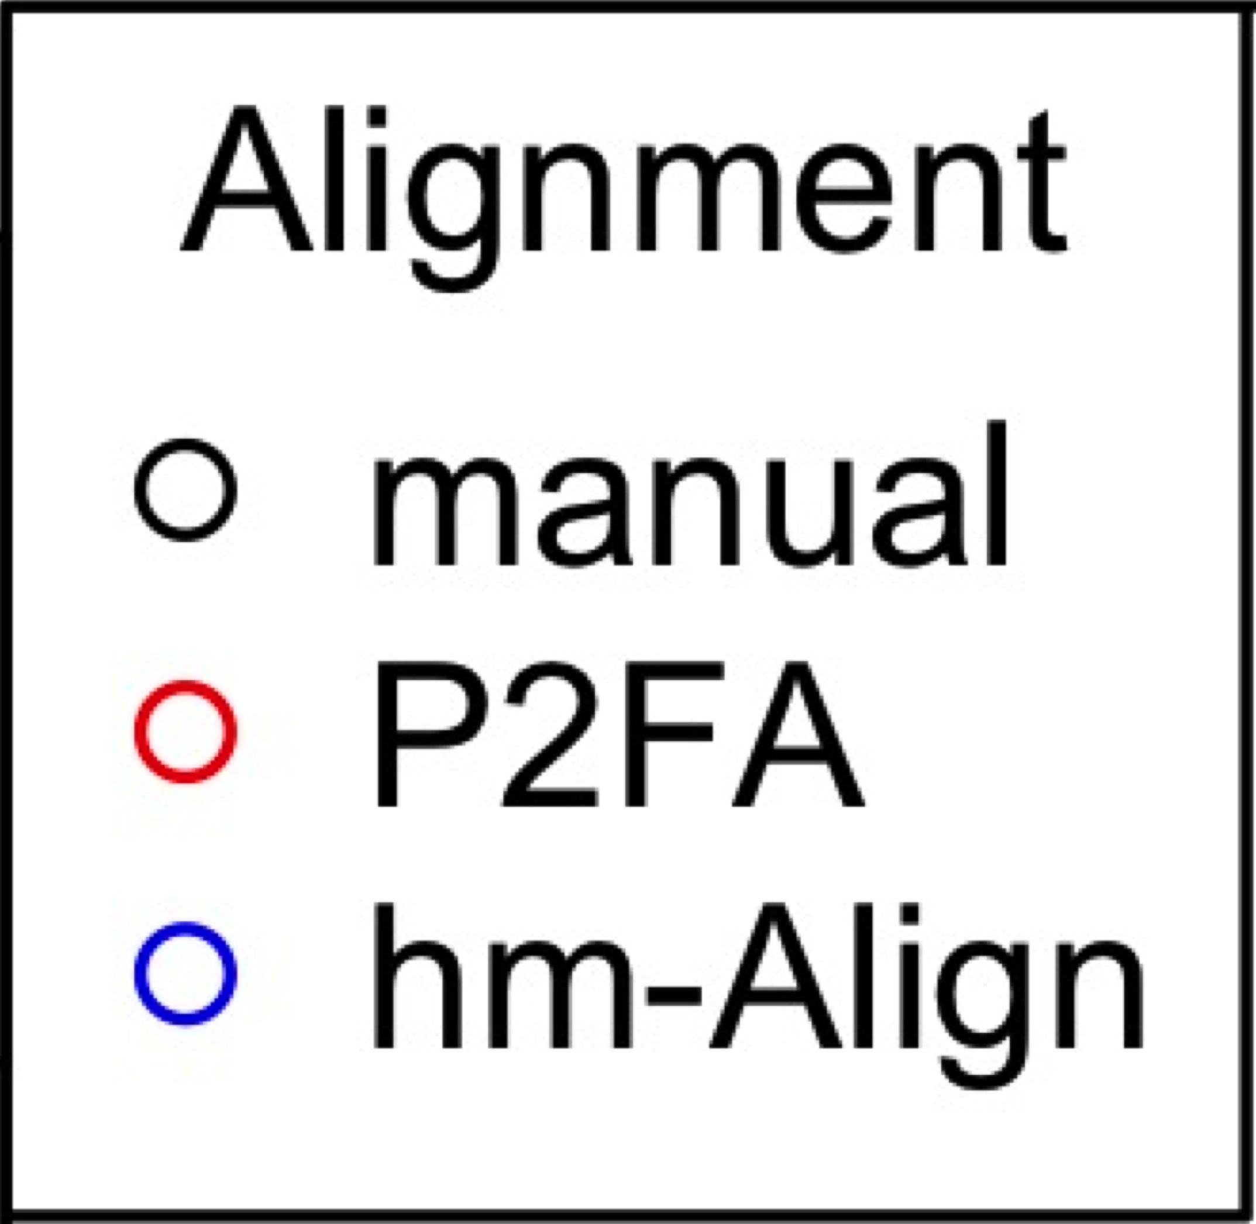
Formant estimates by aligner

Slide 20
Example in practice
DiCanio et al. (2015) investigate vowel dispersion and variability in elicited and spontaneous speech for YM speakers.
Methods involved initial forced alignment of data, followed by some hand-correction.
Spontaneous speech data took 1/3 time to segment using P2FA.

Slide 21
Vowel space in YM across speech styles (from DiCanio et al. 2015)

Slide 22
Discussion (2)
Forced alignment can be reliably used to examine endangered language corpus data.
Despite some inaccuracy in alignment, the average values of measures converge.
Aligned sound files can be used for publishable phonetic research.

Slide 23
The Arapaho Corpus
Narrative and elicited speech from 20 speakers.
40 hours of recordings collected from 2004-2007 by Lisa Conathan. From these recordings, we examined how well the aligner worked with 7 texts, comprising 51 minutes of narrative speech (=16182 segments).
Transcriptions and translations of the texts.

Slide 24
Arapaho phonological inventory
Inventory of 12 consonants.
Four vowel qualities contrast in length (short/long/extra long).
Diphthongs are always long, but extra long ones occur too.
Notes:
Emphasize the length distinction here – it is important for later.

Slide 25

Words in Arapaho
Heetneh'éí'tobe'enoo
/hɛɛtnɛhʔeɪʔtɔbɛʔɛnɔɔ/
‘I'm going to tell you something.’
Comes out as:
[hɛɛtnɛhəʔeɪ(ʔ)tɔbɛɛnɔɔ]
Notes:
Hannah takes over.

Slide 26
Orthography – Aligner phone key
Arapaho Orthography | Aligner Phone | IPA | Arapaho Orthography | Aligner Phone | IPA
b | B | b | e | EH1 | ɛ
t | T | t | ee | AE1 | æ
k | K | k | eee | AE2 | æ
‘ | T | ʔ | u | UH1 | ʊ
c | CH | tʃ | uu | UW1 | u
n | N | n | uuu | UW2 | u
3 | TH | θ | o | AH1 | ə
s | S | s | oo | AO1 | ɔ
x | SH | x | ooo | AO2 | ɔ
h | HH | h | ei | EY | eɪ
w | W | w | eii | EY2 | eɪ
y | Y | j | ou | OW1 | oʊ
i | IH1 | ɪ | oou/ouu | OW2 | oʊ
ii | IY1 | i | io | IH1 + AH1 | ɪa
iii | IY2 | i | oe | AY1 | aɪ

Slide 27
Results: Aligner agreement
Threshold | Percentage of 16182 segments
10 ms | 33.8%
20 ms | 52.3%
30 ms | 62.6%
40 ms | 68.9%
50 ms | 73.3%
60 ms | 76.5%

Slide 28
Results: Aligner agreement

Slide 29
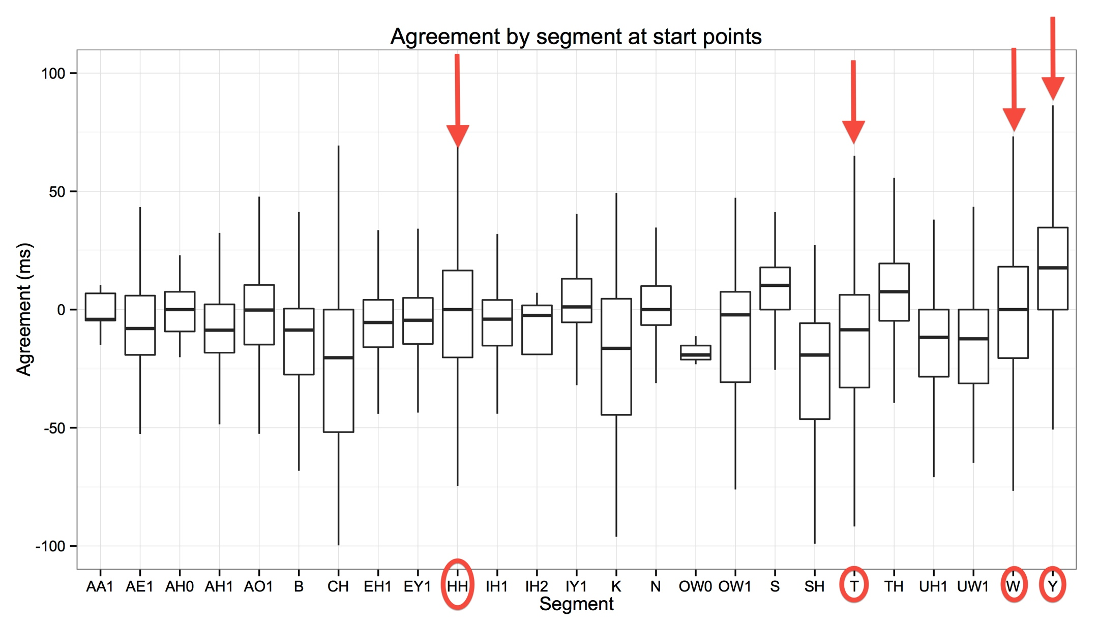
Results: Aligner agreement

Slide 30
Findings/Issues
Alignment worse for Arapaho than for YM. Much of this was due to poor alignment of glottalization.
Orthography is not as variable as speech is and the alignment depends on a morphophonological transcription, which is not always the same as the surface phonetics.
Forced aligner was not trained on Arapaho.
If one segment is misaligned, so are the ones that are nearby.

Slide 31
Can we use this data?
As observed for the YM data, even with poor alignment, certain measures (like formants) remain accurate.
Can we use this data to investigate vowel undershoot in Arapaho among short/long vowels?

Slide 32
Vowel undershoot in Arapaho
Typically, the expectation is that when vowels are shorter, speakers lack the duration to reach a vowel target. This is called vowel undershoot (Lindblom, 1963). Over time, these patterns become part of the phonology of a language, so vowels of different quantity also differ in quality.
While some researchers mention differences in quality with quantity in Arapaho (Saltzman 1956, Cowell & Moss 2008), it is only mentioned for the high vowels and not analyzed as a general phonetic process.

Slide 33
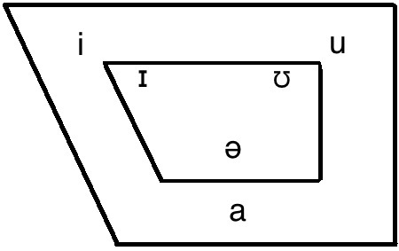
Undershoot

Slide 34
Methods
Corpus consisted of elicited data (6 hours) to narrative data (1 hour, 36 minutes). A subset consisting of four speakers’ data was used.
A total of 12,426 vowels were analyzed.
Used forced alignment for initial segmentation of narrative speech. This tool allows us to automatically segment the corpus with transcriptions.
Hand-correction of the forced alignment was done for the narrative speech data. Hand-labelling was done for the elicited speech.
Labeled vowels and analyzed formant values on vowels of different lengths using a script written for Praat (Boersma and Weenink, 2013).

Slide 35
Results: duration
Notes:
Long vowels are long, but shorter in narrative speech than in elicited speech. This is fairly typical, but it only significantly affects the long vowels.

Slide 36
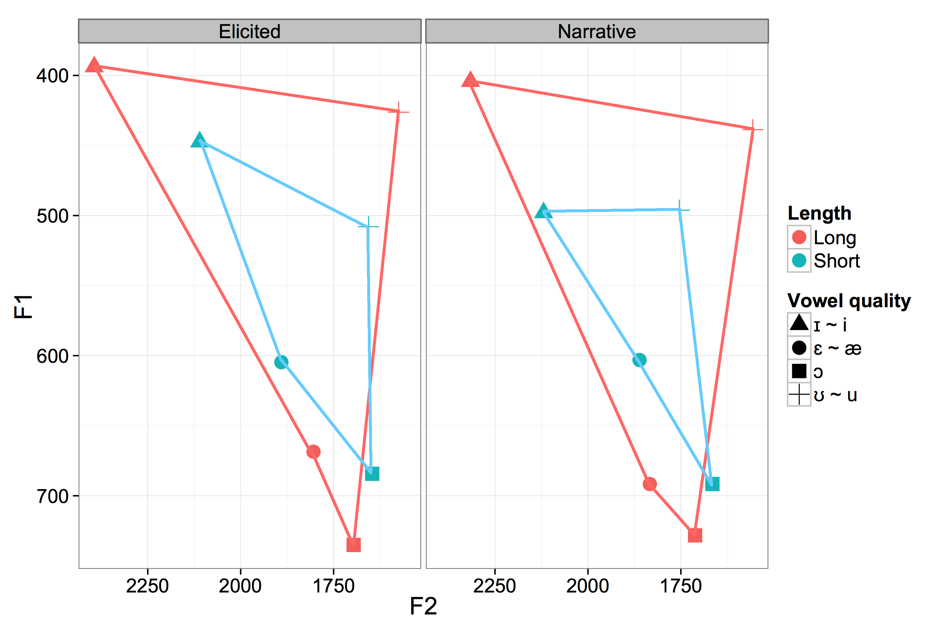
Results: formants
Notes:
The quality differences are stronger for the narrative speech, but they are similar across styles.

Slide 37
Discussion
All short vowels are reduced compared to long vowels, but the back vowel ‘o’ /ɔ/ is not reduced as much as the others.
Even though the duration of long vowels changes across speech styles, their quality stays the same.
Yet, while the duration of short vowels is similar across speech styles, their quality changes more across speech styles; short vowels undergo more reduction in narratives than in elicited speech.
The acoustic distance (measured in formants) between long and short vowels is greater in narrative speech than in elicited speech.

Slide 38
Discussion (2)
Findings fit with the more general notion that short vowels are centralized, or undershot, while long vowels are more peripheral in the vowel space. Arapaho is more like Creek (Johnson & Martin 2001) than Norwegian (Behne et al. 1996).
While Arapaho vowels clearly contrast in vowel length, it appears that vowel quality is emphasized more in narrative speech than in elicited speech.
Since narrative speech tends to be faster than elicited speech, this observation appears to be a case of phonetic compensation. As speech rate increases, speakers and listeners may rely more on the quality of the vowels than just their duration.

Slide 39
Discussion (3)
The relationship between vowel length and quality holds up across different speech styles, but it is stronger in narrative speech.
When teaching Arapaho pronunciation, one must both emphasize the duration of the vowels and their differences in quality. Quality may be more important in natural, connected speech.
While forced alignment saved time in the segmentation of Arapaho speech here, its use was also revealing.
It was not useful for the elicited speech, as the English here was not transcribed.
Substantial human correction of alignment was still needed for narrative speech because of the mismatch between the transcription and the surface forms.

Slide 40
General Discussion
For phonetic and lexical segmentation, forced alignment can speed up the process.
True even when the aligner is trained on a different language, if the phones match relatively well.
Helps us bring out speech from existing recordings for online dictionary creation and second language learning.

Slide 41
Thank you!
This work was supported by NSF Grant No. 0966411 to Haskins Laboratories: “From endangered language documentation to phonetic documentation.”
We would also like to thank Jonathan Amith, Rey Castillo García, the Arapaho community and Lisa Conathan.

Slide 42
References
Behne, D. M., Moxness, B., and Nyland, A. (1996). Acoustic-phonetic evidence of vowel quantity and quality in Norwegian. Quarterly Progress and Status Report, Speech Transmission Laboratory, Royal Institute of Technology, Stockholm, 2:13–16.
Boersma, P. and Weenink, D. (2013). Praat: doing phonetics by computer [computer program]. www.praat.org.
Castillo García, R. (2007). Descripción fonológica, segmental, y tonal del Mixteco de Yoloxóchitl, Guerrero. Master’s thesis, Centro de Investigaciones y Estudios Superiores en Antropología Social (CIESAS), México, D.F.
Conathan, Lisa (2004 – 2007) Arapaho Language Corpus.
Cowell, A. and Moss Sr., A. (2008). The Arapaho Language. University Press of Colorado.
DiCanio, C., Amith, J. D., and Castillo García, R. (2014). The phonetics of moraic alignment in Yoloxóchitl Mixtec. In Proceedings of the 4th Tonal Aspects of Language Symposium. Nijmegen, the Netherlands.
DiCanio, C., Nam, H., Whalen, D. H., Bunnell, H. T., Amith, J. D., and Castillo García, R. (2013). Using automatic alignment to analyze endangered language data: Testing the viability of untrained alignment. Journal of the Acoustical Society of America, 134(3):2235– 2246.
DiCanio, C., Nam, H., Amith, J.D., Castillo-García, R., Whalen, D.H. (2015) Vowel variability in elicited vs. spontaneous speech: evidence from Mixtec. Journal of Phonetics, 48:45-59.
DiCanio, C., Zhang, C., Amith, J.D., Castillo-García, R., Whalen, D.H. (submitted) Phonetic structure in Yoloxóchitl Mixtec consonants.
Johnson, K. and Martin, J. (2001). Acoustic vowel reduction in Creek: Effects of distinctive length and position in the word. Phonetica, 58:81–102. Malfrère, F., Deroo, O., Dutoit, T., and Ris, C. (2003). Phonetic alignment: speech synthesis-based vs. Viterbi-based. Speech Communication, 40:503–515.
Salzman, Z. (1956). Arapaho I: Phonology. International Journal of American Linguistics, 22(1):49–56.
Yuan, J. and Liberman, M. (2008). Speaker identification on the SCOTUS corpus. In Proceedings of Acoustics - 2008.
Yuan, J. and Liberman, M. (2009). Investigating /l/ variation in English through forced alignment. In Interspeech - 2009, pages 2215– 2218.

