Slide 1

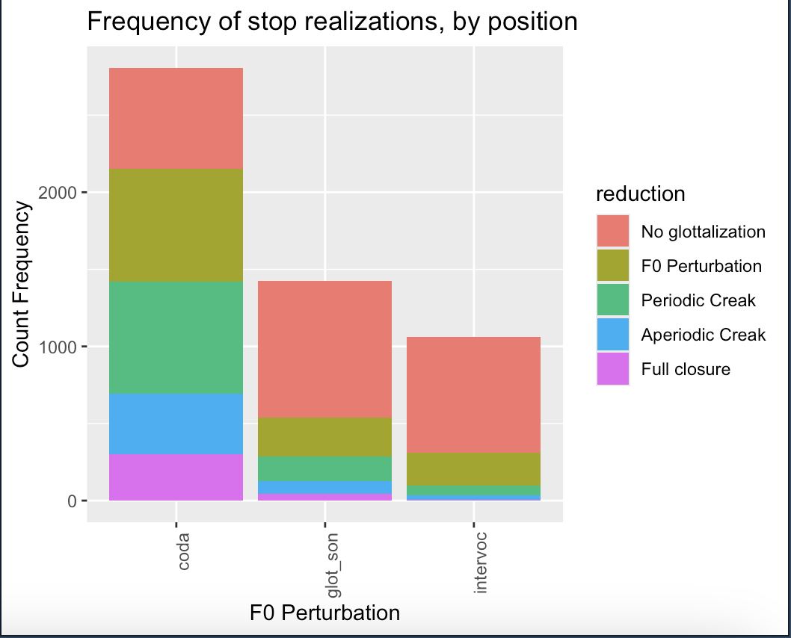
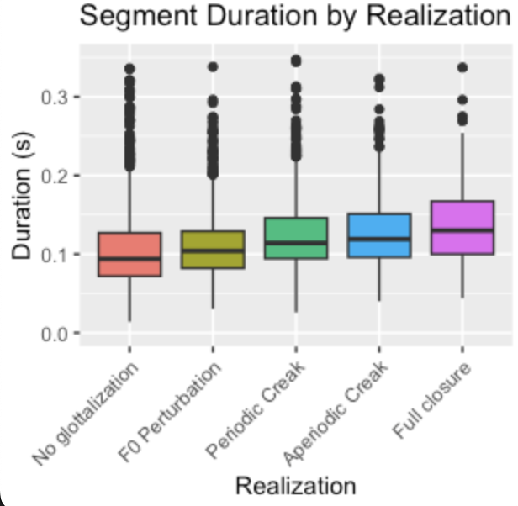

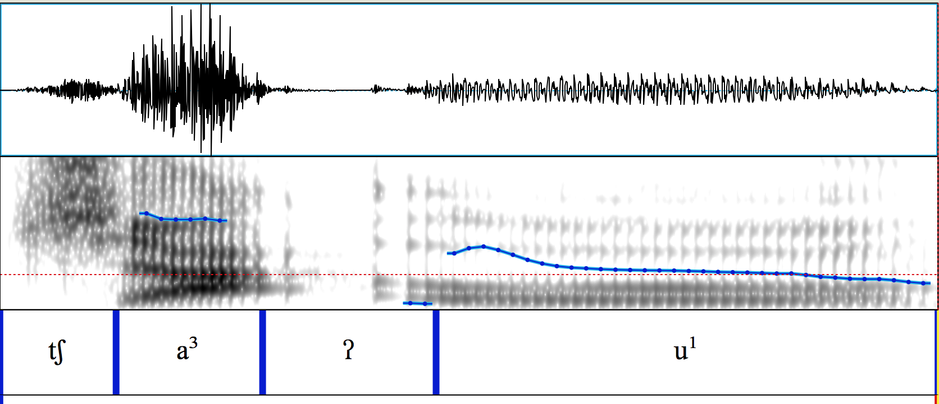
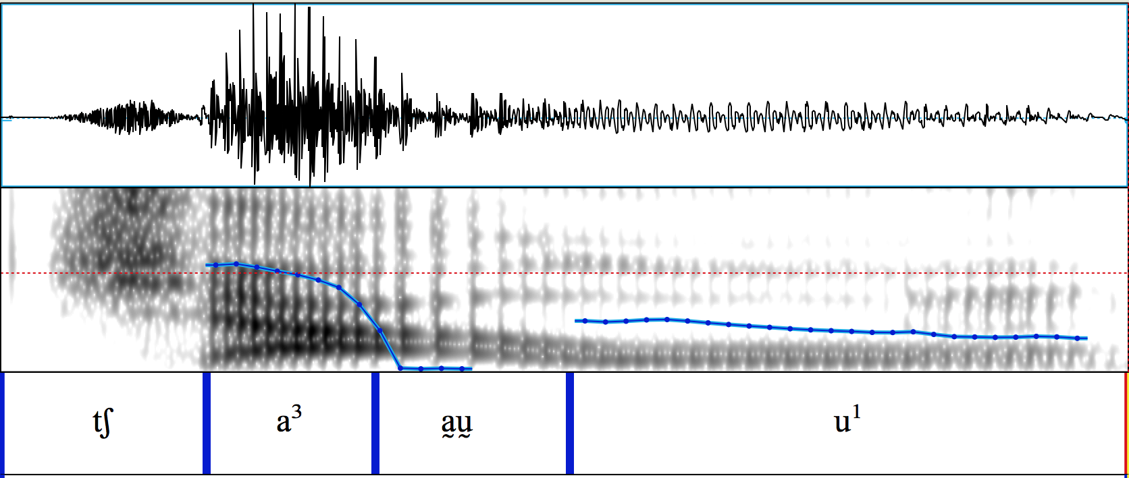
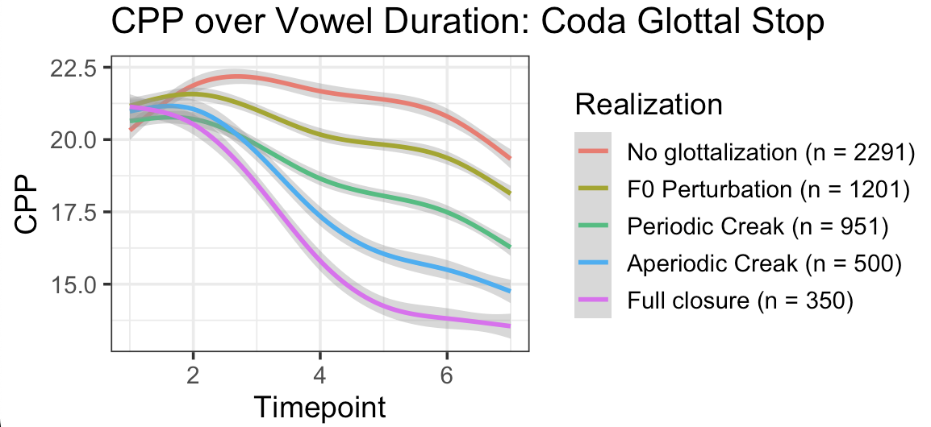
Glottal Allophony in a Spontaneous Triqui Corpus
Kayla Shames and Christian DiCanio
University at Buffalo (kmshames@buffalo.edu, cdicanio@buffalo.edu)
Phonological analysis of glottal stops
What is transcribed /ʔ/ has been analyzed as:
  vocalic feature (Arellanes Arellanes 2009, Chávez Peón 2010, Covarrubias Acosta 2020, Hernández Luna 2019)
  prosodic feature (DiCanio 2008, Hollenbach 1984)
  tonal feature (Hollenbach 1984, Matisoff 1999, Yip 2002)
  morphological feature (Macaulay & Salmons 1995)
  segment/phoneme (Davidson 2021, DiCanio 2008, 2010)
Glottal stops are rarely stops
Glottal stops appear in 37.5% of languages in PHOIBLE (Moran & McCloy 2019).
Realization can be a full stop [aʔa], just non-modal phonation [aa̰a], or it can be omitted [aː].
Though, lenition is much more common than it is for other stops (Davidson 2021, Whalen et al. 2023).
  Arapaho: full closure 25-27% of the time
  Hawaiian: full closure just 7% of the time
Reduction of glottal stops correlates with duration.
Itunyoso Triqui
Otomanguean, 2,500 speakers in Oaxaca, Mexico
Phonemic word-final and intervocalic /ʔ/, glottalized sonorants /ˀn/, /ˀβ/, /ˀj/. It is also heavily tonal.
High functional load, lexical and morphological
  /stĩ⁴/ ‘fingernail’ vs. / stĩʔ⁴/ ‘our fingernail’
  /jã³​²/ ‘salt’ vs. /jã³ʔã³²/ ‘fire’
  /nĩɦ³²/ ‘to fall down’ vs. /ˀnĩɦ³²/ ‘to hold up’
Methods
Hand-corrected Triqui speech corpus
2.2 hours of spontaneous speech
5.396 glottal stops extracted and hand-labeled
  Qualitative judgements of f0 perturbation and voice quality (aperiodicity)
Used PraatSauce to extract voice quality measures
  f0, spectral tilt, CPP, HNR
Should talk more about the emergent categories and how we came to this cline
Glottal reduction grades
At least four levels of glottal reduction can be distinguished
↓ Prosodically weak positions show more reduction
A scale of glottal lenition?
Less lenited More lenited
[t > t̬ > d > ð > ð̞ > Ø ] /t/
[ʔ > ? > ? > V̰ > ? > Ø ] /ʔ/
48% of all glottal stops are fully reduced!
I. No glottalization
Nonmodal periodic, no f0 change
Modal, f0 perturbation
and only 6.6% are full stops
II. Nonmodal periodic, f0 perturbation
Reduced glottal stops are shorter ꜛ
Research motivations/questions
Glottal stops have many acoustic correlates, each of which may vary orthogonally (f0 perturbation, intensity perturbation, non-modal phonation, full glottal closure).
Describing glottal reduction is much more complex than just degree of closure
Can we create a rigorously defined scale for observed glottal reduction?
Does glottal reduction correlate with prosodic lenition patterns?
Can we use automated voice quality measures to reliably measure glottal reduction?
Voice quality and glottal reduction
III. Aperiodic
IV. Full Closure (20ms)
Two (speculative) articulatory strategies for glottal reduction:
Maintain longitudinal tension but reduce epilaryngeal space
  = change in voice quality but not f0 (Moisik 2013)
Increase thyroarytenoid constriction
  = f0 reduction but no aperiodicity (DiCanio 2008, Moisik 2013, Titze 1994).
Glottal reduction categories can be reliably distinguished by Cepstral Peak Prominence (CPP)
Qualitative judgements are backed by quantitative differences
References
Davidson, L. (2021). Effects of word position and flanking vowel on the implementation of glottal stop: Evidence from Hawaiian. Journal of Phonetics, 88:1–14.
DiCanio, C. T. (2008). The Phonetics and Phonology of San Martín Itunyoso Trique. PhD thesis, University of California, Berkeley.
Kirby, J. and Puggaard-Rode, R. (2025) PraatSauce. Praat-based tools for spectral processing. Version 1.0.4. GitHub: kirbyj/praatsauce.
Moisik, S. R. (2013). The Epilarynx in Speech. PhD thesis, University of Victoria.
Moran, Steven & McCloy, Daniel (eds.) 2019. PHOIBLE 2.0. Jena: Max Planck Institute for the Science of Human History. (Available online at http://phoible.org, Accessed on 2021-12-15.)
Titze, I. R. (1994). Principles of Voice Production. Prentice-Hall, Englewood Cliffs, NJ.
Whalen, D., DiCanio, C. T., and Chen, W.-R. (2023). Variable realization of the Arapaho glottal stop, despite its being distinctive and frequent. In Skarnitzl, R. and Volín, J., editors, Proceedings of the 20th International Congress of Phonetic Sciences, Prague 2023, pages 3301–3305. Guarant International.
Department of Linguistics
School of Arts and Sciences
Notes:
Figures will all be reformatted for easier reading at this scale

